Slide 1
Towards eliminating ThO trajectories which hit the ITO coated Field Plates
Xing Wu

Slide 2
To avoid hitting the extended field plates
‘0th order’ approximation:
Using ideal lens formula, and object has finite size (no aberration, no fuzziness)
Magnification=di/do=Si/So
Object:
Molecule
cloud
Lens:
Field plates:
Image: LIF detection
d_{o}=5mm
d_{i} ≈ 15mm
D=45mm
S_{o}=30cm
S_{i}≈90cm
Detection volume

Slide 3
To avoid hitting the extended field plates
‘0th order’ approximation:
Using ideal lens formula, and object has finite size (no aberration, no fuzziness)
Magnification=di/do=Si/So
Longer field plates → larger image. If take aberration (i.e. ‘fuzziness’ of the image ) into account:
→ smaller signal for a given finite detection volume (we already knew)
→ more likely to hit the field plates
Object:
Molecule
cloud
Lens:
Field plates:
Image: LIF detection
d_{i}
d_{o}=5mm
D=45mm
S_{o}=30cm
S_{i}≈160cm
Detection volume

Slide 4
To avoid hitting the extended field plates
‘0th order’ approximation:
Using ideal lens formula, and object has finite size (no aberration, no fuzziness)
Magnification=di/do=Si/So
Longer field plates → larger image. If take aberration (i.e. ‘fuzziness’ of the image ) into account:
→ smaller signal for a given finite detection volume (we already knew)
→ more likely to hit the field plates
‘Desirable’ feature:
Lens-to-field-plates distance as short as possible
bigger field-plates separation, D
Object:
Molecule
cloud
Lens:
Field plates:
Image: LIF detection
d_{i}
d_{o}=5mm
D=45mm
S_{o}=30cm
S_{i}≈160cm
Detection volume

Slide 5
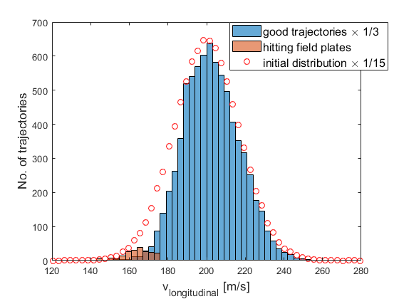
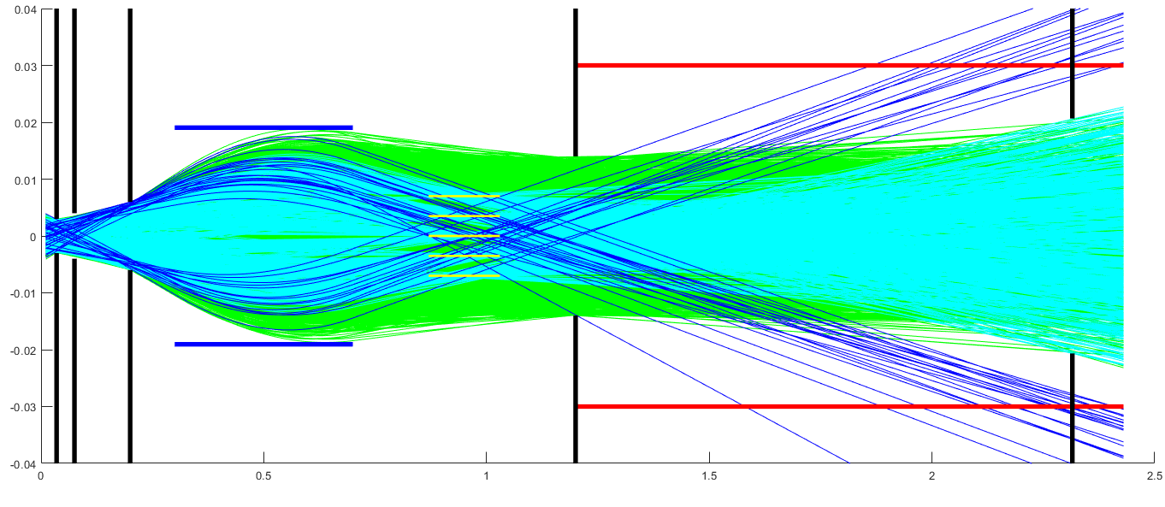
Looking at the trajectories
Major difference between good & bad: longitudinal velocities
Plan 1: pump them out of the X-C-Q STIRAP ground state after rotational cooling & before STIRAP takes place

Slide 6
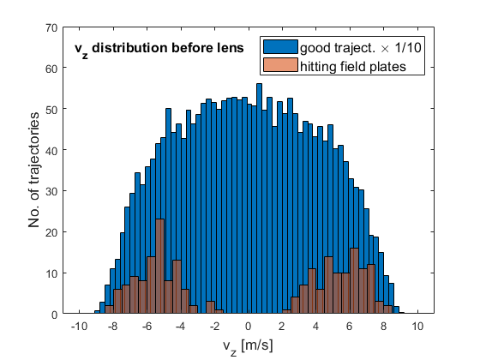
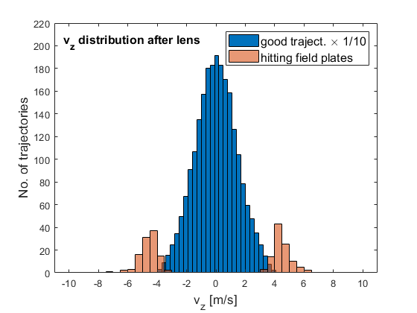
Transverse velocity (v_z) (z is the same as defined in ACME II)
Cannot differentiate good & bad trajectories in v_z before lens. But they get separated after lens because the bad ones are all slower in v_x and hence spend longer time in lens→ over-focused
Plan 2: do not STIRAP these back to X after lens, and use electrostatic deflector

Slide 7
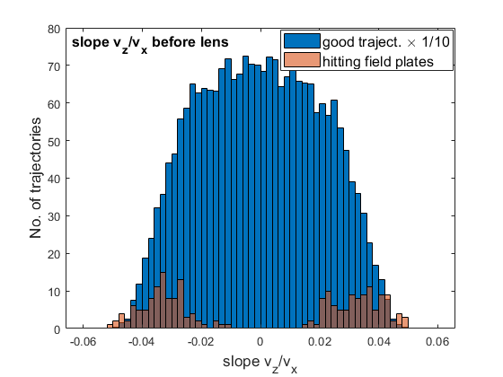
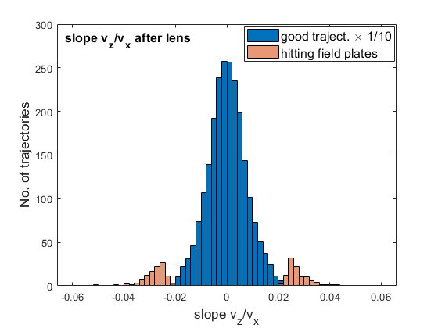
Trajectory slope (v_z/v_x)
The differentiation gets ‘doubly’ enhanced by looking at the slope (v_z/v_x). This is what the horizontal collimator tries to filter out. However, because of convolution between spatial distribution and slope of the trajectories, about x20 times more good trajectories (about 17% of all the good trajectories) are blocked than the bad ones (100% of the bad ones). Scatter from the collimator surfaces are not included yet
Plan 3: filter them out with horizontal collimator after lens

Slide 9
Proposed sensitivity gain for ACME III
extending Field Plates: from
43cm (2x11.5cm for fringing
Fields + 20cm for spin
precession) to 123cm
Improvement | Signal Gain | EDM Sensitivity Gain
Increased Precession Time | 0.20 | 2.3
Electrostatic Lens | 16 | 4
SiPM Detector Upgrade | 2.3 | 1.5
Timing Jitter Noise Reduction | 1 | 1.7
Total | 7.4 | 23.5
Also need to avoid ‘direct’
coating of ThO on Field Plates

