Slide 1
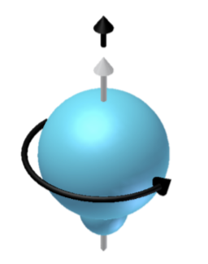
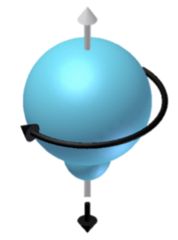
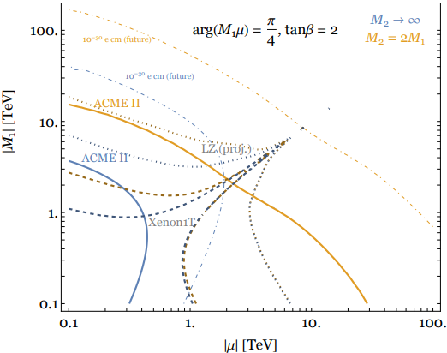
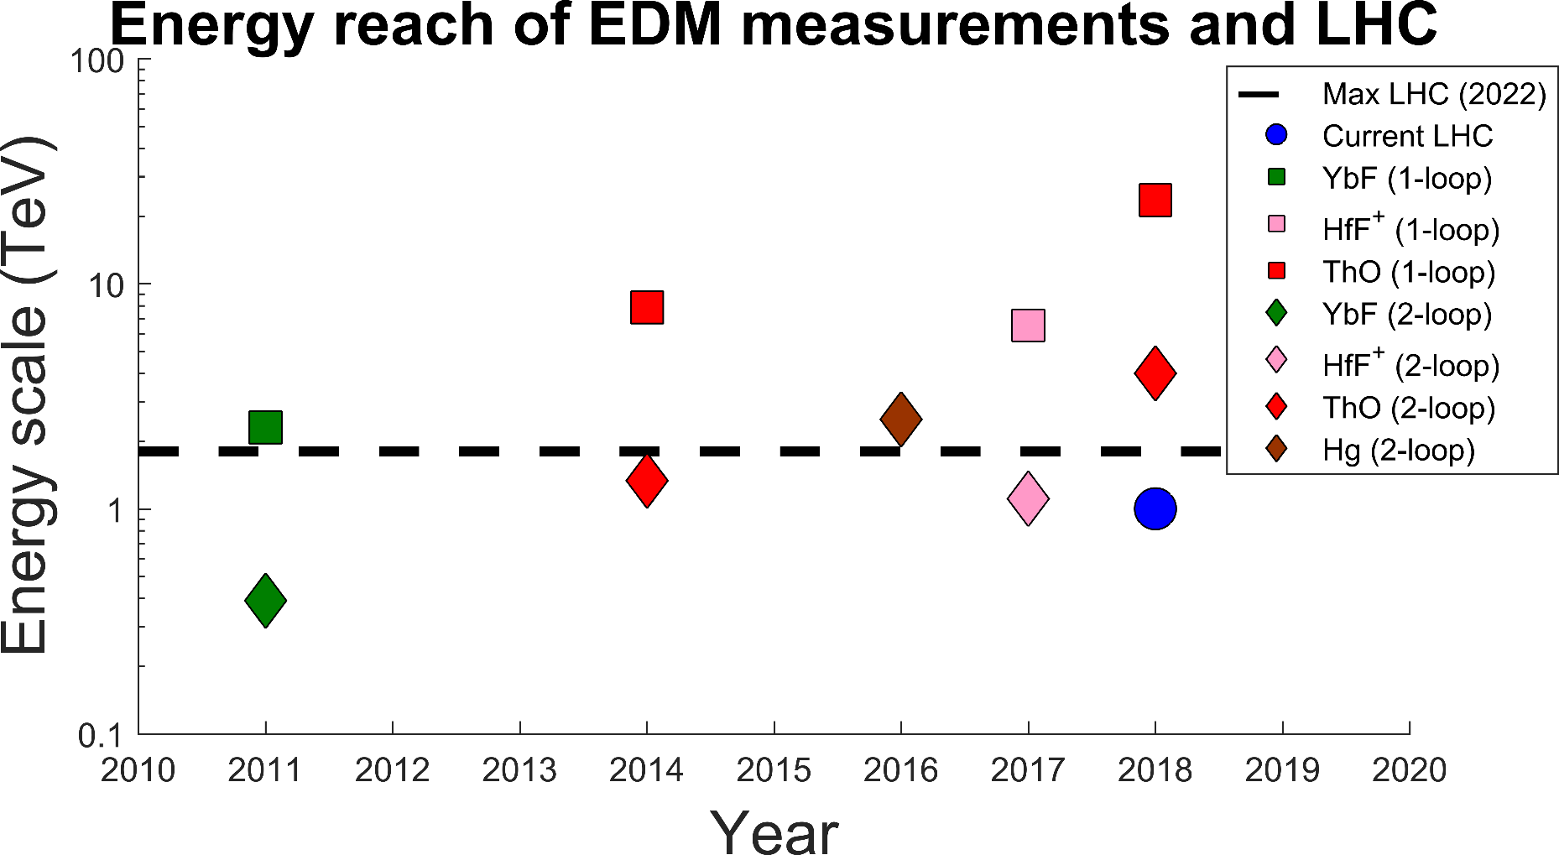
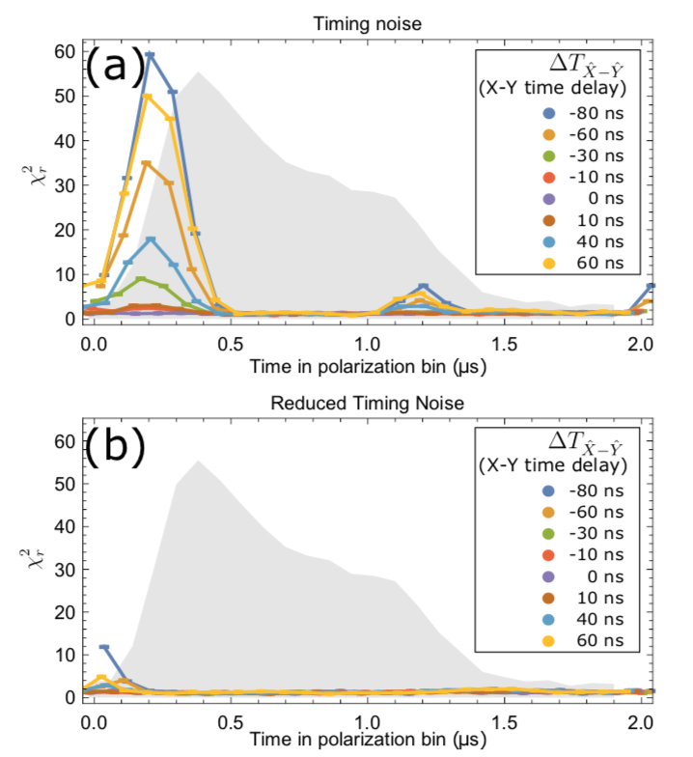
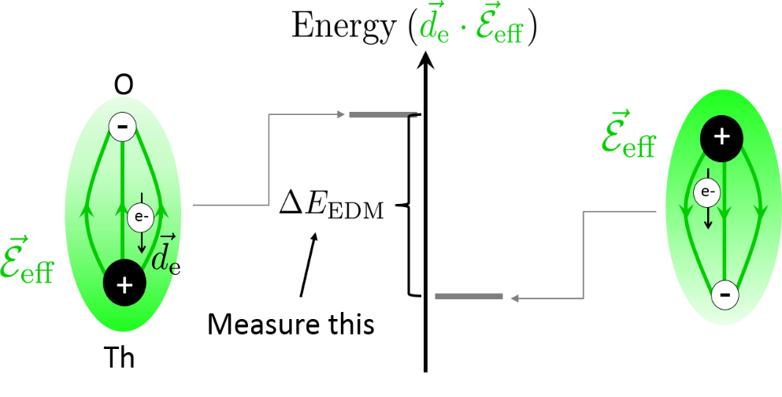
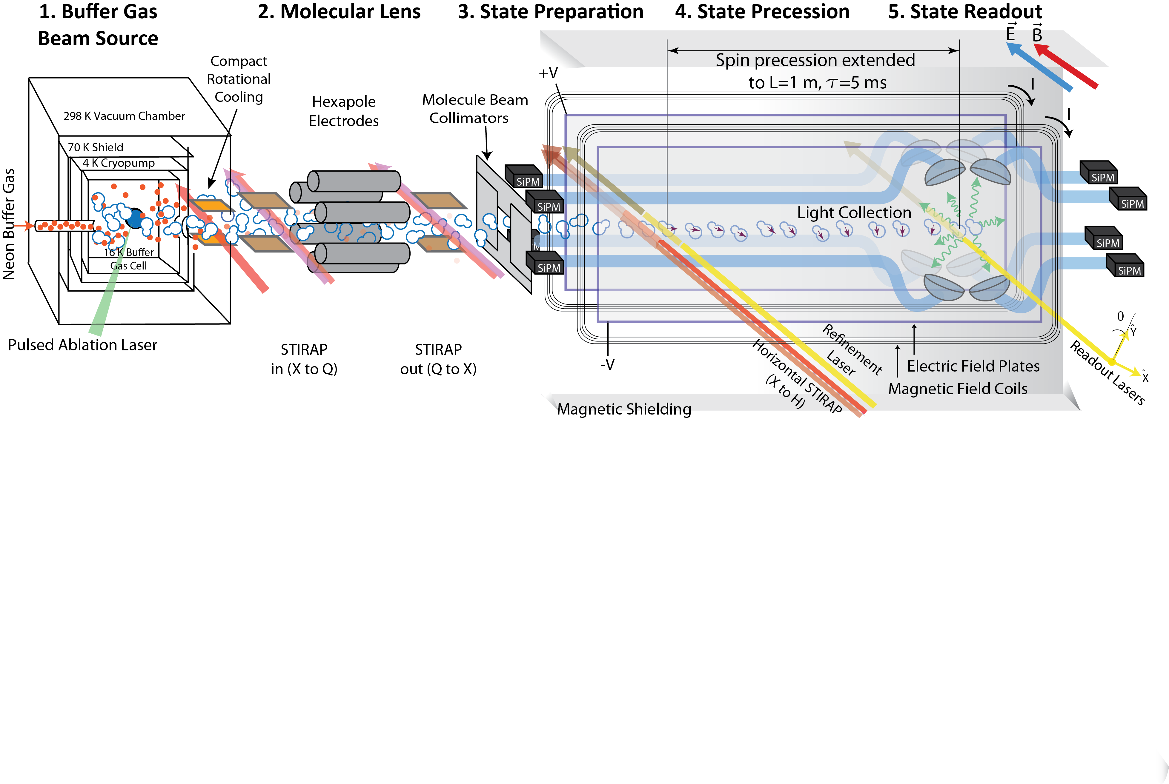
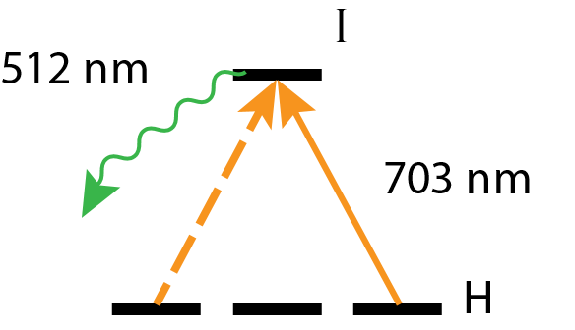
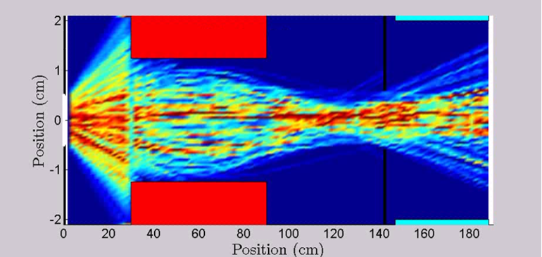
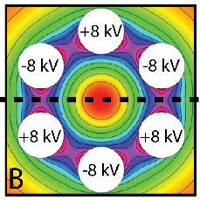
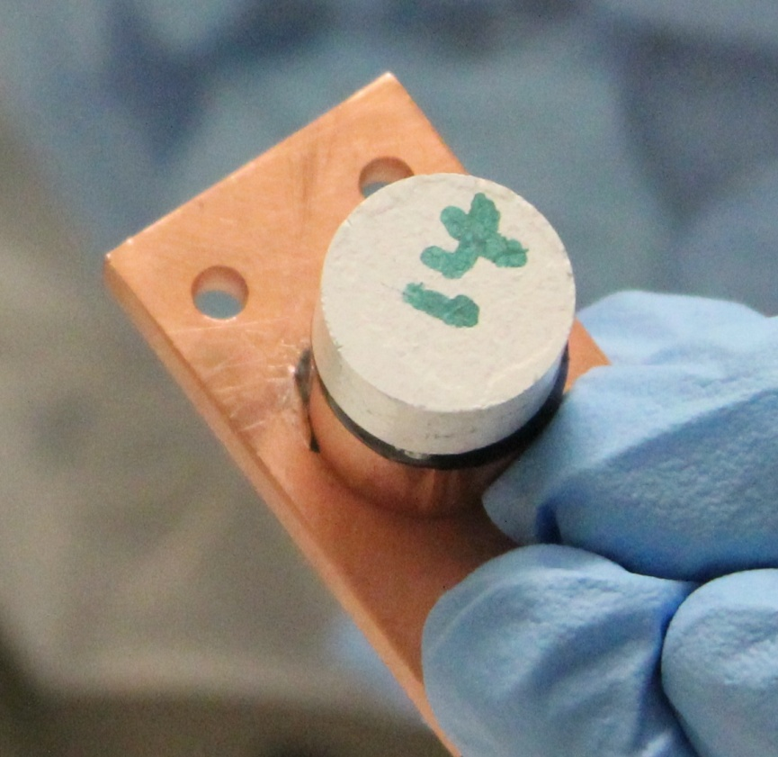
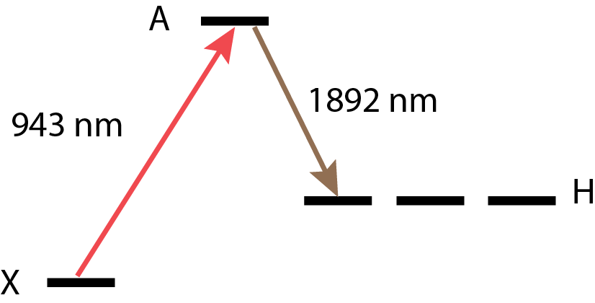
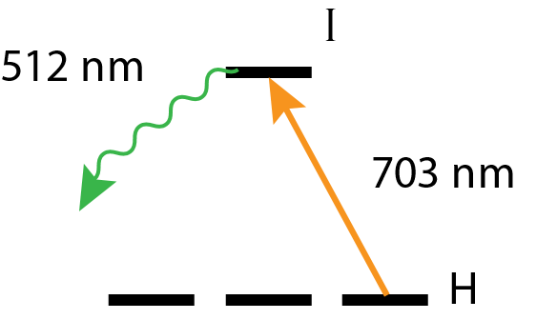
Motivation & Theory
Systematic Search & Characterization
$$S$$
$$d_{e}$$
Permanent EDMs violate T-symmetry.
Many theories beyond the Standard Model predict T violation and EDMs at current experimental precision.
$$d_{e}$$
$$T$$
Beyond the ACME II Limit on the Electron EDM
$$S$$
ACME Collaboration: Cole Meisenhelder¹, Daniel Ang¹, Vitaly Andreev¹, James Chow², David DeMille², John Doyle¹, Gerald Gabrielse³, Jonathan Haefner¹, Zhen Han², Nicholas Hutzler⁴, Zack Lasner², Takahiko Masuda⁵, Brendon O’Leary², Cristian Panda¹, Satoshi Uetake⁵, Adam West², Elizabeth Petrik West¹, Xing Wu^{1,2}, Koji Yoshimura⁵
Affiliation: ¹Harvard University, ²Yale University, ³Northwestern University, ⁴California Institute of Technology, ⁵Okayama University
In ACME II, we varied 40 different experiment parameters in the search for systematic errors (e.g. electric & magnetic fields, laser powers, detunings, pointing, polarization, molecular beam clipping, experiment timing, and analysis parameters)
Where possible, we intentionally exaggerate the parameter and assume $ω$depends linearly on the parameter$P$. The systematic error under optimal conditions $(P=\overline{P})$ is given as
$$ω_{P}^{\tilde{N}\tilde{E}}=\left({∂ω^{\tilde{N}\tilde{E}}}/{∂P}\right)\overline{P}$$
The final contribution to the systematic uncertainty is computed from the linear error propagation of the two variables $\overline{P}$ and ${∂ω^{\tilde{N}\tilde{E}}}/{∂P}$.
ACME III planned improvement: further suppress systematics related to $E^{nr}$ using improved electric field plates and horizontal STIRAP
SUSY particle bounds from this result.
Fig. from Matt Reece (unpublished)
ACME III projection ($\sim {10}^{−30}e⋅cm$) dashed.
Key EDM results since 2010. Two-loop sensitivity from Nakai & Reece (2017).
One-loop sensitivity from Feng (2013). LHC scale gives stop mass sensitivity.
Noise Reduction
ThO: effective electric field $E_{eff} \sim 80 GV/cm$
ACME II parameters:
Precession time $τ \sim 1 ms$
Measurement contrast $C \sim 0.95$
Detected molecule flux $\dot{n}$ $\sim 1×{10}^{7} s^{−1}$
Result: $d_{e}=\left(−4.3±4.0\right)×{10}^{−30} e⋅cm$
$\left|d_{e}\right|<1.1×{10}^{−29} e⋅cm$
ACME II had 1.7 times more noise than expected at the shot noise limit
This noise was determined to come from both timing error in the data acquisition system and a timing offset between polarization bins
ACME III demonstrated improvement: We were able to suppress this noise by controlling both parameters
ACME III planned improvement: Reduce noise from velocity fluctuations by applying smaller magnetic fields
New magnetic shield designs will need to reduce ambient fields to 1 µG and gradients to < 1 µG/cm
$$δd_{e}=\frac{ℏ}{2Cτℇ_{\text{eff}}\sqrt{\dot{n}T}}$$
ACME III Apparatus
4. State Precession
5. State Readout
The molecules in the prepared state acquire phase as they fly through the electric and magnetic fields of the interaction region.
ACME III planned improvement: Recent measurements determined that the lifetime of the H-state is 4-6 ms, allowing us to increase precession time by a factor of 4-6 compared to ACME II (improved lifetime measurements are underway)
Increased precession time decreases solid angle that reaches the detection region (see table below)
Molecular lens will help to counteract this loss
Requires new interaction region design to accommodate increased length
After precession, the final state is projected to a pair of orthogonal basis vectors using a 703 nm probe laser (on the H-I transition) with linear polarization rapidly switched (200 kHz) between x and y.
We collect the 512 nm fluorescence as the molecules decay back to the ground state.
ACME III planned improvement: upgrade PMTs to silicon photomultipliers (SiPMs) and optimize collection optics
SiPM characterization tests have been performed
 | Requirement | Measured Value
Photon Detection Efficiency | ~ 50% | 2.5 x PMT
Dark Count Rate | < 10 Mcps | < 10 Mcps @ -10 °C
Cross Talk and After Pulse | < 25% | ~ 15%
1. Buffer Gas Beam Source
2. Molecular Lens
3. State Preparation
Overall projected sensitivity
References
Produce ThO molecules through pulsed ablation of a ceramic ThO₂ target at 50 Hz
Neon buffer gas thermalizes the molecules. Molecule beam is cooled to 4 K
~10¹¹ molecules/sr in the electro-vibrational ground state.
Rotational cooling transfers more population to the $J=0$ level.
+
STIRAP coherently transfers population to experimental H-state with ~75% efficiency (ACME II)
ACME III planned improvement: perform STIRAP horizontally through the X-A-H states (1892 nm, 943 nm), which will allow better suppression of systematics caused by birefringence gradients
703 nm cleanup laser reprojects the state onto a coherent superposition of $M=+1, M=−1$ states
Improvement | Signal Gain | EDM Sensitivity Gain
Increased precession time | 0.20 | 2.3
Electrostatic lens | 20.5 | 4.5
SiPM detector upgrade | 2.3 | 1.5
Timing jitter noise reduction* | 1 | 1.7
Total | 9.4 | 26.4
ACME II daily statistical sensitivity |  | $$\sim 1×{10}^{−29}e⋅cm$$
Projected ACME III daily sensitivity |  | $$\sim 4×{10}^{−31}e⋅cm$$
ACME II result: V Andreev et al., Nature 562, 355-360 (2018)
ACME I result: J Baron et al., Science 343, 269-272 (2014)
ACME I detailed report: J Baron et al., New J. Phys.19 (2017)
E_{eff} Calculations: L. V. Skripnikov et al., J. Chem. Phys. 142 024301 (2015), T. Fleig et al., J. Mol. Spec. 300:16-21 (2014)
EDM & SUSY: J. Feng, Annu. Rev. Nucl. Part. Sci., 63:35, 1-82 (2013), Y. Nakai, et al., J. High Energy Phys. 2017:31 (2017)
Interpreting the Electron EDM Constraint: C. Cesarotti et al., J. High Energ. Phys. 2019:59 (2019)
-
-
+
-
+
E
9 cm
4 K
1.5 cm
ACME III planned improvement: Improve collimation of molecular beam by applying a hexapole electric field
Requires compact rotational cooling to maximize input flux
Molecules are transferred efficiently from the ground state (X) to the lensing state Q and back using X-C-Q STIRAP
Demonstrated double STIRAP efficiency >75%
Expected increase of molecular flux by a factor of 15 vs. ACME II
STIRAP Level Structure
Cleanup Level Structure
16 K
Beamline
Neon
flow
line
Ablation
window
*Already implemented

