Slide 1




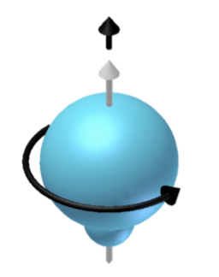
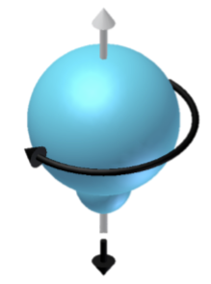
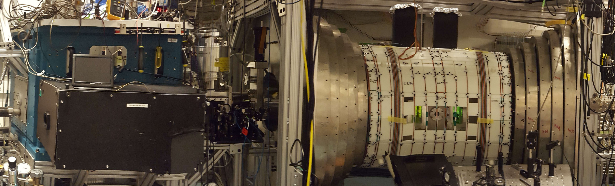
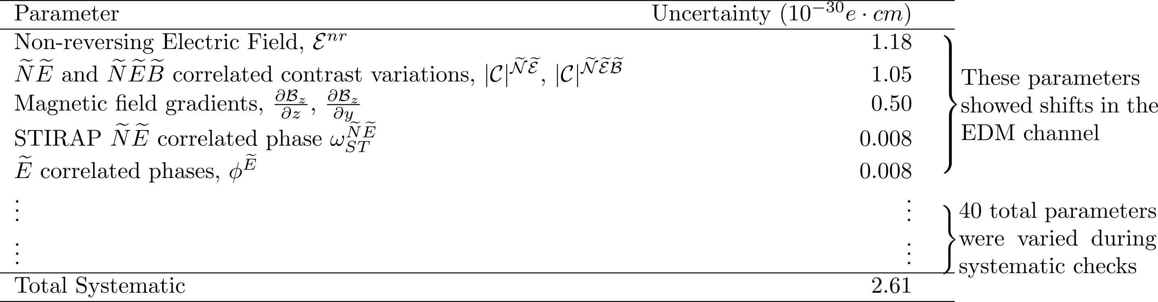
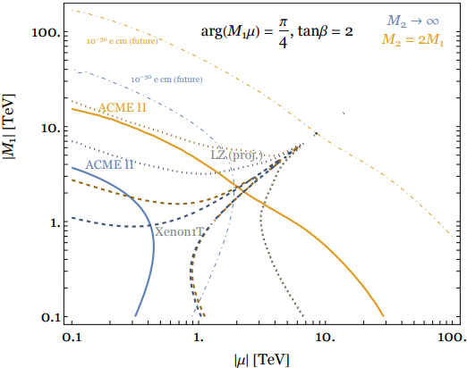
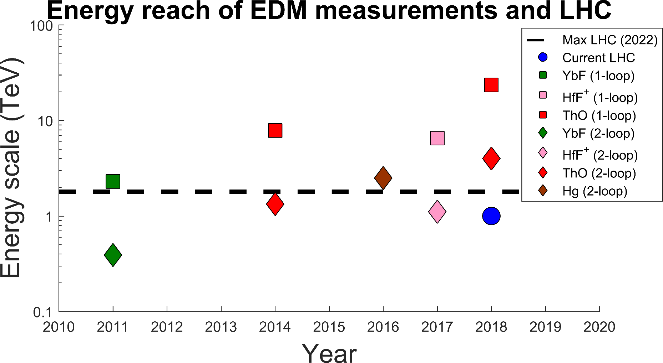
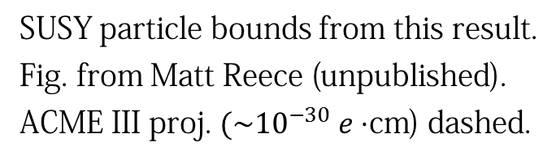
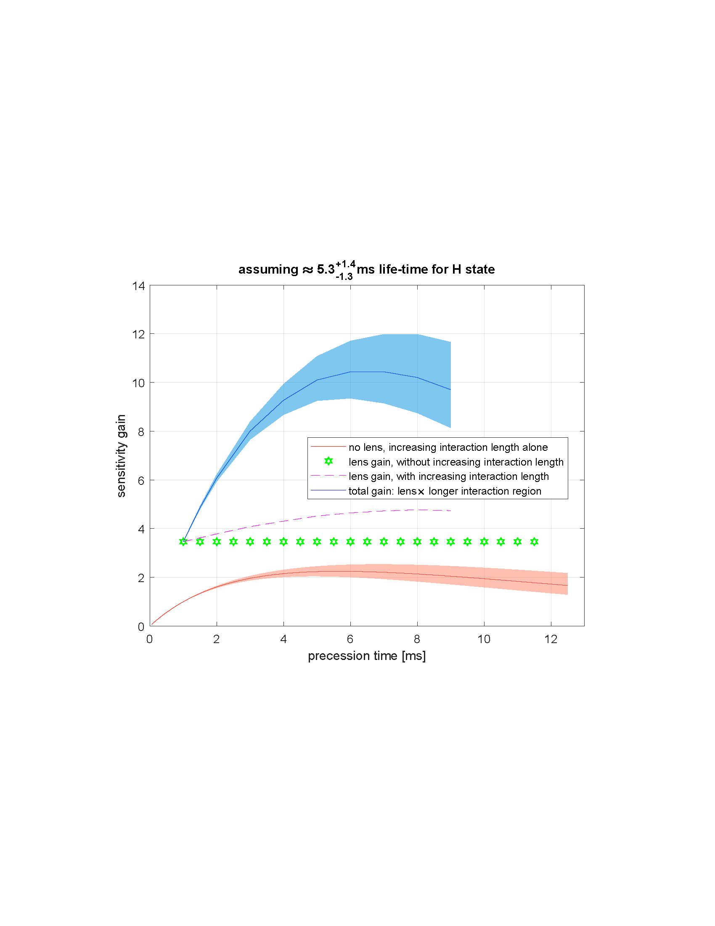
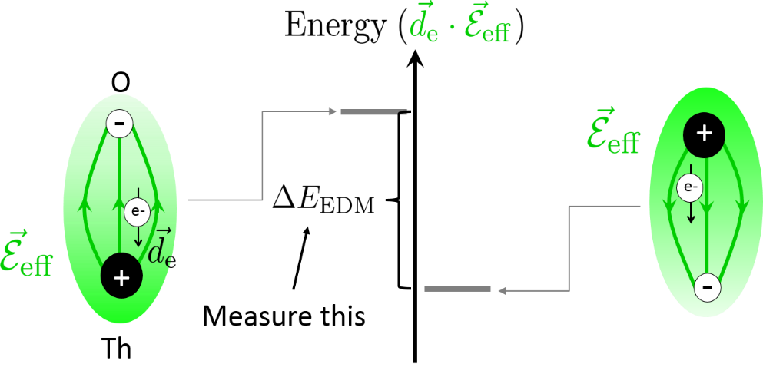
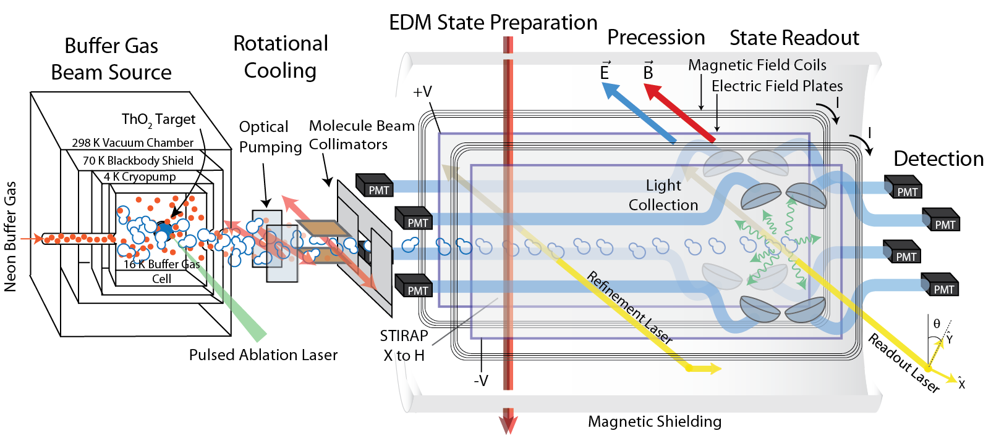
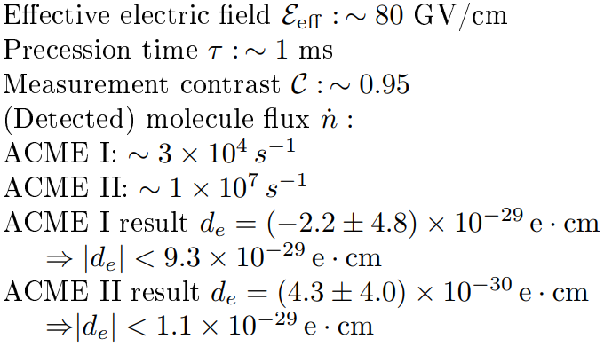
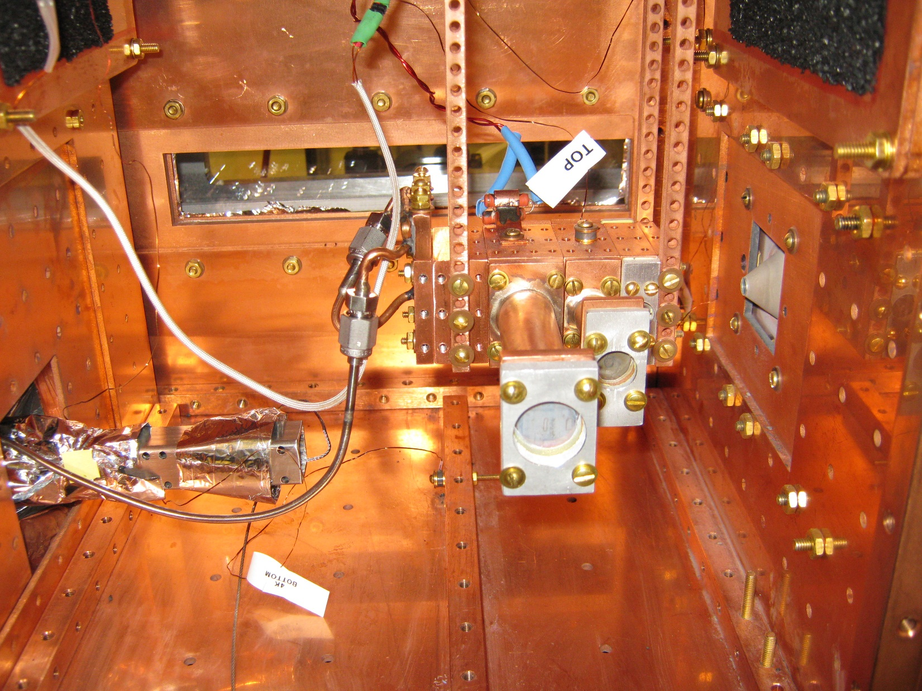
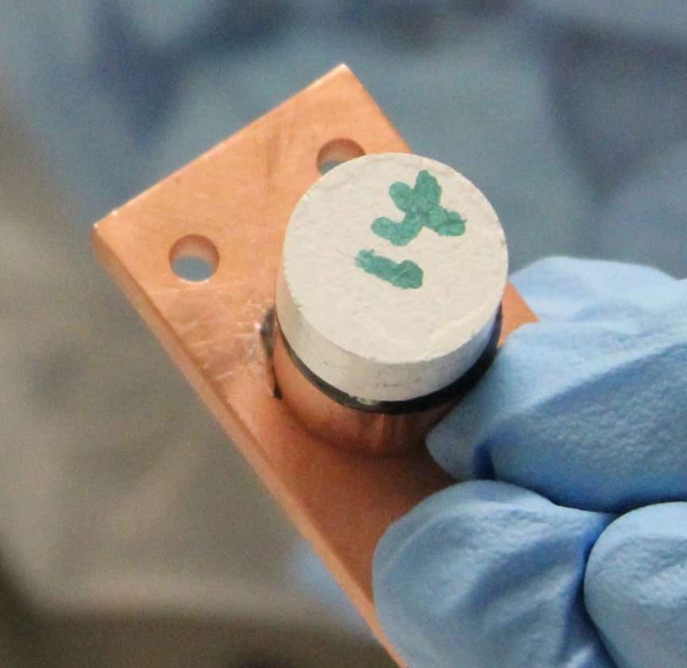
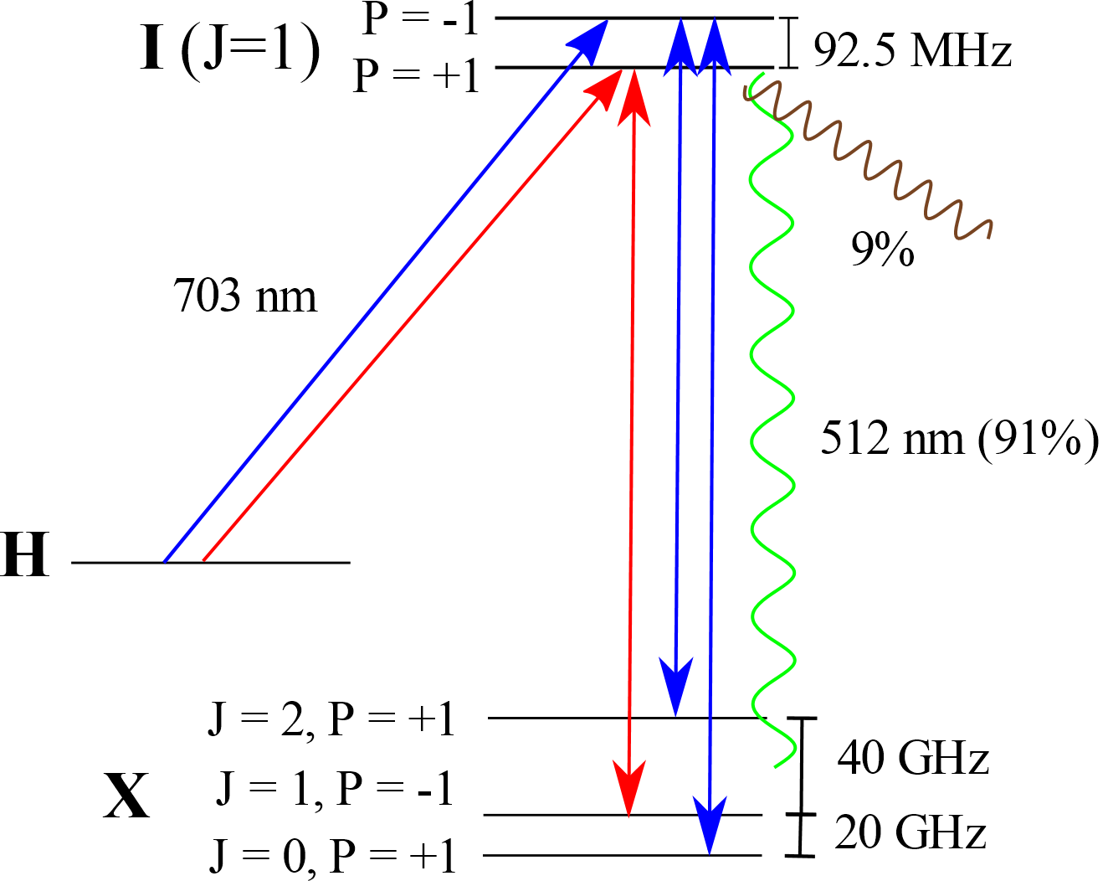
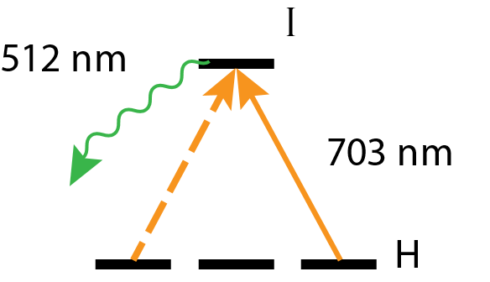
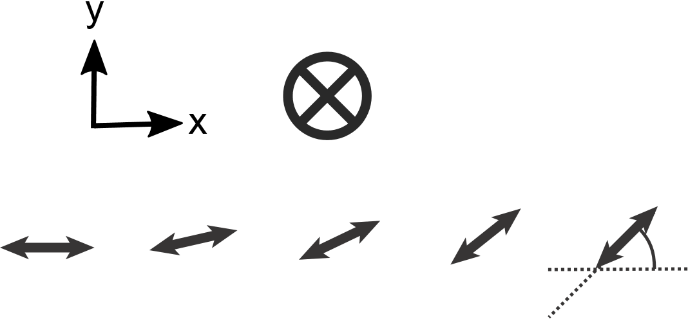
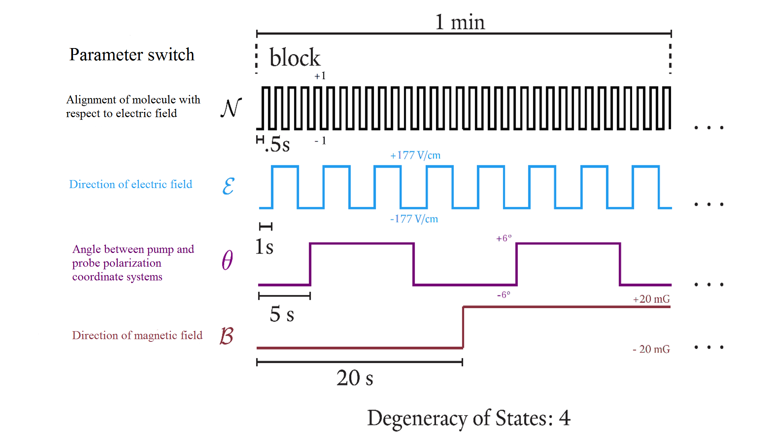
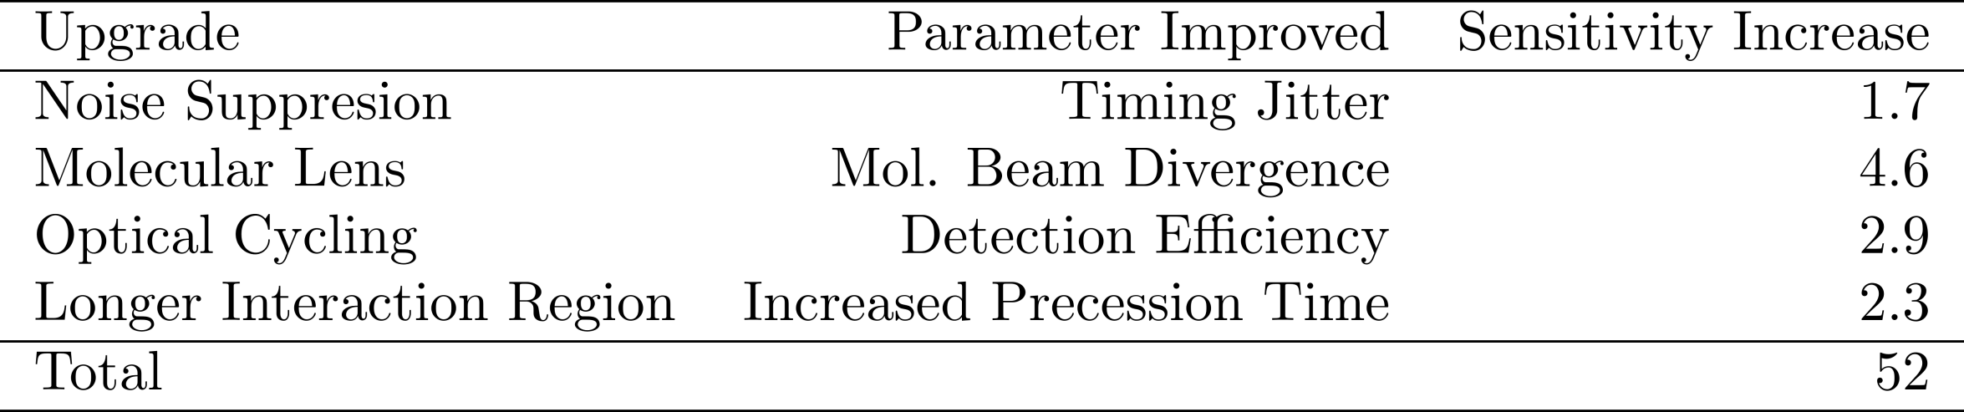
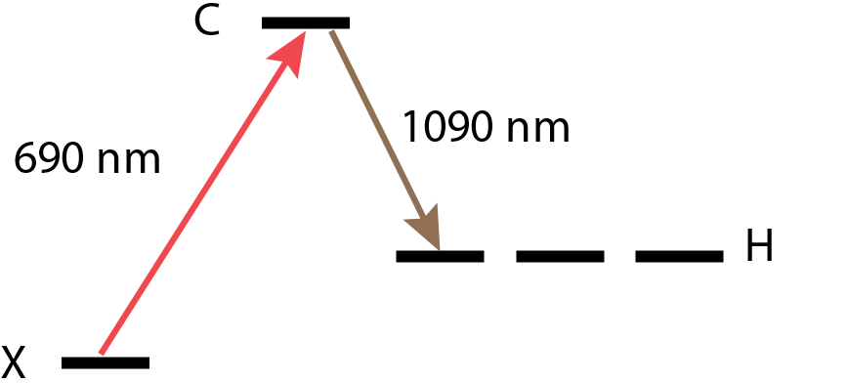
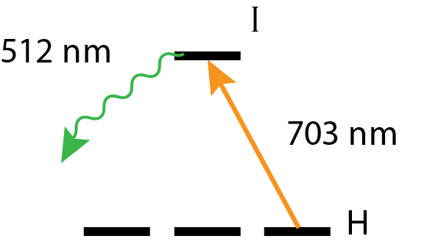
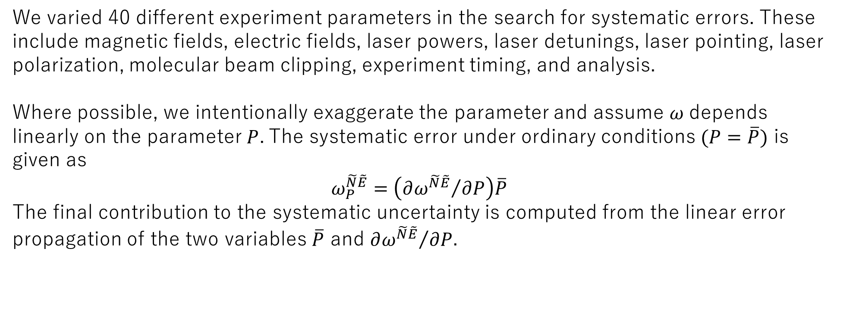
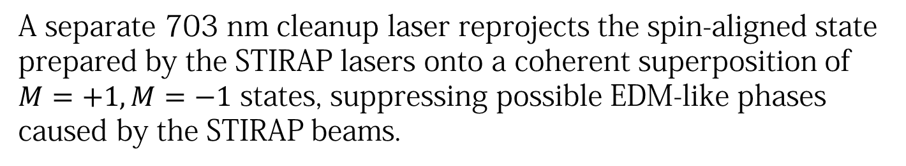
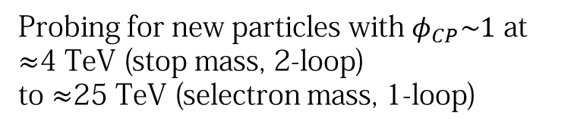

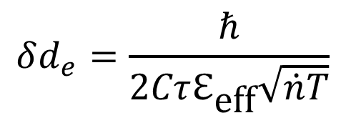



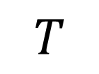
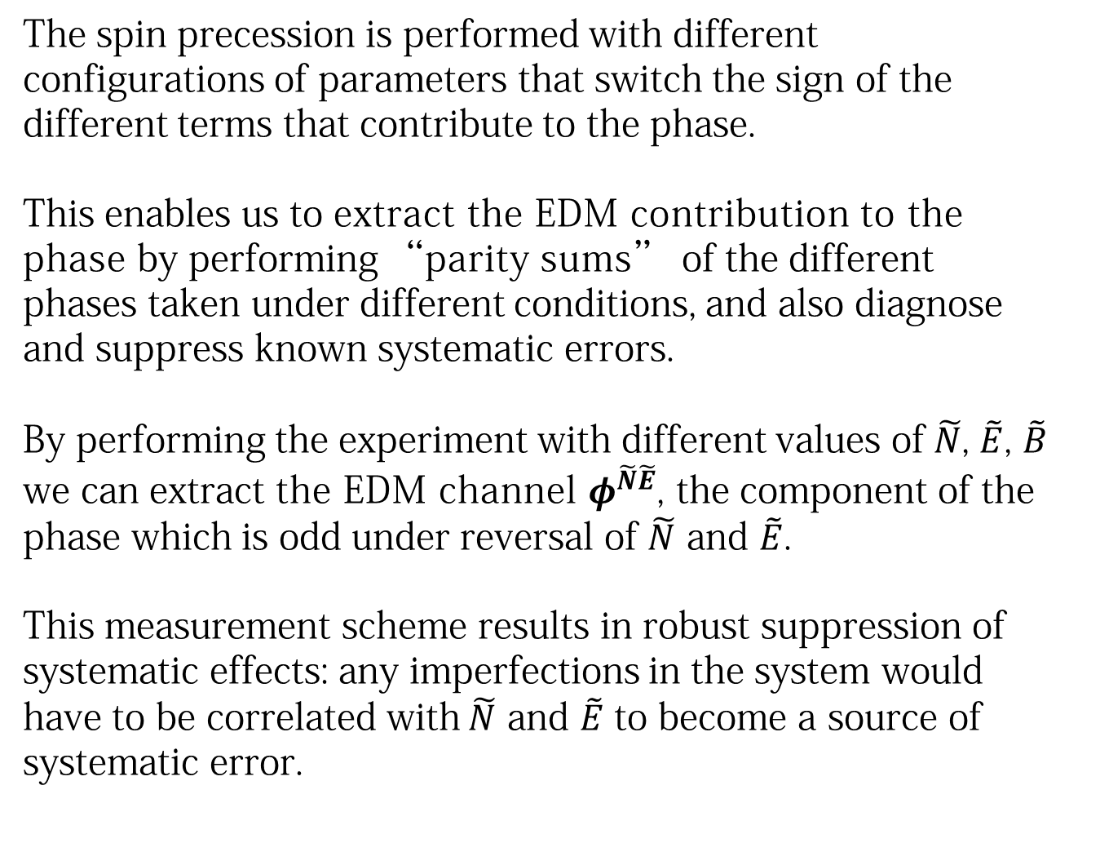

An Order of Magnitude Improved Limit
on the Electron Electric Dipole Moment
ACME Collaboration: Daniel G. Ang,¹ Cole Meisenhelder,¹ Xing Wu,^{1,2} Vitaly Andreev,¹ Piroz Bahar,¹ David DeMille² (PI), John M. Doyle¹ (PI), Gerald Gabrielse³ (PI), Jonathan Haefner,¹ Zhen Han,¹ Nicholas R. Hutzler, ⁴ Zack D. Lasner,² Brendon R. O’Leary, ² Cristian D. Panda,¹
Adam D. West,² Elizabeth P. West¹
Affiliation: ¹Harvard University, ²Yale University, ³Northwestern University, ⁴California Institute of Technology
Motivation & Theory
ACME II Apparatus
Systematic Search & Characterization
$$S$$
$$d_{e}$$
Permanent EDMs violate T-symmetry.
Many theories beyond the Standard Model predict T violation and EDMs at current experimental precision.
$$d_{e}$$
$$T$$
3.
$$S$$
This
work
4.
5.
1.
2.
We varied 40 different experiment parameters in the search for systematic errors. These include magnetic fields, electric fields, laser powers, laser detunings, laser pointing, laser polarization, molecular beam clipping, experiment timing, and analysis.
Where possible, we intentionally exaggerate the parameter and assume $ω$depends linearly on the parameter$P$. The systematic error under ordinary conditions $(P=\overline{P})$ is given as
$$ω_{P}^{\tilde{N}\tilde{E}}=\left({∂ω^{\tilde{N}\tilde{E}}}/{∂P}\right)\overline{P}$$
The final contribution to the systematic uncertainty is computed from the linear error propagation of the two variables $\overline{P}$ and ${∂ω^{\tilde{N}\tilde{E}}}/{∂P}$.
Probing for new particles with $φ_{CP}\sim 1$ at
$≈$4 TeV (stop mass, 2-loop)
to $≈$25 TeV (selectron mass, 1-loop)
Key EDM results since 2010. Two-loop sensitivity from Nakai & Reece (2017).
One-loop sensitivity from Feng (2013). LHC scale gives stop mass sensitivity.
3.
4.
5.
1.
2.
Proposed ACME III Improvements
Molecular Lens
$$δd_{e}=\frac{ℏ}{2Cτℇ_{\text{eff}}\sqrt{\dot{n}T}}$$
Due to molecular beam divergence, only 0.05% of molecules reach the detection region. An electrostatic lens can significantly increase molecular flux by focusing molecules in the electrically-sensitive Q (J=2) state into the measurement region.
1. Buffer gas beam source
ThO in the gas phase is produced through pulsed ablation of a ceramic ThO₂ target with an Nd:YAG laser. Ablation is performed at 50 Hz in a cryogenic buffer gas cell. The ThO molecules thermalize with and are entrained in the flow of the neon buffer gas. The molecular beam is cooled to 4 K. Each pulse produces a flux of ~10¹¹ molecules per steradian in the electro-vibrational ground state.
Increased Precession Time
Recent measurements determined that the H state lifetime of ThO is 4-6 ms. This is 4-6 times longer than the ACME II precession time. Combined with the molecular lens, increasing the precession region length by roughly 1 m will significantly increase measurement sensitivity.
9 cm
Beamline
4 K
1.5 cm
Plot of sensitivity gain versus precession time with and without the molecular lens.
Neon
flow
line
16 K
Ceramic ThO₂ ablation target
Optical Cycling
Ablation
window
4. State Precession
5. State Readout
Only ~5% of fluorescence from the spin-precessed molecules was detected, due to losses from collection optics and quantum efficiency. Photon cycling on a relatively closed transition (I-X, 91%) will increase the number of photons emitted per molecule. Combined with planned improvements to collection optics and detector upgrades, this might result in at least an order of magnitude increase in signal.
The molecules in the prepared state precess and acquire phase as they fly through the electric and magnetic fields of the interaction region.
At the end of the interaction region, the final state is projected to a pair of orthogonal basis vectors by subjecting the molecules to a 703 nm probe laser (on the H-I transition) with linear polarization rapidly switched (200 kHz) between x and y.
We collect the 512 nm fluorescence using PMTs as the molecules in the short-lived I-state decay back to the ground state.
2. Rotational Cooling
The molecules in the X state are primarily distributed in the lowest four rotational states after leaving the cell. Optical pumping on the $X−C$ transition transfers population from the $J=0, 1, 2$ levels to the $J=0$ level, increasing usable molecule flux by a factor of ~2.7.
Schematic of optical cycling
Step 1
Step 2
Data Acquisition Structure
Outlook
The spin precession is performed with different configurations of parameters that switch the sign of the different terms that contribute to the phase.
This enables us to extract the EDM contribution to the phase by performing “parity sums” of the different phases taken under different conditions, and also diagnose and suppress known systematic errors.
By performing the experiment with different values of$\tilde{N}$, $\tilde{E}$, $\tilde{B}$ we can extract the EDM channel $φ^{\tilde{N}\tilde{E}}$, the component of the phase which is odd under reversal of $\tilde{N}$ and $\tilde{E}$.
This measurement scheme results in robust suppression of systematic effects: any imperfections in the system would have to be correlated with $\tilde{N}$ and $\tilde{E}$ to become a source of systematic error.
We are currently pursuing upgrades to the ACME apparatus with the goal of at least an order of magnitude improvement in measurement sensitivity.
3. State Preparation
The EDM measurement is performed in the metastable H state. STIRAP coherently transfers population through an intermediate short-lived state to the spin-aligned state that represents the beginning of the EDM measurement. This transfer occurs with an efficiency of ~75%.
STIRAP Level Structure
Cleanup Level Structure
References
ACME II result: V Andreev et al., Nature 562, 355-360 (2018)
ACME I result: J Baron et al., Science 343, 269-272 (2014)
ACME I detailed report: J Baron et al., New J. Phys.19 (2017)
E_{eff} Calculations: L. V. Skripnikov et al., J. Chem. Phys. 142 024301 (2015), T. Fleig et al., J. Mol. Spec. 300 p. 16-21 (2014)
EDM & SUSY: J. Feng, Annu. Rev. Nucl. Part. Sci., 63:35,1-82 (2013), Y. Nakai, et al., J. High Energy Phys. 2017:31 (2017)
Interpreting the Electron EDM Constraint: C. Cesarotti et al., arXiv (2018)
A separate 703 nm cleanup laser reprojects the spin-aligned state prepared by the STIRAP lasers onto a coherent superposition of $M=+1, M=−1$ states, suppressing possible EDM-like phases caused by the STIRAP beams.
EDM frequency
More information: www.electronedm.info

