Slide 1









Magnetic Field Control and Monitoring for
The ACME III Electron
Electric Dipole Moment Search
Xing Fan, Siyuan Liu, Maya Watts, Ayami Hiramoto, Daniel G. Ang, David DeMille, Collin Diver,
John M. Doyle, Gerald Gabrielse, Zhen Han, Peiran Hu , Nick R Hutzler, Zack Lasner,
Takahiko Masuda, Cole Meisenhelder, Cris D Panda, Satoshi Uetake, Xing Wu, Koji Yoshimura
X05.00005
2024 Jun 4 DAMOP, Fort Worth, Texas

Slide 2

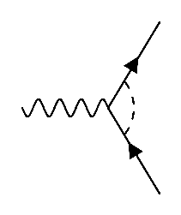
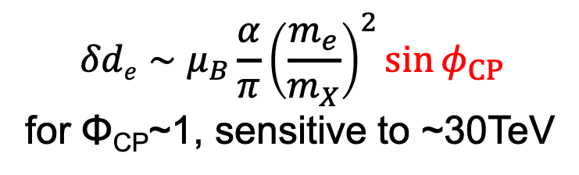
Electron’s Electric Dipole Moment as a BSM CP probe
spin
spin
time-reversal
unit: charge×length
d_{e}･s>0
d_{e}･s<0
e⁻
Φ_{CP}
$$δde∼μ_{B}\frac{α}{π}{\left(\frac{m_{e}}{m_{X}}\right)}^{2}\sin{φ_{CP}}$$
for Φ_{CP}~1, sensitive to ~30TeV
X
e⁻

Slide 3
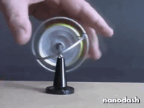
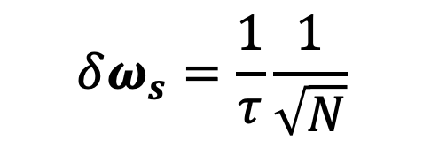
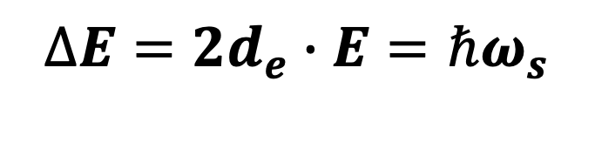
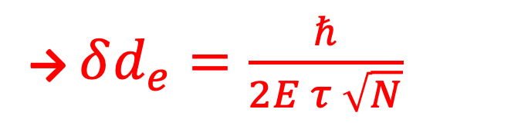

Principle of EDM measurement
Apply an electric field
d_{e}
$$∆E=2d_{e}∙E=ℏω_{s}$$
E
e⁻
or
spin precession energy
e⁻
$$δω_{s}=\frac{1}{τ}\frac{1}{\sqrt{N}}$$
Experimentally
precession time
# of measured spins
→ $δd_{e}=\frac{ℏ}{2E τ \sqrt{N}}$
E
spin precession $ω_{s}$

Slide 4
ACME’s Molecule: ThO
huge flux by Cryogenic Buffer Gas Beam (CBGB) = high N
E_{eff}=80 GV/cm
³Δ₁ state : long τ and B-insensitivity
O²⁻
e⁻
E_{eff}~80GV/cm
Th²⁺
http://doylegroup.harvard.edu/edm

Slide 5

The ACME Experiment
E_{ext}
magnetic shield
O²⁻
e⁻
Th²⁺
flow
many
many
many
ThO
E_{ext} bias plate
spin prep
spin readout

Slide 6
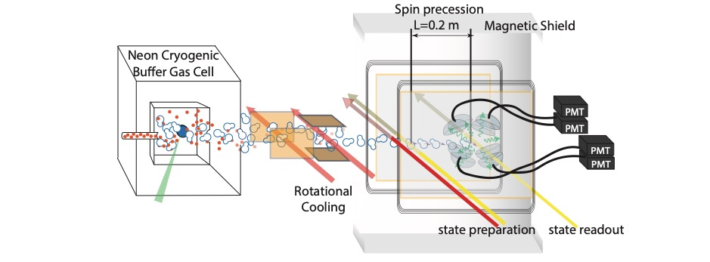
ACME I (2014) |d_{e}| < 8.7×10⁻²⁹ e•cm
Science 343, 269 (2014)

Slide 7
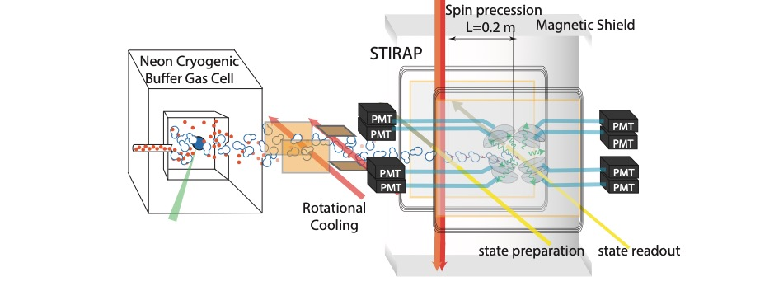
ACME I (2014) |d_{e}| < 8.7×10⁻²⁹ e•cm
ACME II (2018) |d_{e}| < 1.1×10⁻²⁹ e•cm
Nature 562, 355 (2018)

Slide 8
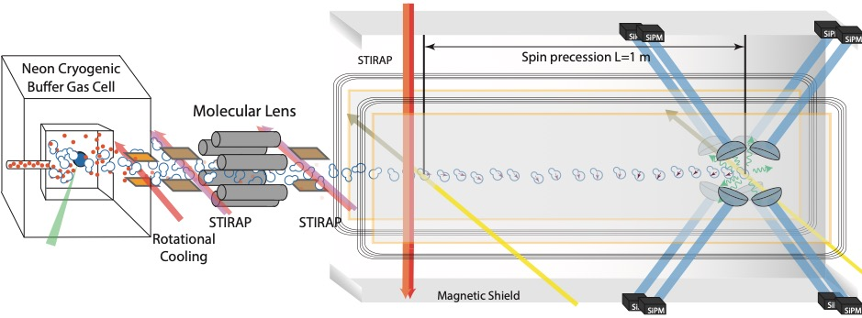
ACME I (2014) |d_{e}| < 8.7×10⁻²⁹ e•cm
ACME II (2018) |d_{e}| < 1.1×10⁻²⁹ e•cm
ACME III (2025?) |d_{e}| < 0.03?×10⁻²⁹ e•cm
new photon counter
x5 longer coherence time
D.G.Ang, et al, Phys. Rev. A 106, 022808(2022)
X Wu, et al, New J. Phys. 24 073043(2022)
A. Hiramoto, et al, NIM A, 1045, 167513(2022)

Slide 9
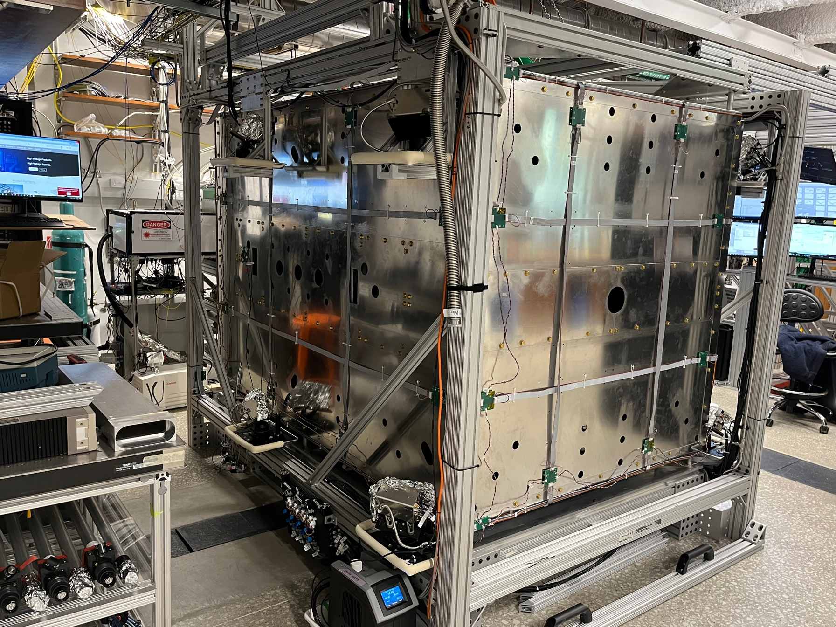
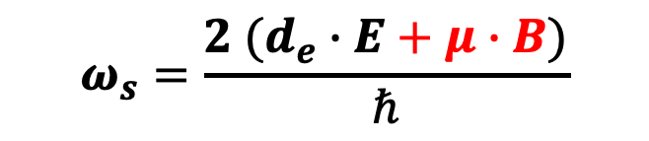
Magnetic Field Control
$$ω_{s}=\frac{2 (d_{e}∙E+μ∙B)}{ℏ}$$
E
B
spin precession $ω_{s}$
B_{earth}=500mG ↔︎d_{e}=10⁻²⁴ e･cm
(target: d_{e}=10⁻³⁰ e･cm)
*ThO ³Δ₁ state and switching help a lot
3-layer magnetic shield
3000 lbs = 1500kg
3,600 wire connections
<30μG without active cancellation
<5μG with active cancellation
1.5m
2m

Slide 10
Degaussing
after assembling
large magnetization
→large residual B field
small residual B field

Slide 11
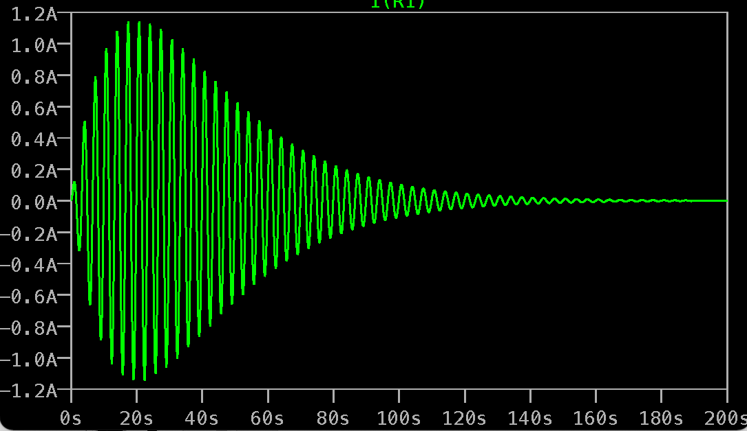
Degaussing Coil
degaussing coils
shield

Slide 12
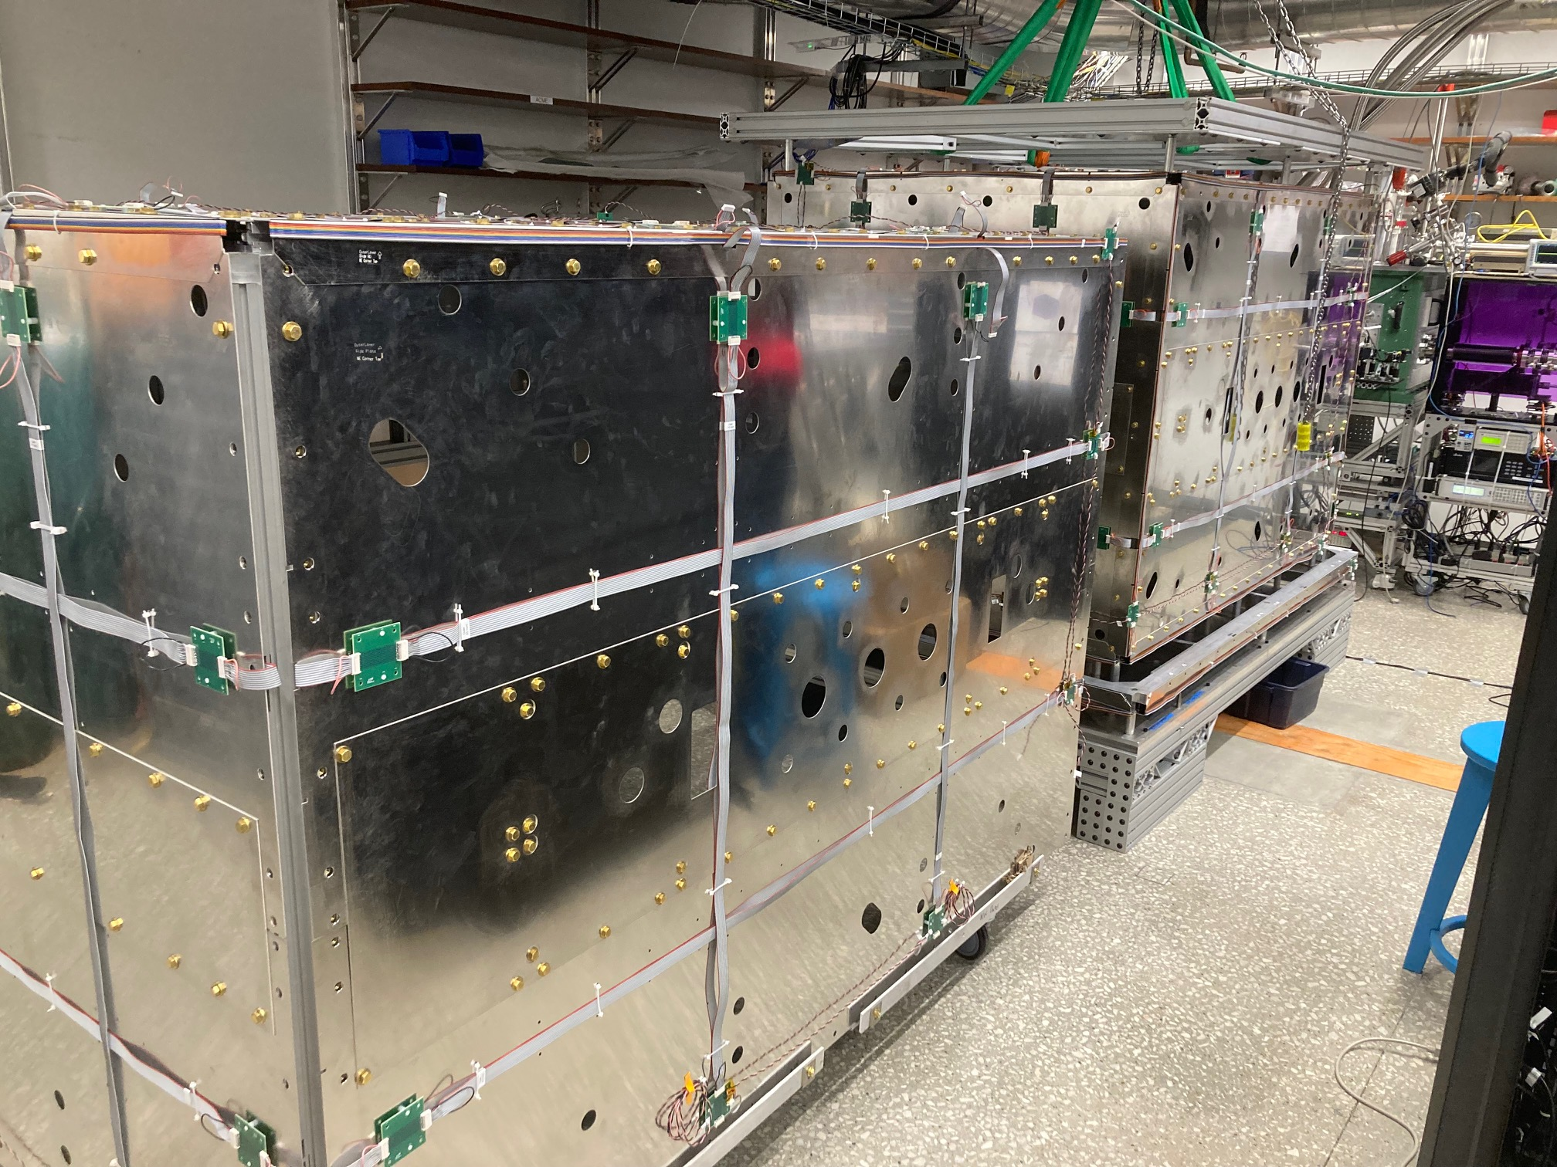
Degaussing Coil
degaussing coils
degaussing freq <1Hz
current offset in degaussing
is very important! (<1mA)

Slide 13
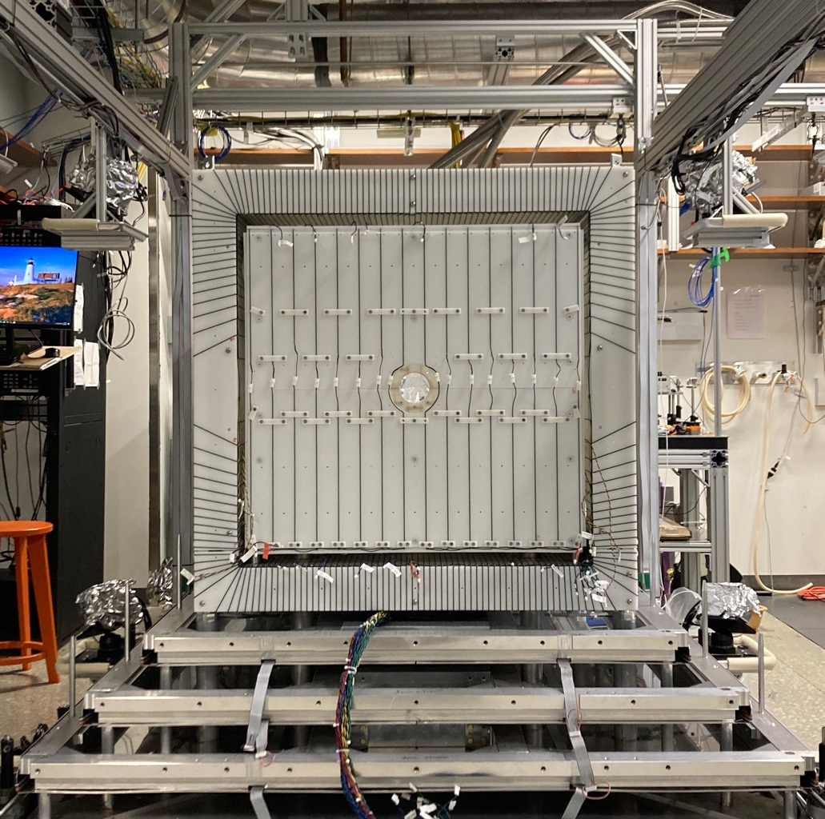
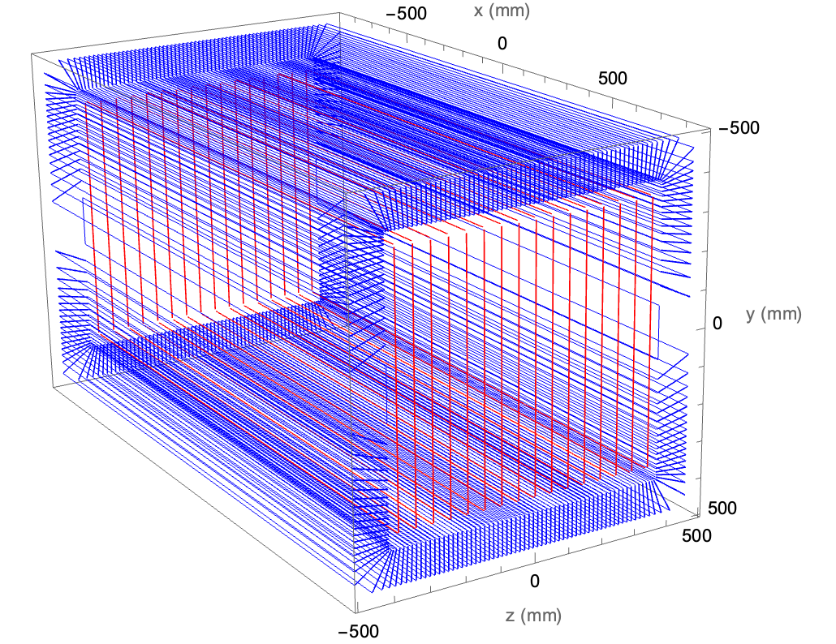
Low Fringe-Field Magnetic Field Coil
cosθ coil + artificial return yoke
0.33% homogeneity
over 100cm
8 sub-coils
able to cancel up to
linear order gradient
B
ThO

Slide 14
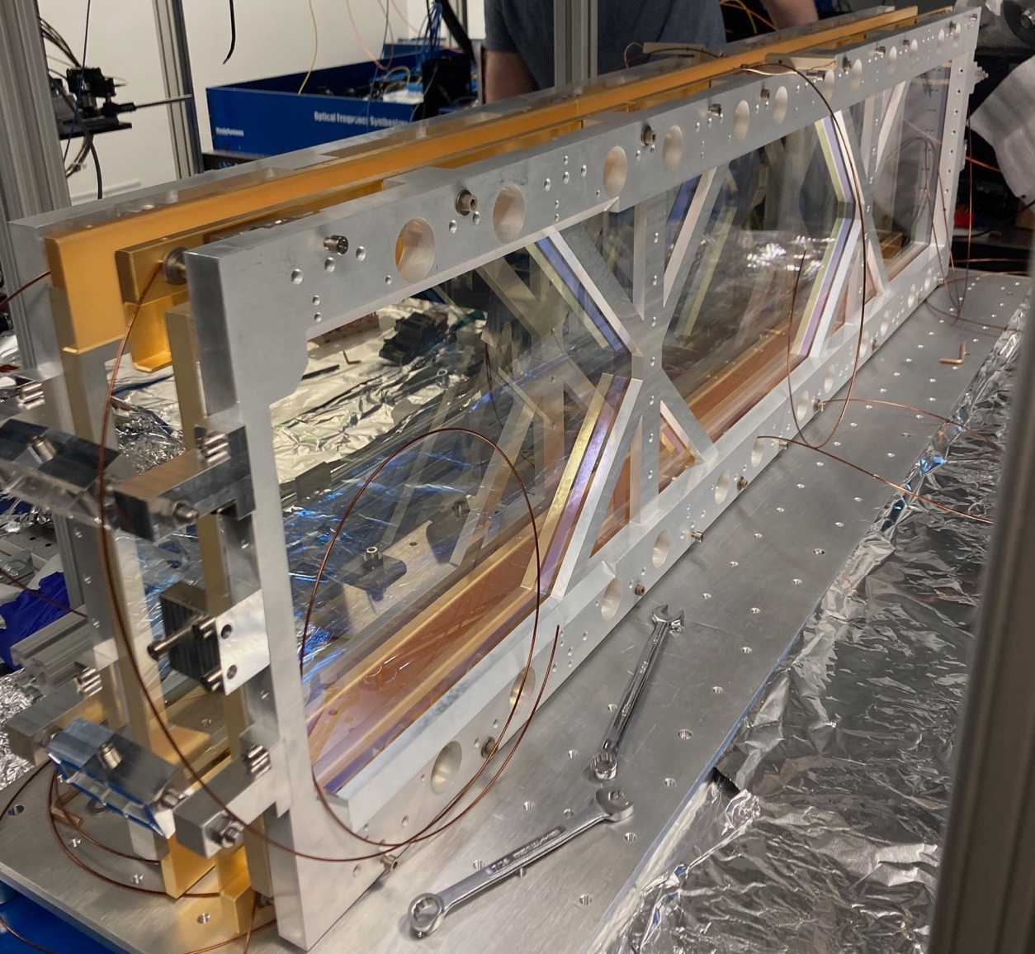
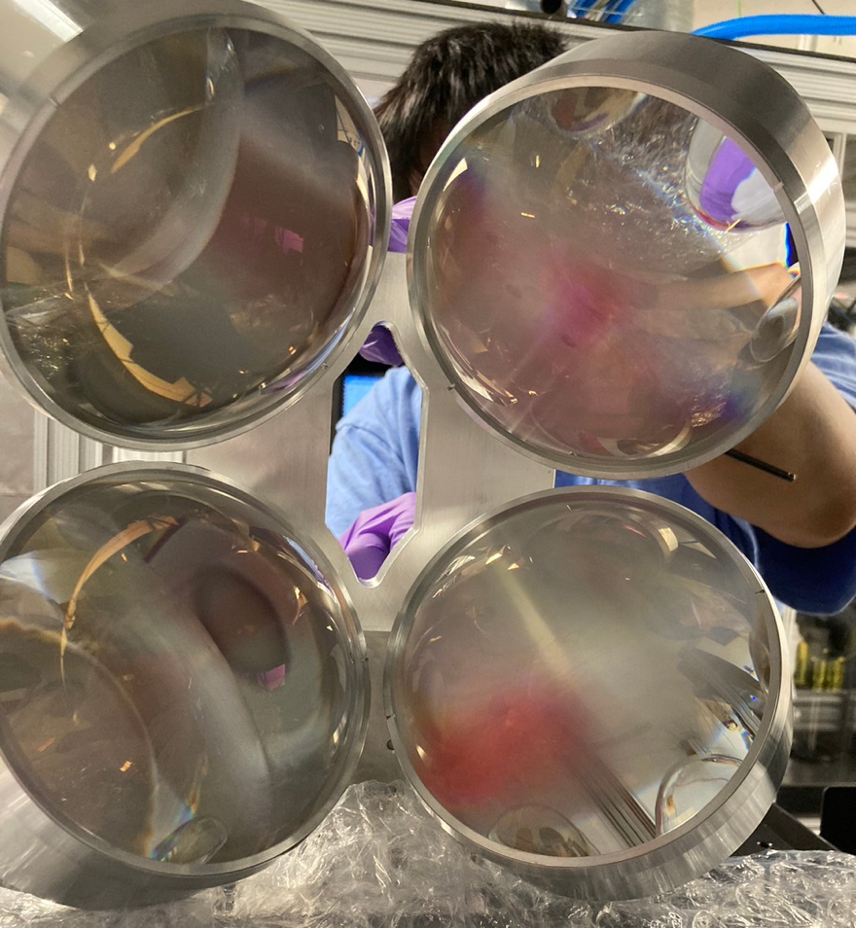
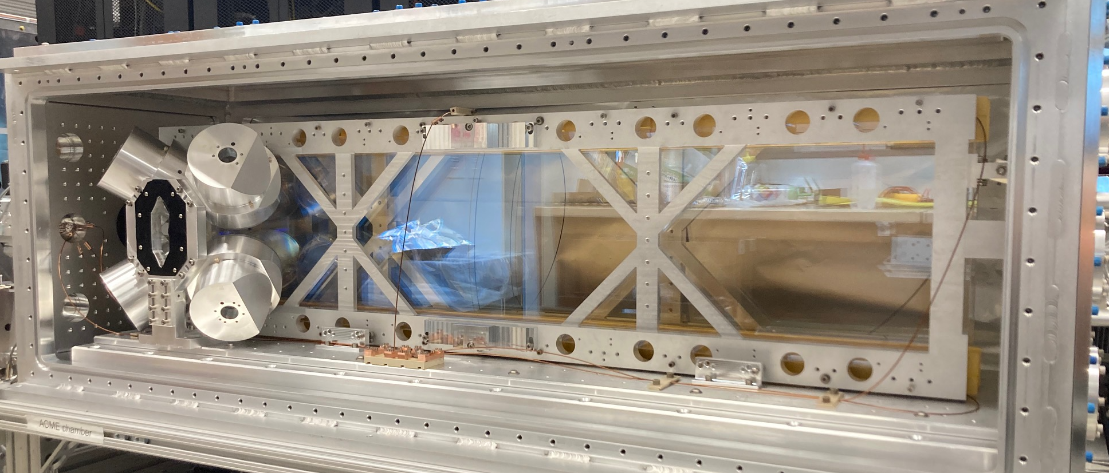
fluorescence collection lens
>30% solid angle!
E_{bias}
E-field plates
ITO-coated fused silica
low non-reversing E
low mounting stress
non-magnetic
ThO
Aluminum chamber
ThO
readout
prep

Slide 15
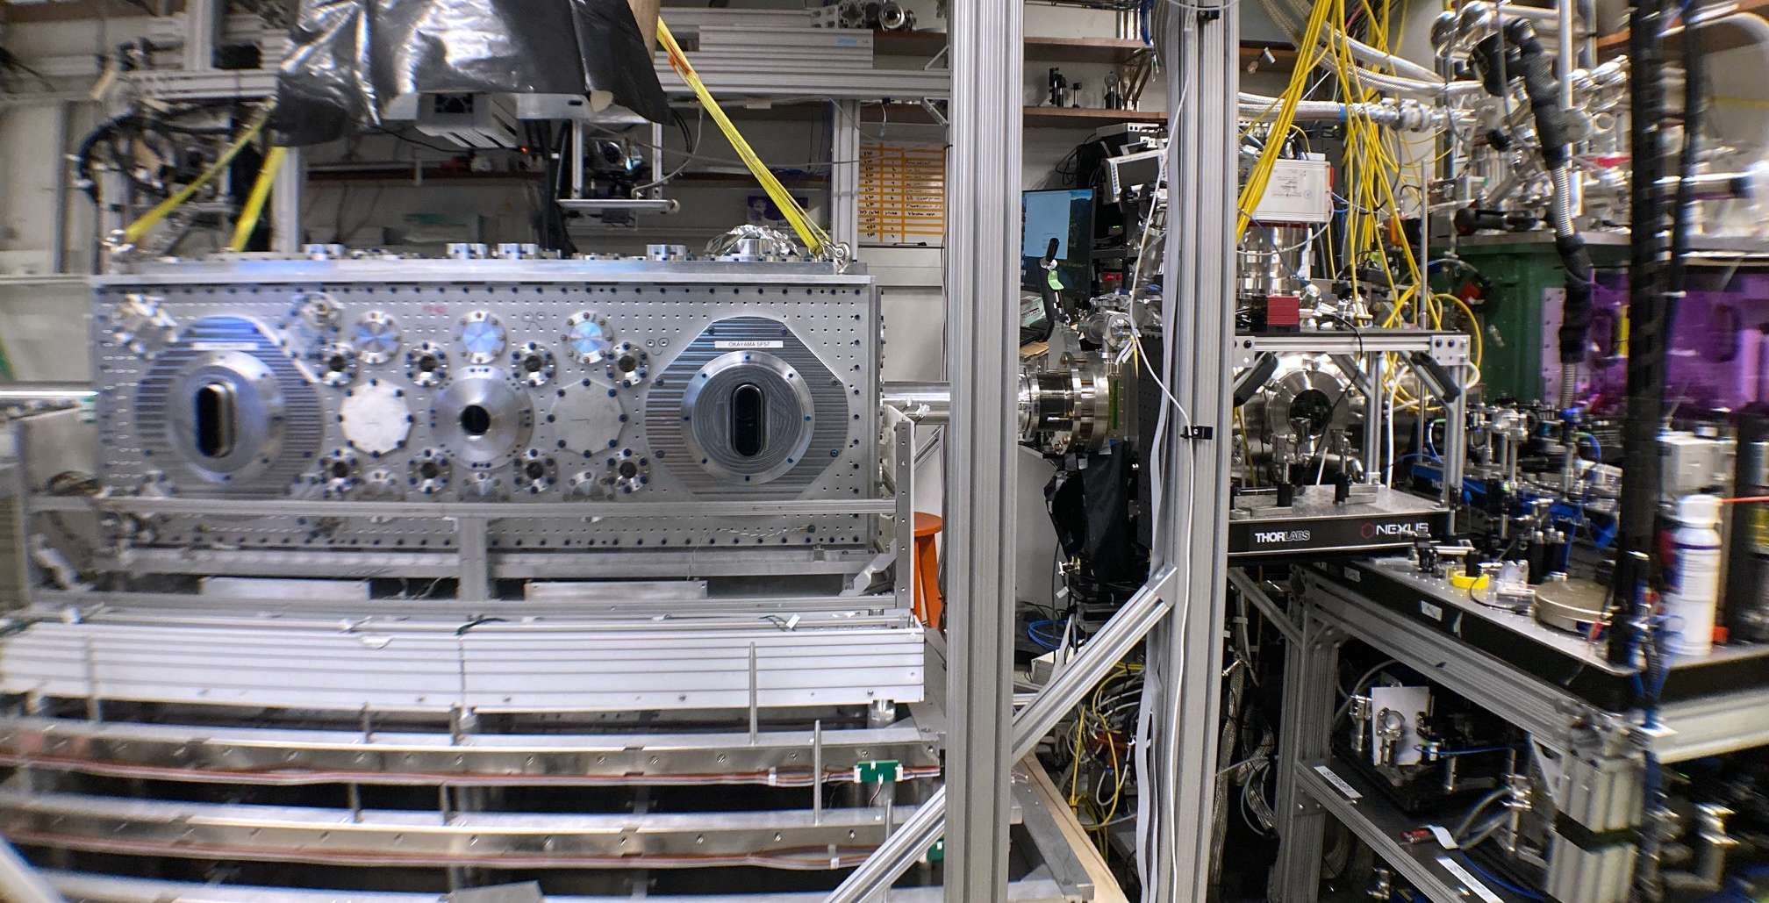
The Whole Beamline
X Wu, et al, New J. Phys. 24 073043(2022)
Cryogenic
Buffer Gas Source
molecular
lens
aluminum chamber
ThO
prep
readout
YAG
molecule pulse spacial length ~1m
50 Hz rep rate

Slide 16
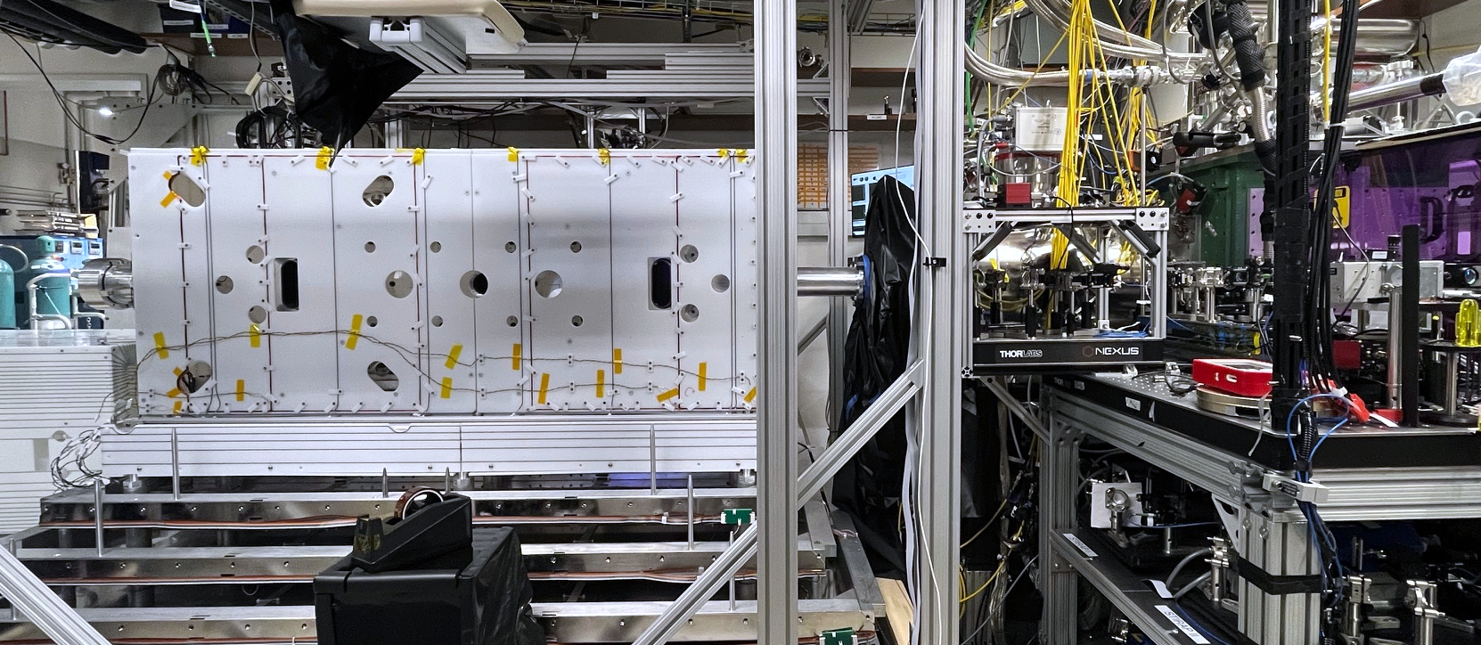
Magnetic Field Coil On
coil
B_{x}, B_{y}, B_{z} + linear gradient
ThO

Slide 17
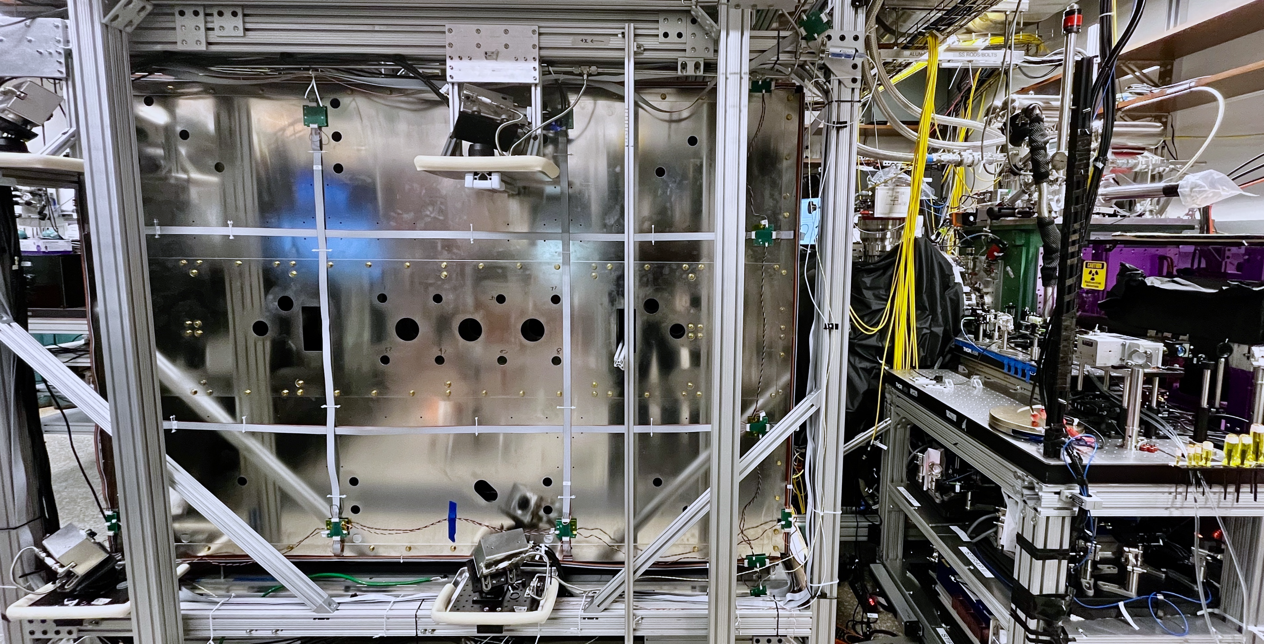
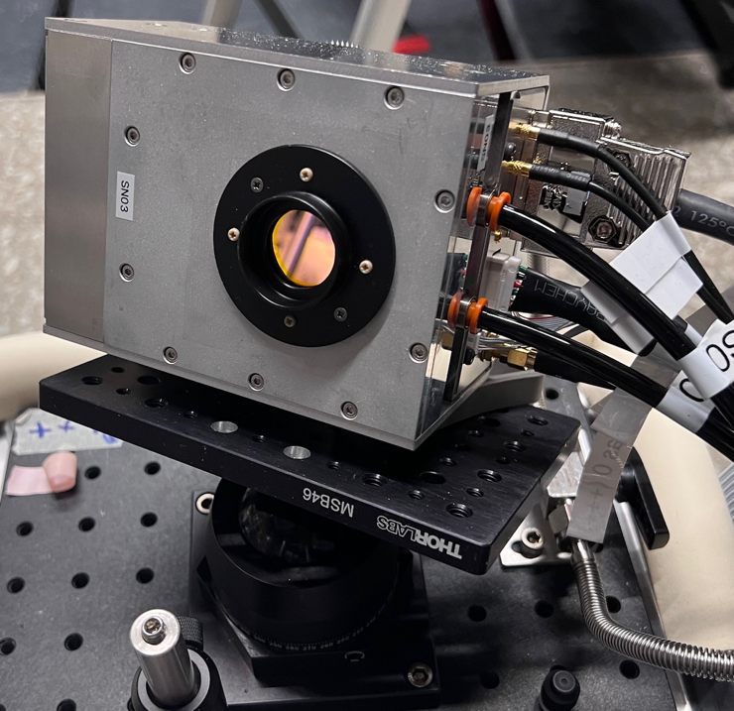
Magnetic Shield On
ThO
SiPM
x1.8 higher Q.E.
A. Hiramoto et al NIM A 1045 167513 (2022)

Slide 18
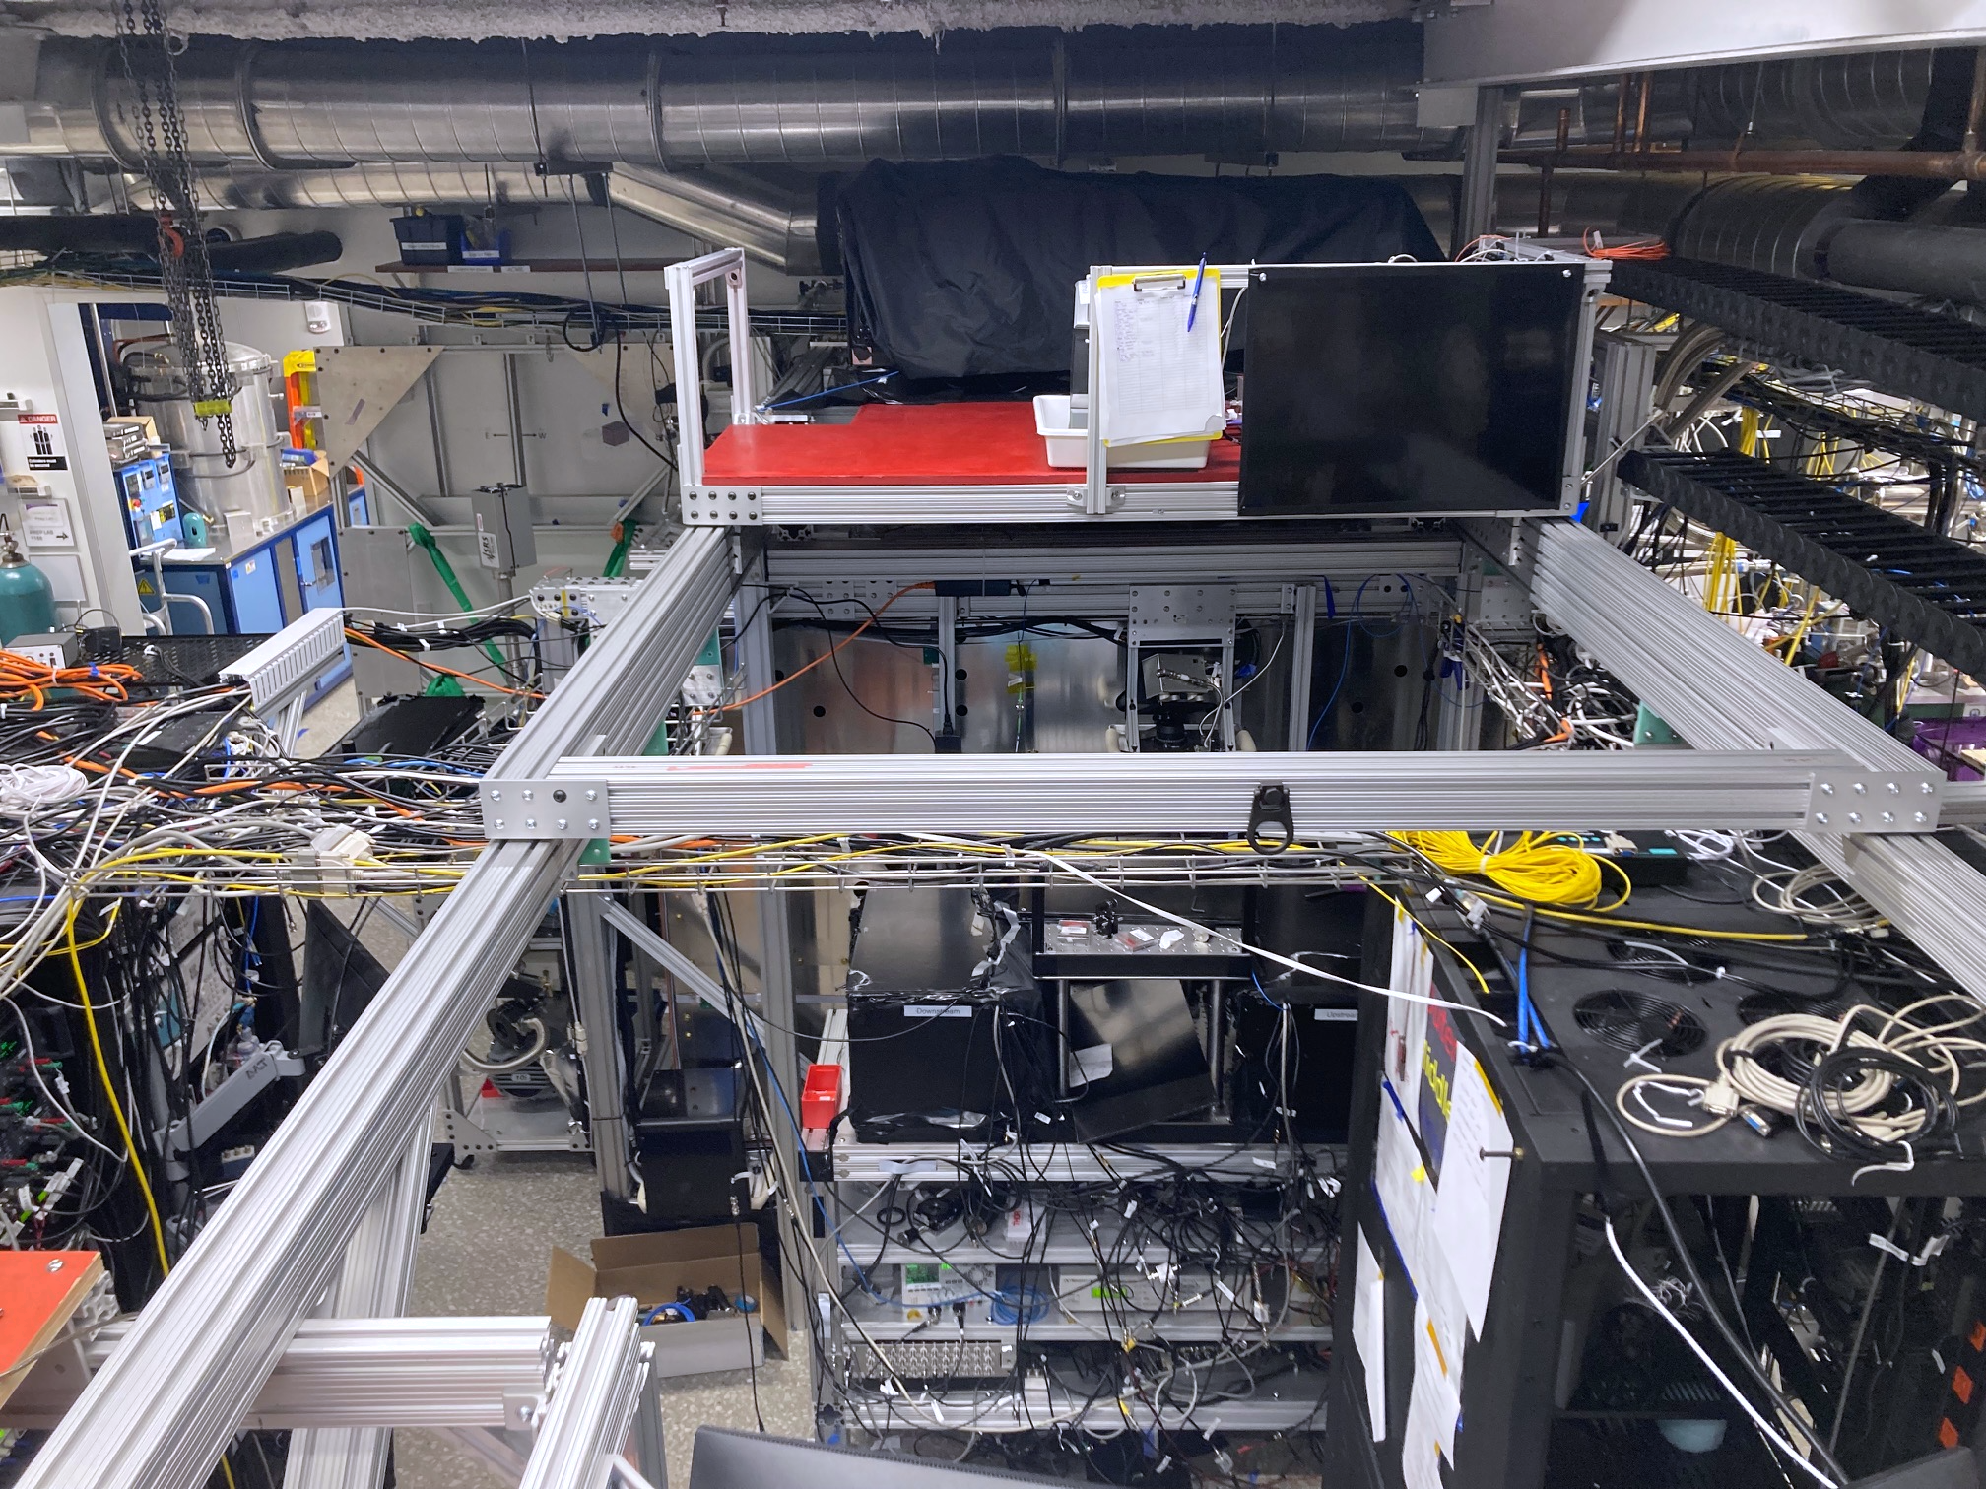
And Many More Peripherals
vertical STIRAP
stage
racks
ThO
optics cart
racks

Slide 19
Let There Be ThO Fluorescense!
x30 higher than ACME2
with x5 longer beamline!
Will start data-taking in 2024, probes ~100TeV scale
physics with ThO signal → next talk

Slide 20

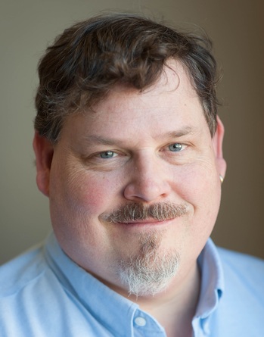
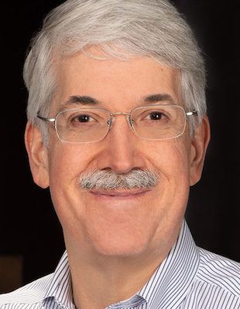
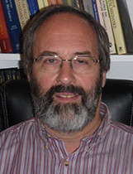
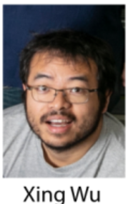
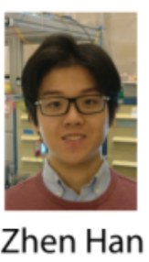
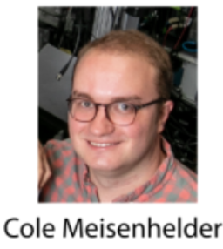

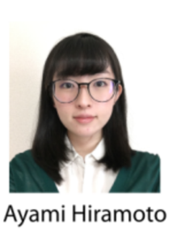

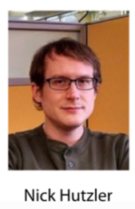



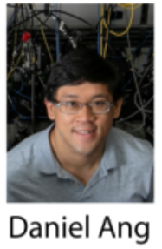
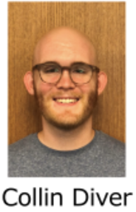
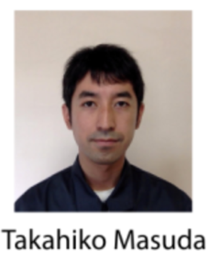
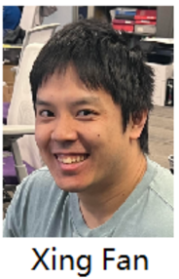

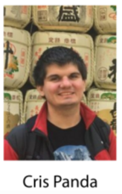
Many Thanks!
ACME Collaboration
David P DeMille
John M Doyle
Gerald Gabrielse
Zack Lasner

Slide 22
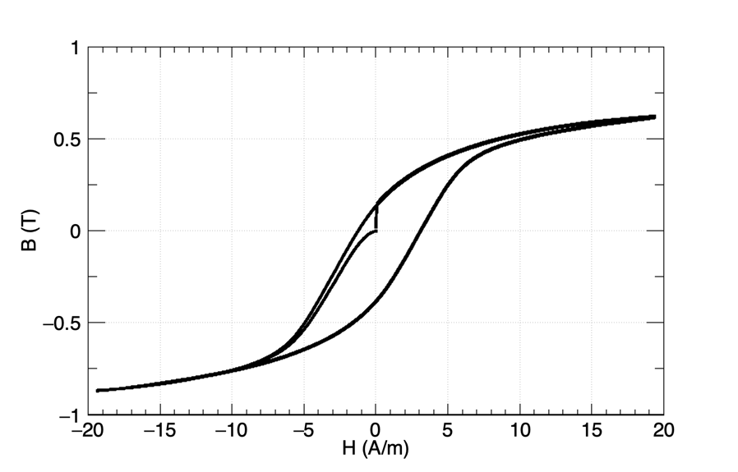
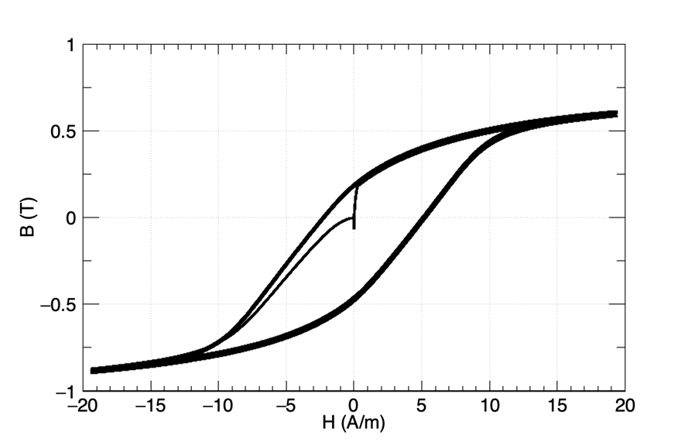
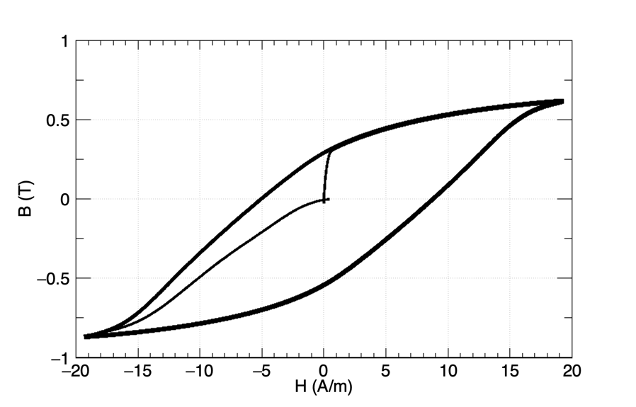
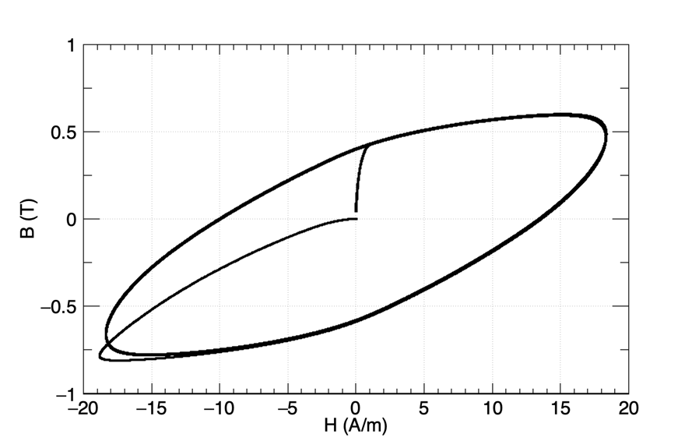
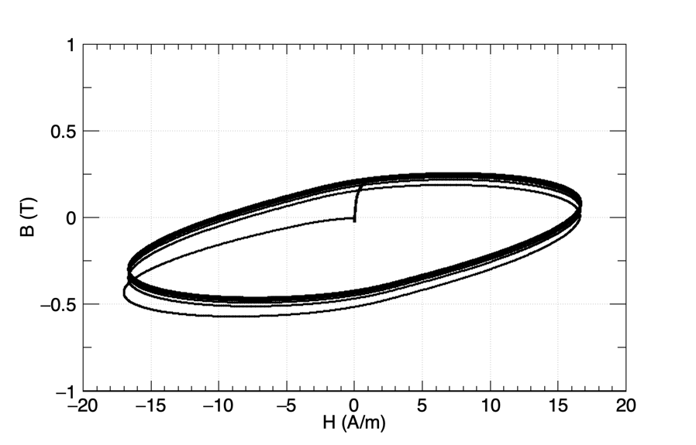
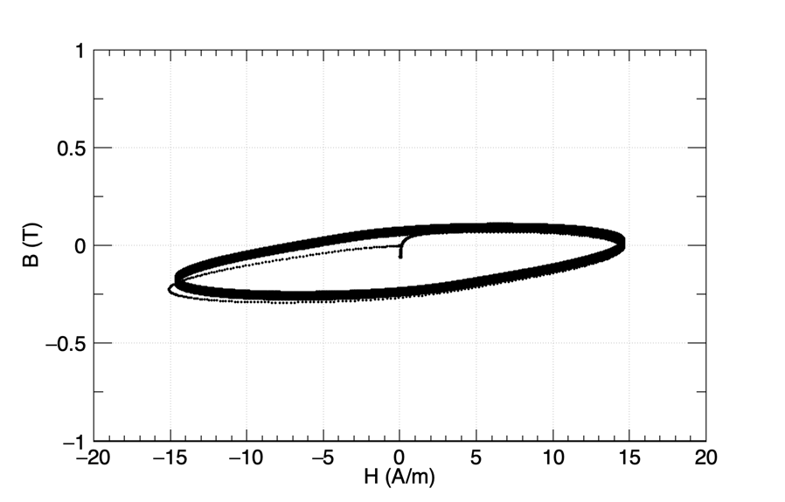
Degaussing Needs to be <1Hz
0.1Hz
0.3Hz
1Hz
3Hz
10Hz
30Hz

