Slide 1
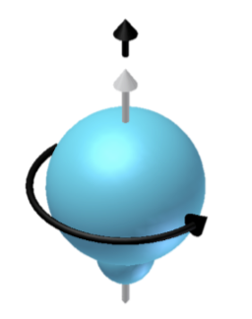
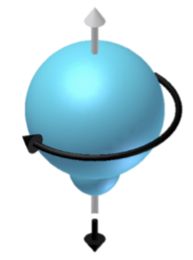
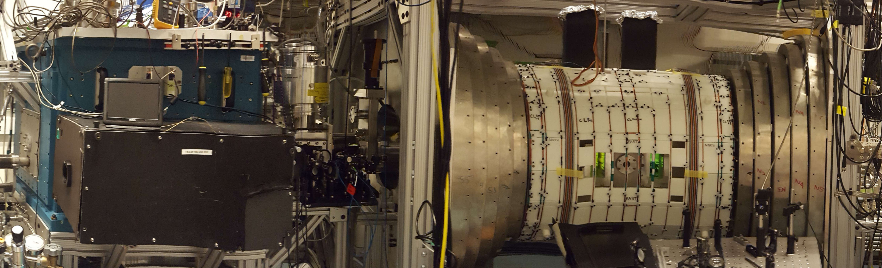
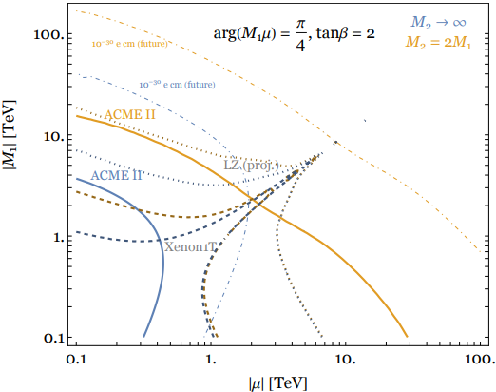
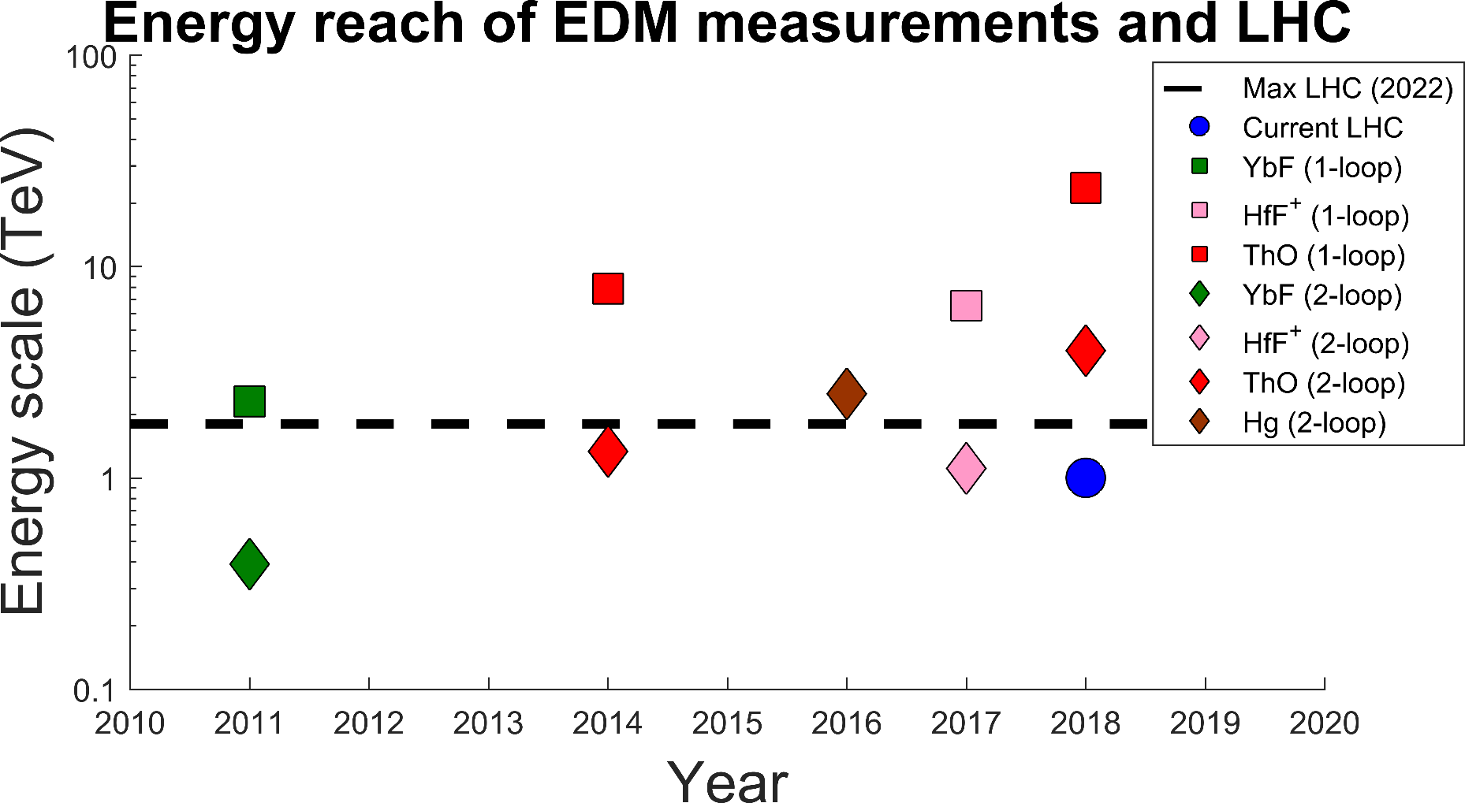
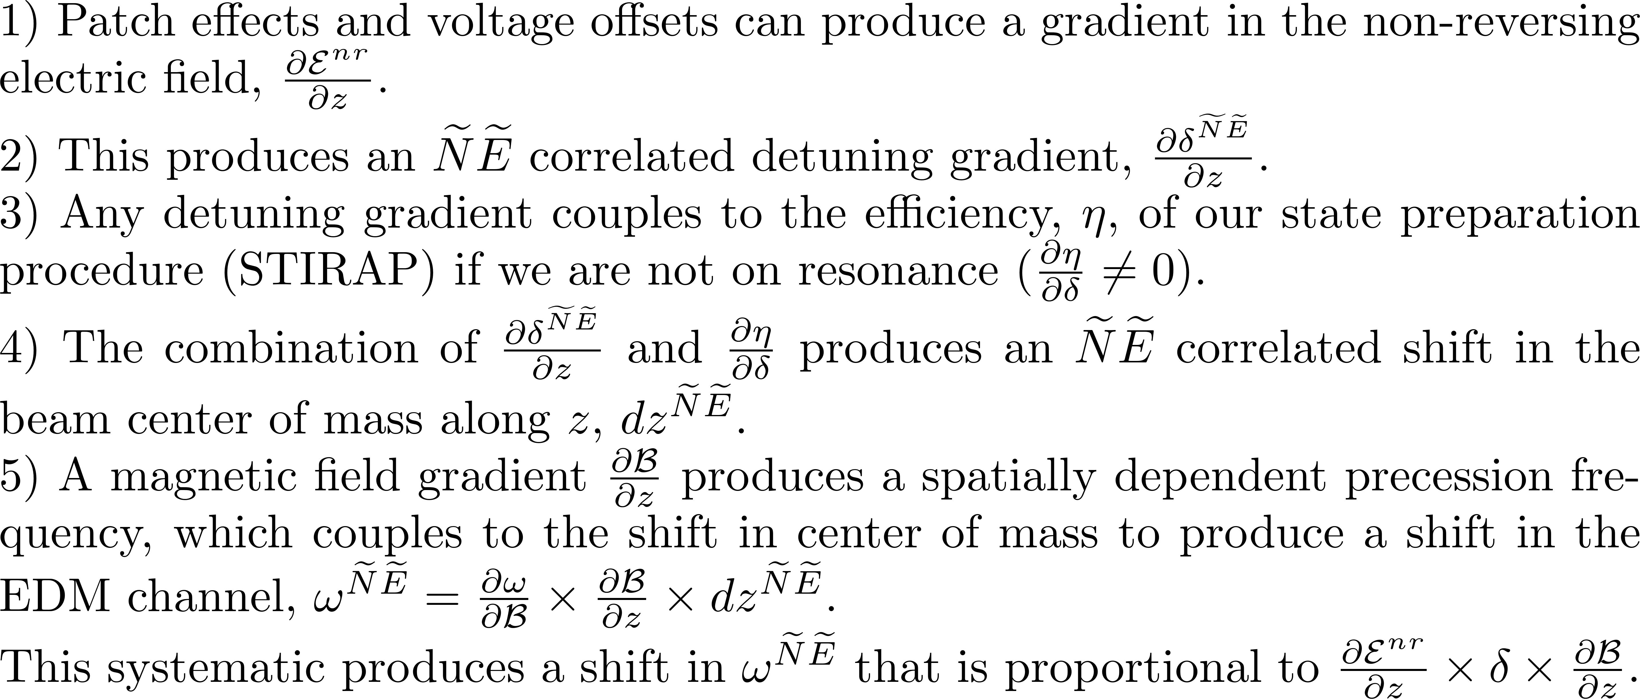
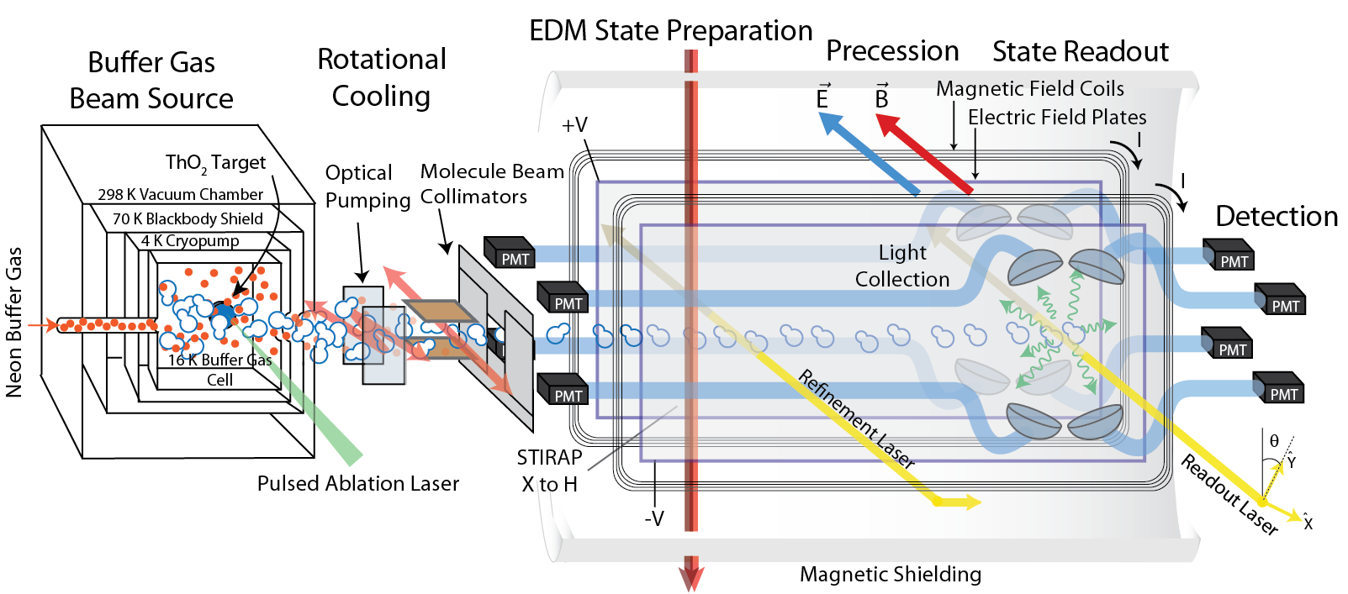
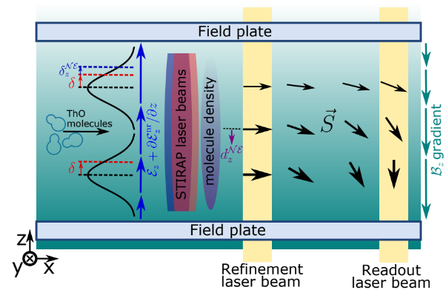
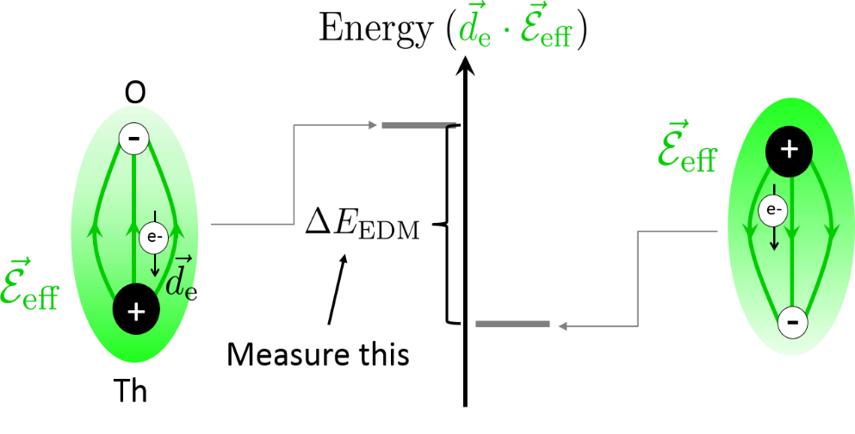
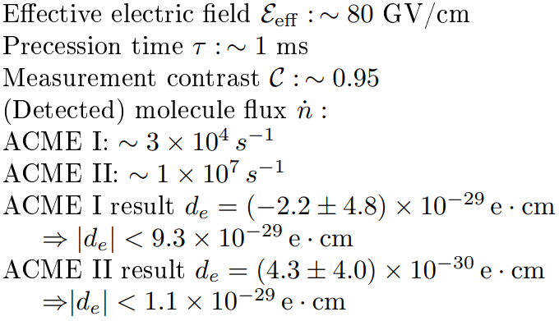
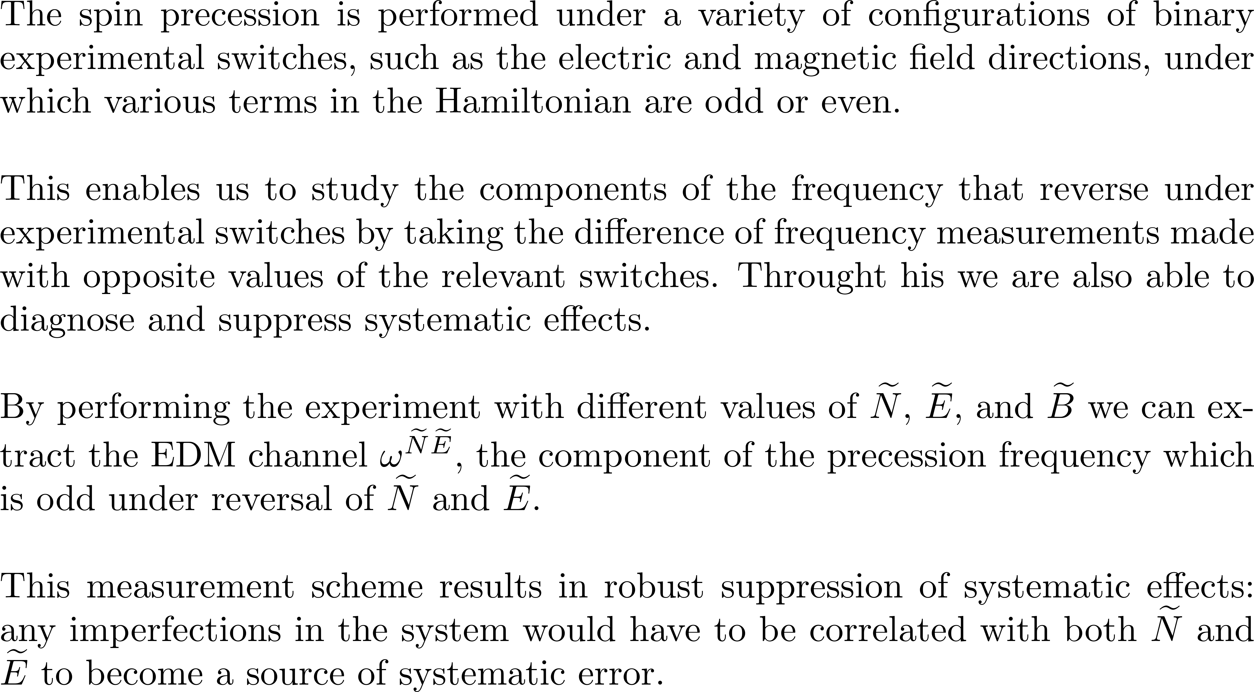
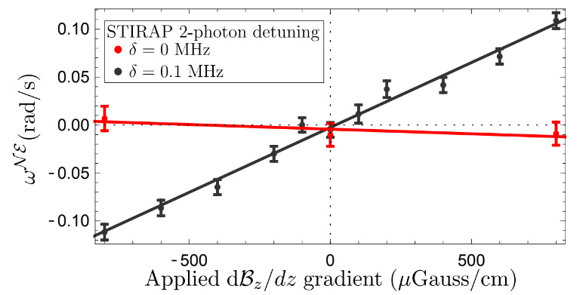
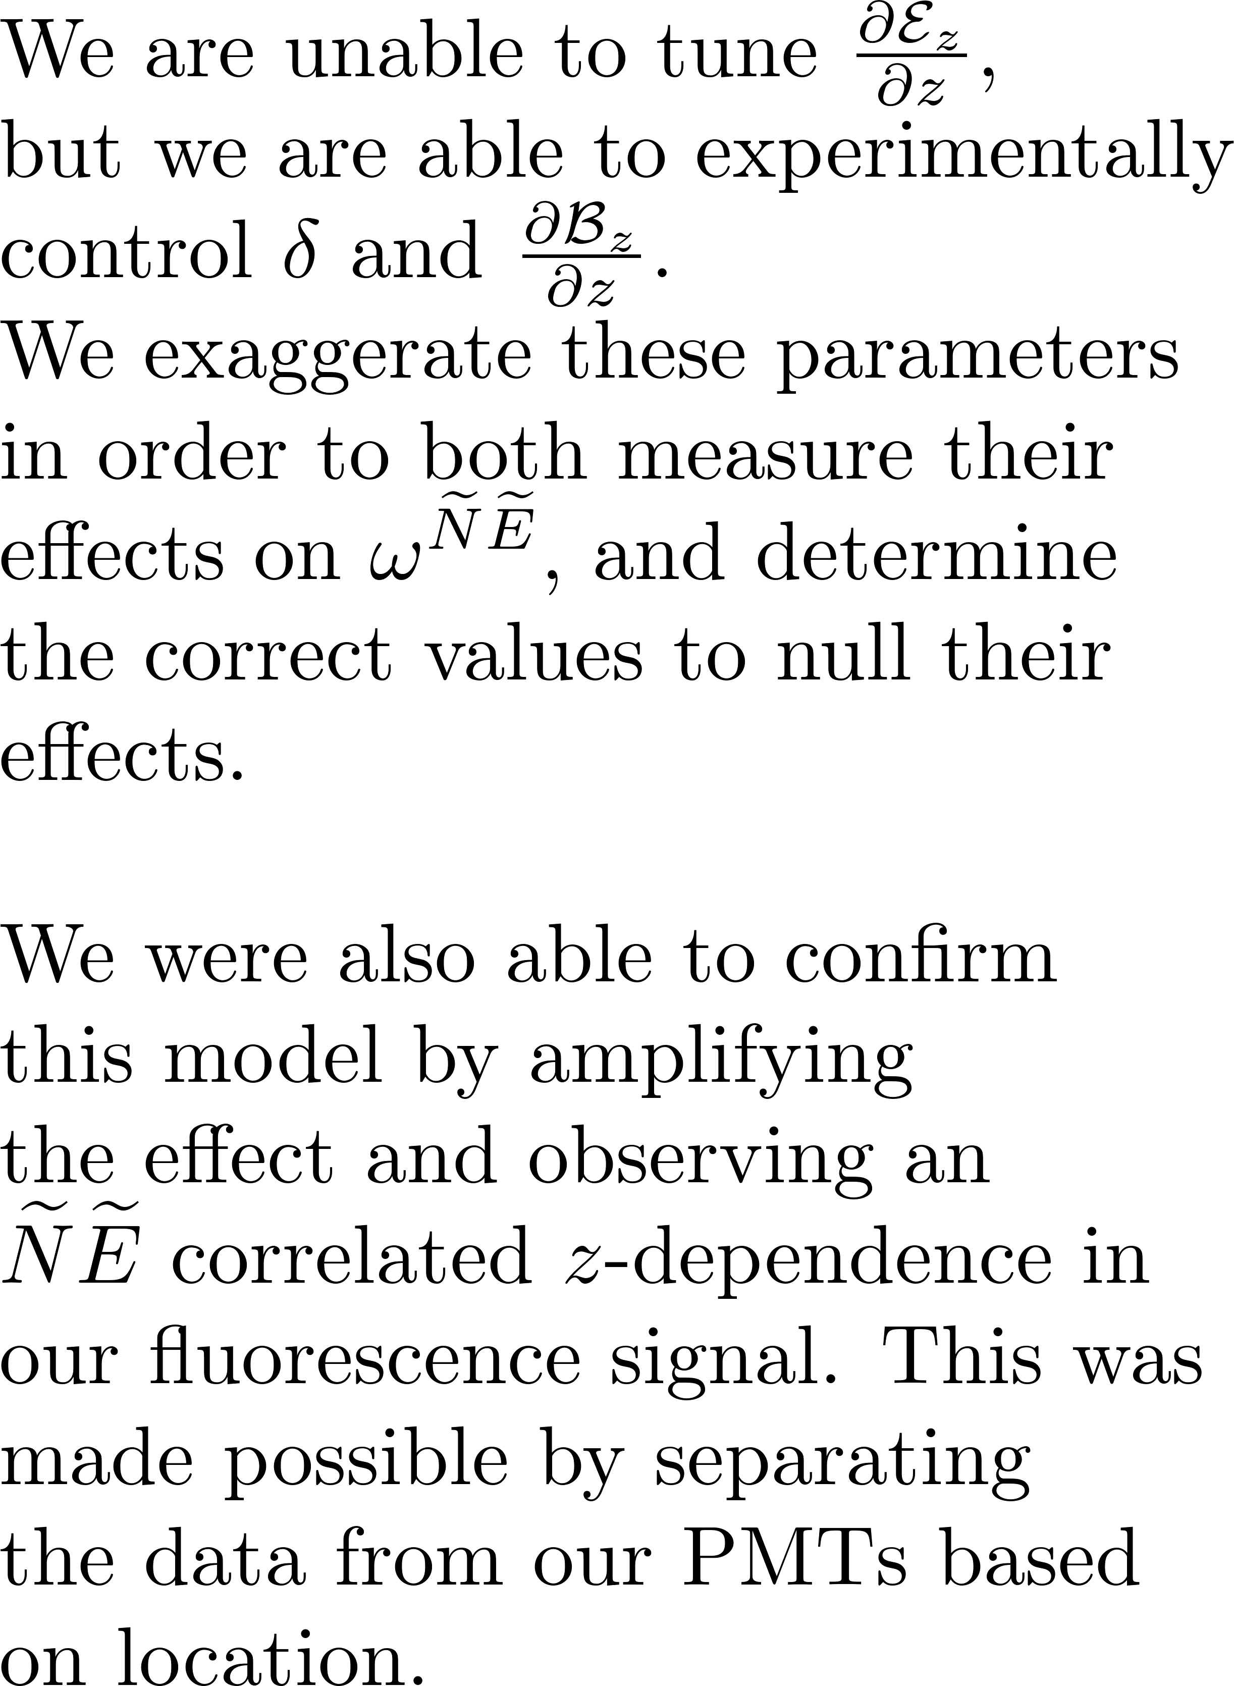
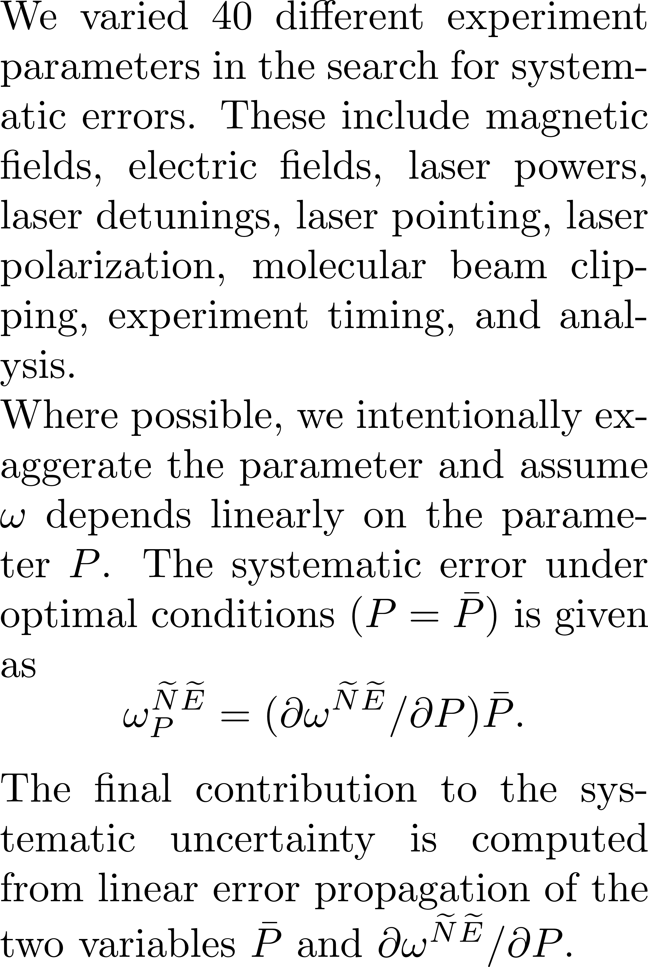
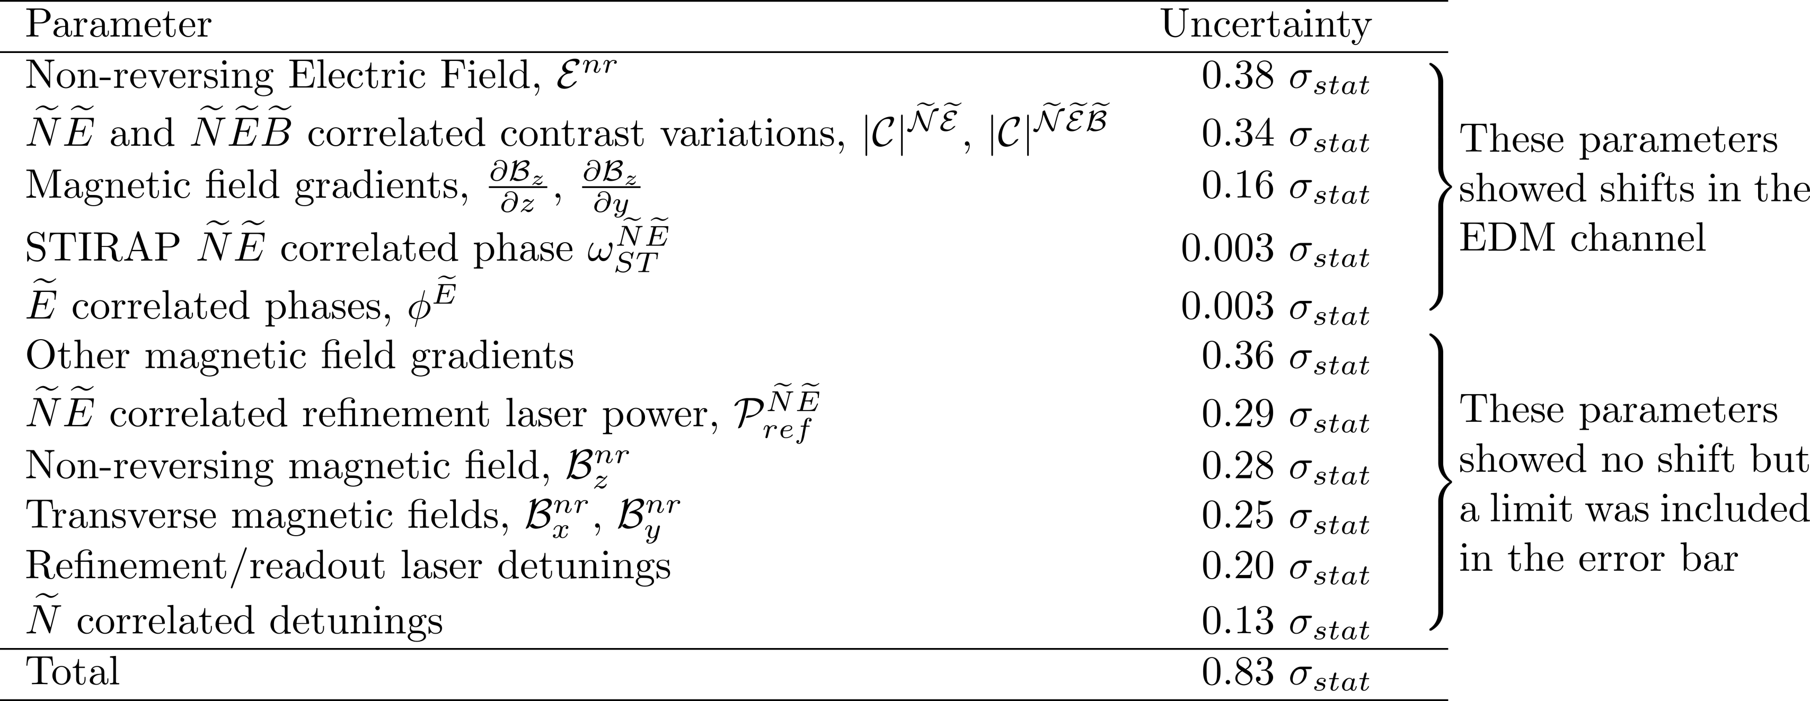
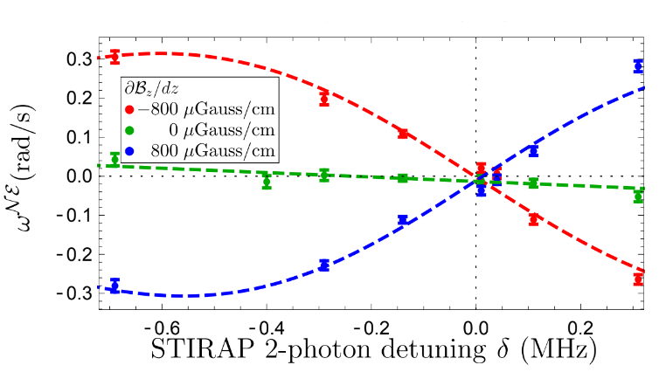
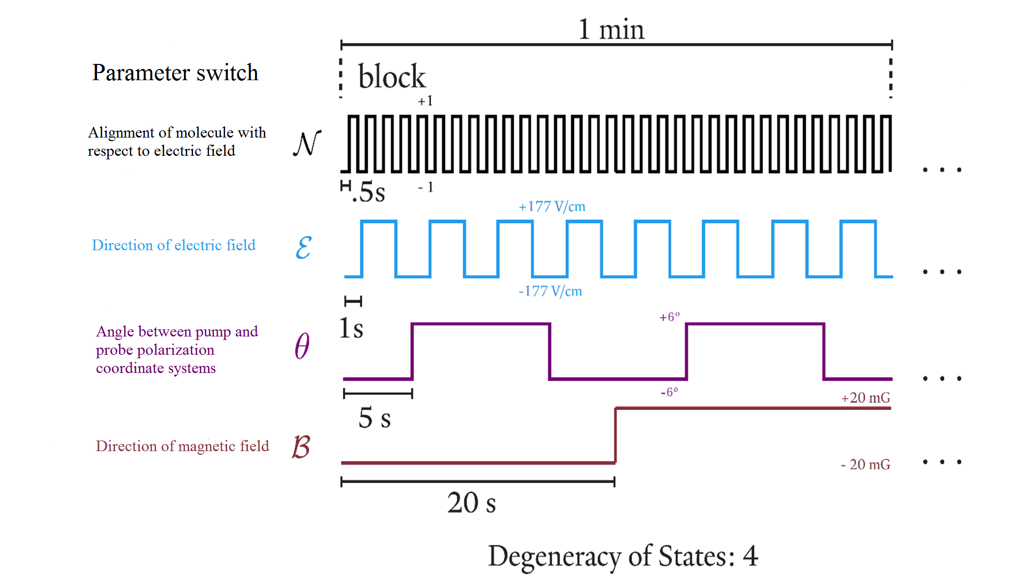
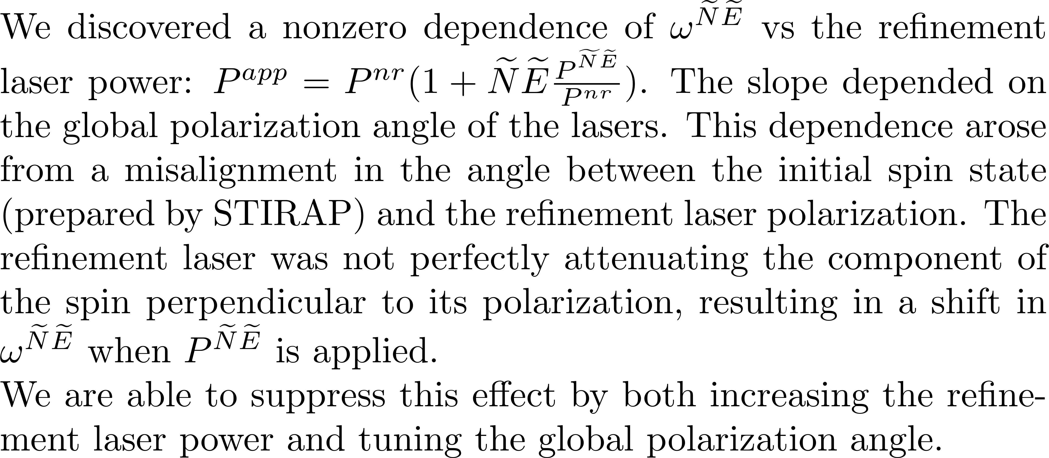
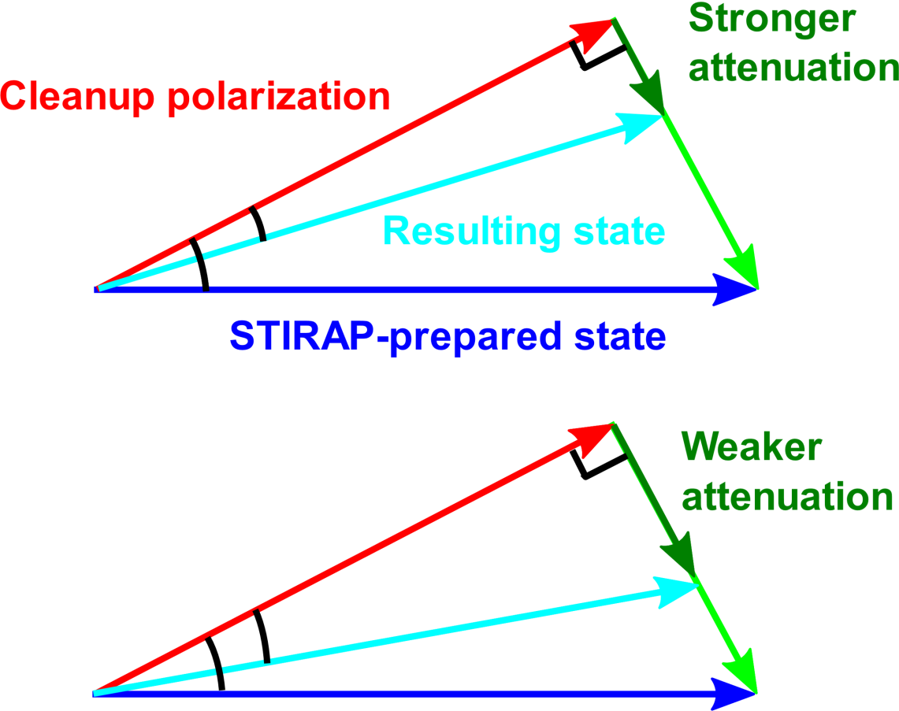
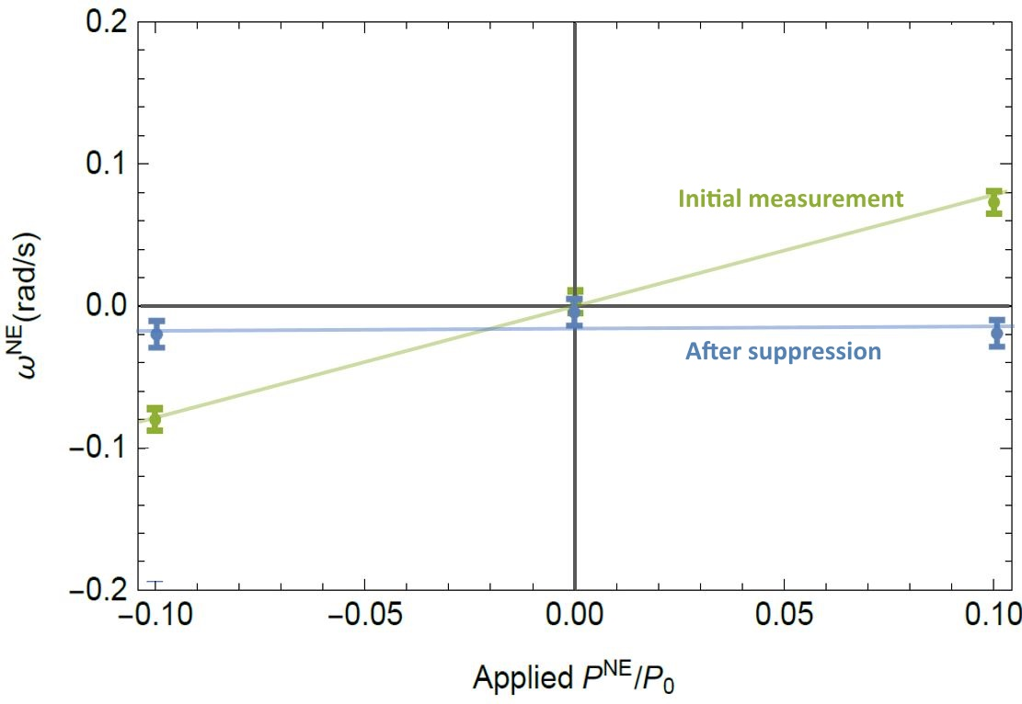
Order-of-magnitude improvement in the limit on the electron electric dipole moment
ACME Collaboration: Vitaly Andreev, ¹ Daniel G. Ang,¹ David DeMille² (PI), John M. Doyle¹ (PI), Gerald Gabrielse¹ (PI), Jonathan Haefner,¹ Nicholas R. Hutzler, ³ Zack D. Lasner,² Cole Meisenhelder,¹ Brendon R. O’Leary, ² Cristian D. Panda,¹ Adam D. West,² Elizabeth P. West,¹ Xing Wu²
Affiliation: ¹Harvard University, ²Yale University, ³California Institute of Technology
Motivation & Theory
ACME II Apparatus
Example Systematic 2: Non-reversing Electric Field Gradients Coupling to Magnetic Field Gradients and Laser Detunings
$$S$$
$$d_{e}$$
Permanent EDMs violate T-symmetry.
Many theories beyond the Standard Model predict T violation and EDMs at current experimental precision.
$$H_{d}=−{\vec{d}}_{e}⋅\vec{ℇ}$$
$$d_{e}$$
$$T$$
3.
$$S$$
This
work
4.
5.
1.
2.
Probing for new particles with $φ_{CP}\sim 1$ at
$≈$4 TeV (stop mass, 2-loop)
to $≈$25 TeV (selectron mass, 1-loop)
SUSY particle bounds from this result.
Fig. from Matt Reece (unpublished).
ACME III proj. $(\sim {10}^{−30} e⋅$cm) dashed.
Key EDM results since 2010. Two-loop sensitivity from Nakai & Reece (2017).
One-loop sensitivity from Feng (2013). LHC scale gives stop mass sensitivity.
4.
5.
1.
2.
3.
$$δd_{e}=\frac{ℏ}{2Cτℇ_{\text{eff}}\sqrt{\dot{n}T}}$$
Data Acquisition Structure
Contributions to the Systematic Uncertainty
Outlook
Example Systematic 1: Correlation Between Prepared Phase and Laser Power
References
ACME I result: J Baron et al., Science 343, p. 269-272 (2014)
ACME I detailed report: J Baron et al., New J. Phys. 19 (2017)
STIRAP state preparation: C.D. Panda et al., Phys. Rev. A 93, 052110 (2016)
Previous eEDM Limit: J. J. Hudson et al., Nature 473, 7348 (2011)
E_{eff} Calculations: L. V. Skripnikov et al., J. Chem. Phys. 142 024301 (2015), T. Fleig et al., J. Mol. Spec. 300 p. 16-21 (2014)
EDM & SUSY: J. Feng, Annu. Rev. Nucl. Part. Sci., 63:351-82 (2013), Y. Nakai, et al., J. High Energy Phys. , 2017:31 (2017)
EDM frequency
More information: www.electronedm.info

