Slide 1





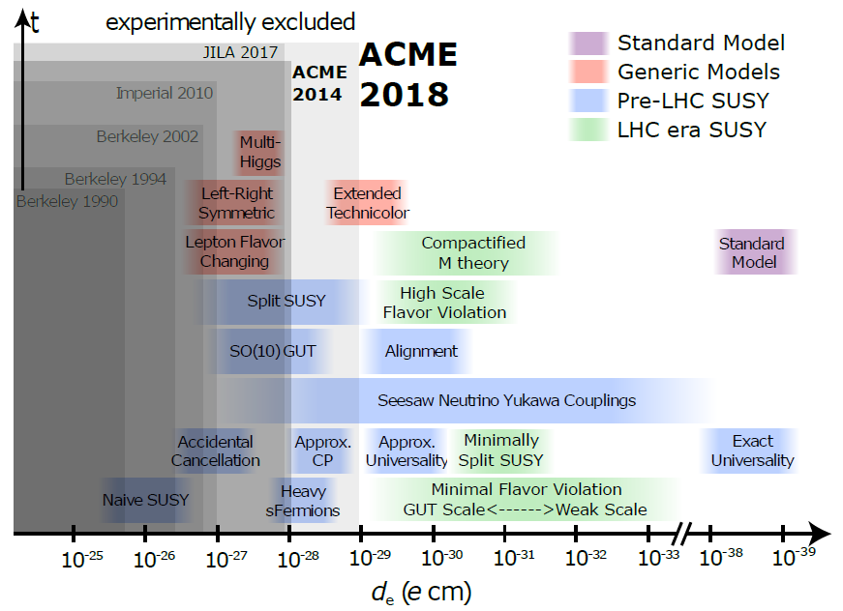
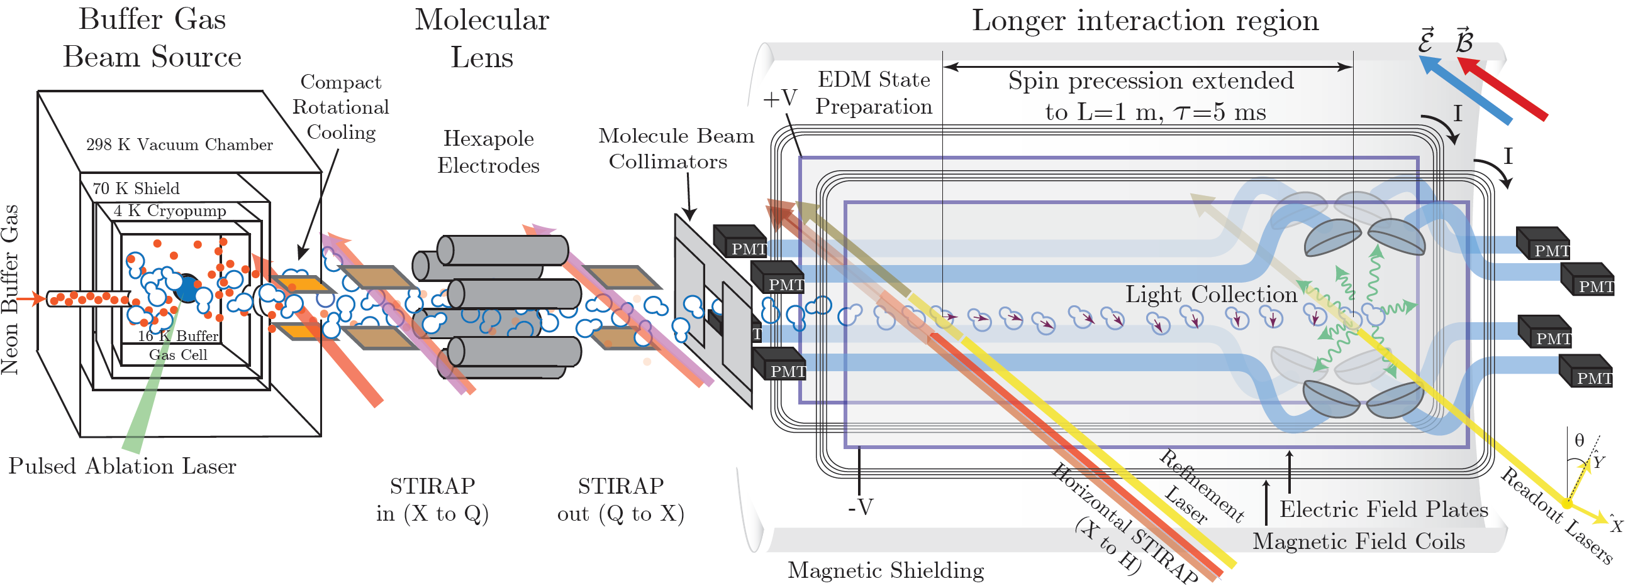
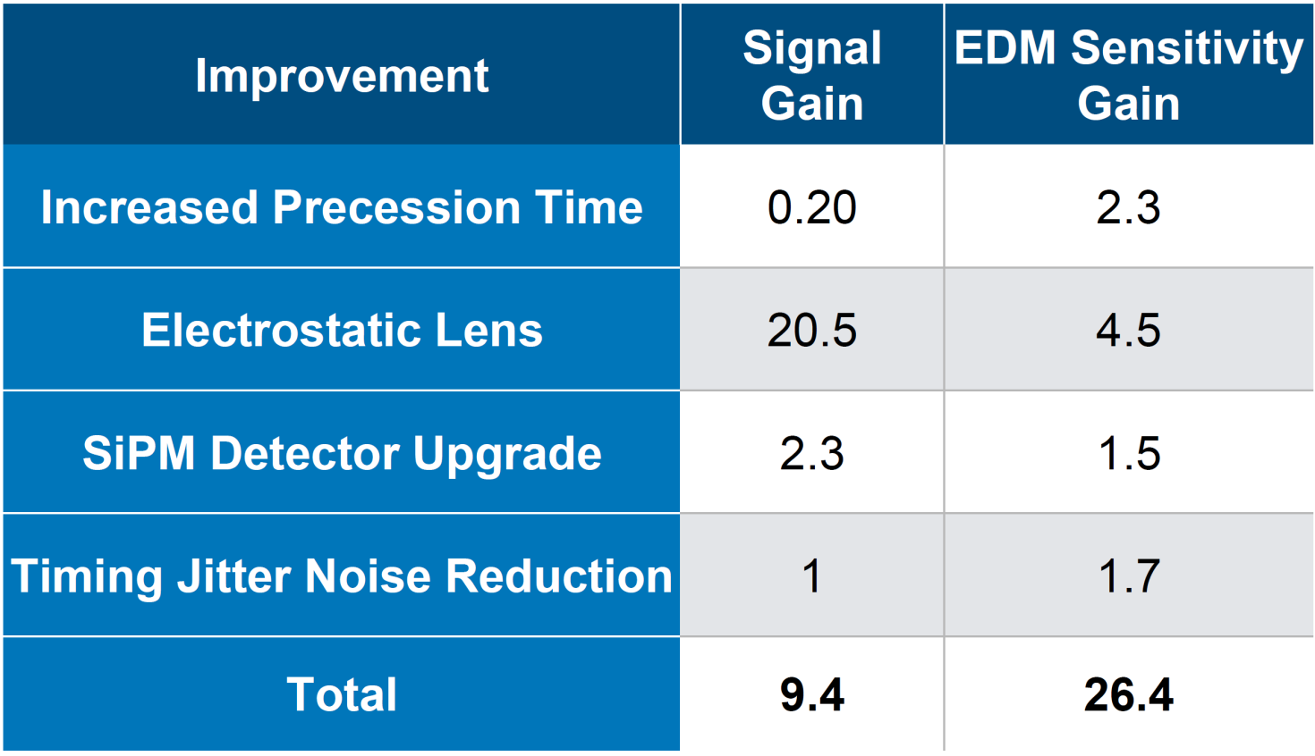
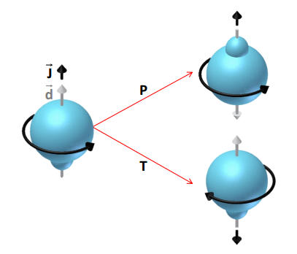
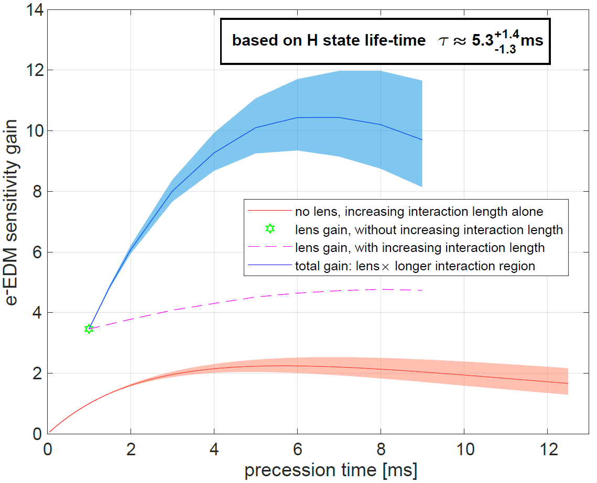

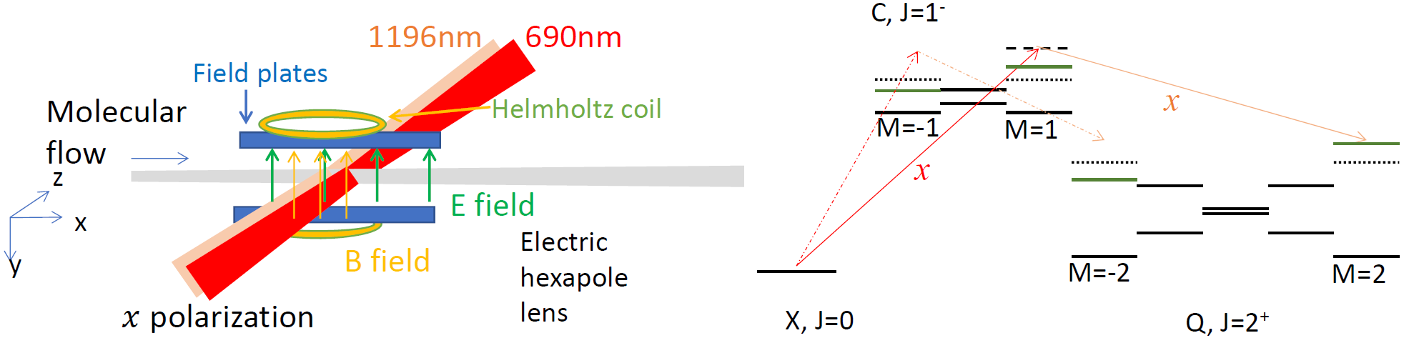
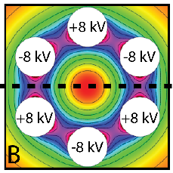
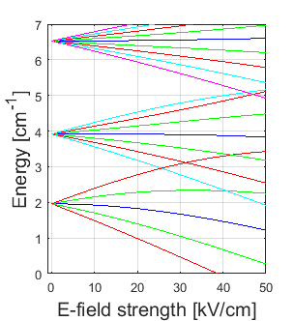
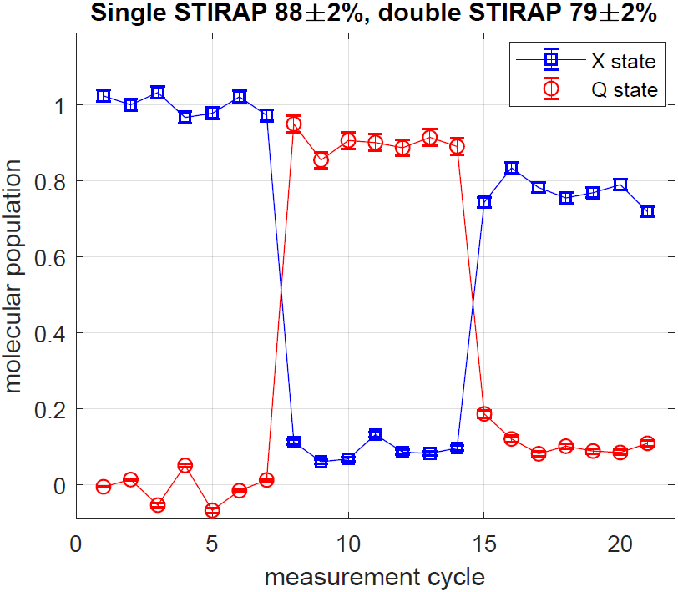
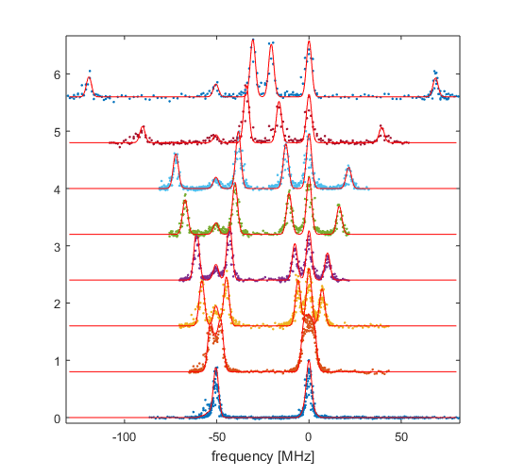
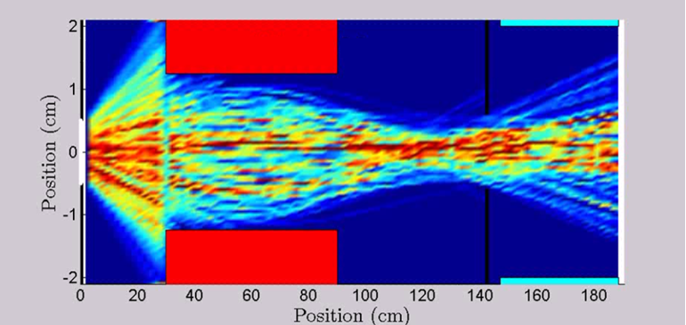
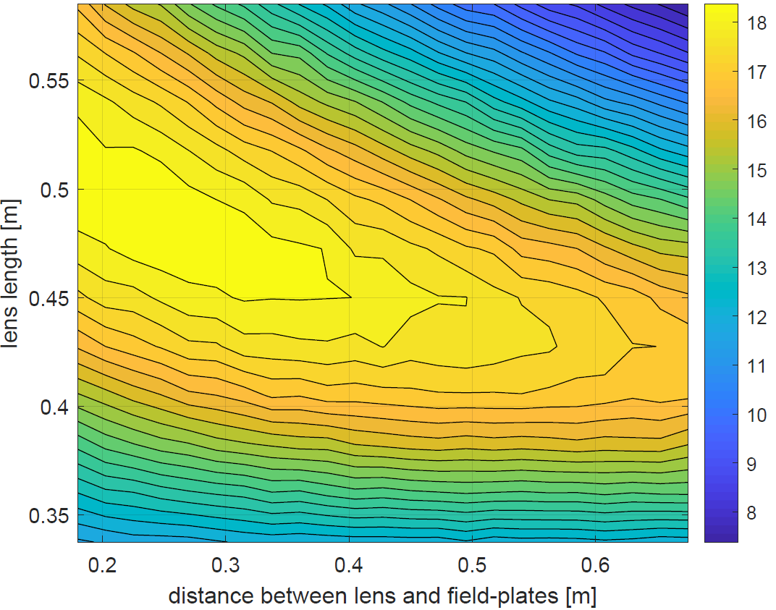
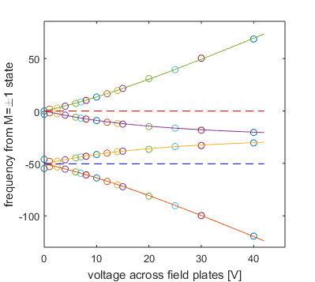
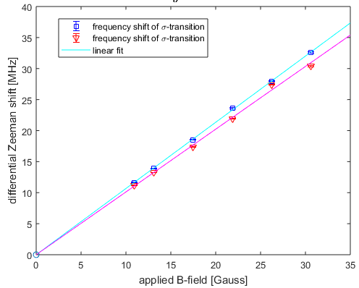
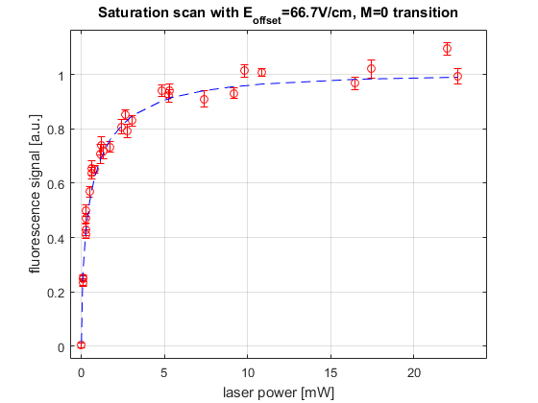
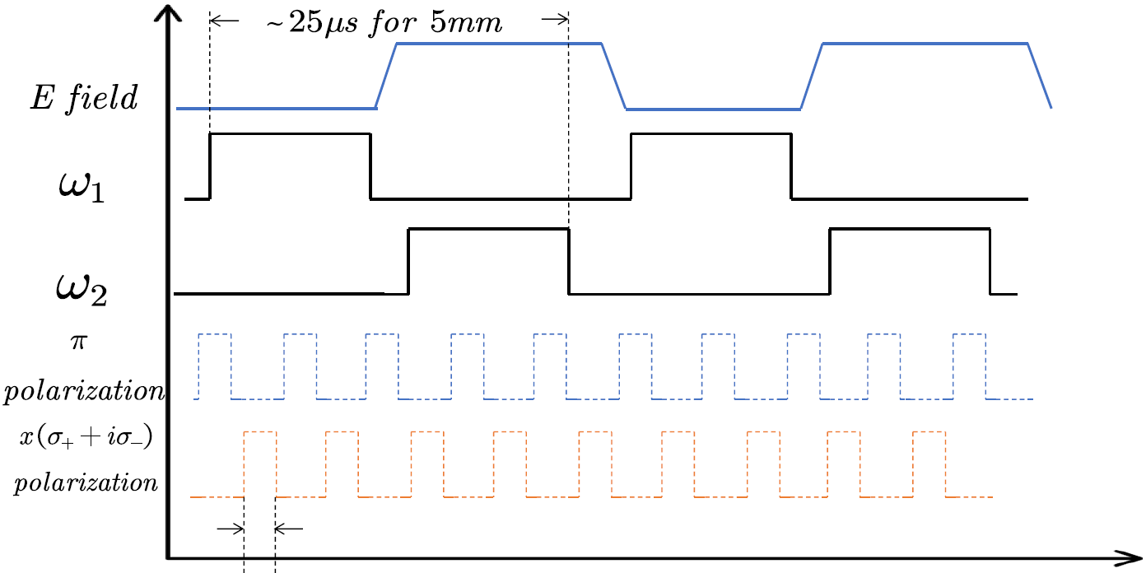
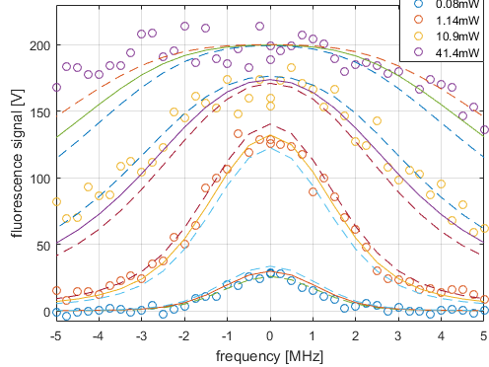
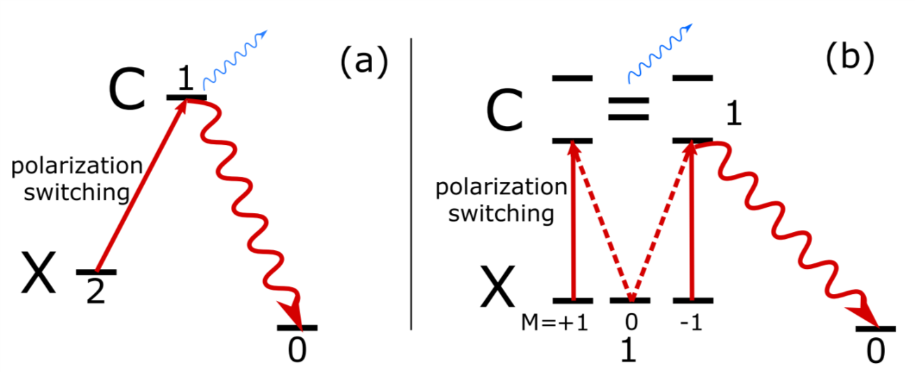
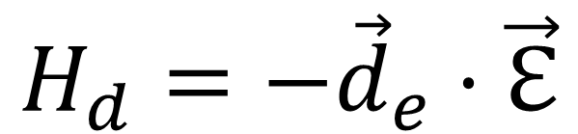


Upgrading the ACME Electron Electric Dipole
Moment (e⁻EDM) Search with a Molecular Lens
ACME Collaboration:
Xing Wu^{1,2}, Daniel Ang¹, Cole Meisenhelder¹, James Chow², David DeMille², John Doyle¹, Gerald Gabrielse³, Nicholas Hutzler⁴ , Zhen Han², Cristian Panda¹
Affiliation: ¹Harvard University, ²Yale University, ³Northwestern University, ⁴California Institute of Technology
Motivation
ACME Gen III overview
Proposed sensitivity improvement
$$H_{d}=−{\vec{d}}_{e}⋅\vec{ℇ}$$
A permanent electric dipole of a fundamental particle violates both T- and P-symmetry
Sensitivity gain vs. interaction length
Many theories beyond the Standard Model predict T-violation and associated EDMs at current experimental precision
eEDM sensitivity of ACME II is at ~4x10⁻³⁰ e•cm.
We optimize the sensitivity by maximizing the detected molecule number
Property of Q (³∆₂) state of ThO
— Use Q state to increase molecule flux & suppress systematics
Increase useful molecule flux with beam focusing
Demonstrate ‘double’ STIRAP between X and Q (³∆₂) state of ThO
ThO energy levels and
transitions
Q state:
Paramagnetic, g_{Q} ≈ g_{L} Λ + g_{S} Σ = 2, compared to g_{H} =4.4x10⁻³ & g_{X} <10⁻³ allows magnetic lensing & co-magnetometer
Long lived (measured lifetime bound >98 ms)
Linear Stark shift due to Ω-doublet (<<100kHz) , efficient electrostatic lensing
H state: for EDM measurement
X-C-H STIRAP: EDM state preparation
I state: read out via 512nm LIF detection
Molecules exiting the beam source have high divergence – solid angle subtended by EDM measurement region ~0.05% in ACME II, and worse for longer interaction region
Lensing-state of ThO: X-C-Q STIRAP to a single M=2 or -2 level in Q (J=2) state
Scheme to prepare single M level in Q
512nm
~91%
I
$$\sim$$
Main challenges:
In a molecular beam: extended spatial and velocity distribution
For molecular lens to work effectively, need to cover Δv_{tran} = ± 10m/s, i.e. FWHM 2-photon linewidth of 6MHz
Complex ambient E and B field environment
Need efficient STIRAP both before and after the Lens!
703nm
690nm
C (77% ¹$Π$, 20% ³Π)
Electric hexapole lens
DC Stark shift of Q state
~75%
1090nm
1196nm, ~10%
Electrode voltage 22.5 kV, .75” radius: ≈1.8K trap-depth
Control and minimize possible X-ray production
Expect factor of ~15 increase in signal (molecular flux)
+
-
D_{Q}=4.1D from measurement
Q (95% ³∆)
-
H (98% ³∆)
+
-
+
Preliminary data on 2-photon
linewidth
X (¹Σ⁺)
E
1.8 K trap-depth
at 35.4kV/cm
Very first signal of double STIRAP between X and Q state, using M=0 sublevel
efficiency
│Ω│
Characterization of Q—C transition
C state:
Quadratic Stark shift
Trajectory simulation for molecular lens design
Differential Stark shift of Q—C transition
J=1
50.4MHz
π
Molecular flux enhance for ACME II interaction length
X-C-Q
STIRAP
Q-C-X
STIRAP
Fluorescence [a.u.]
65 V/cm
Q state:
J=2
40 V/cm
Linear
Stark shift
M: -2 -1 0 +1 +2
25 V/cm
20 V/cm
σ transition of C⁻ branch
σ transition of C⁺ branch
13 V/cm
10 V/cm
Minimize the distance between source and Lens entrance, to increase the spatial acceptance into Molecular Lens
Necessary to cover 15MHz FWHM Doppler distribution. Spectrally broadened by mixing 90 sidebands at 330kHz spacing (natural linewidth of C state).
Single optical path for both rotational line, switch between frequencies, E field, and polarizations
4 V/cm
Simulation of molecule focusing with electrostatic lens. Red is lens, black is collimator
Compact rotational cooling stage
0 V/cm
Large electric & magnetic dipole
Increase quantum efficiency
Extracted molecule
frame dipole:
D_{Q}=4.07D (Q state), D_{C}=2.60D (C state)
From Zeeman shift measurement:
G_{Q}=2.06µ_{B}, G_{C}=1.22µ_{B}
Silicon photomultipliers (SiPMs) for more efficient fluorescence detection
PMTS ~25% efficient. SiPMs ~ 50%, giving factor ~2 increase in signal
Challenge: large dark current, large capacitance (slow), unstable gain
Solution:
R(2)
E-field OFF
E-field ON
large-area SiPM array
Q(1)
J=1
J=1
Strong transition dipole to C state
Custom high-gain, low-noise, high-bandwidth amplifiers
moderately low temperature (-20 Cº) suppresses dark current sufficiently
with nonimaging optical concentrator (Winston cone)
dynamically adjust bias voltage and temperature for stable gain
Power saturation scan of Q—C transition: D_{Q—C} = 1.0±.12 D
J=2
J=0
J=1
J=0
2μs

