Slide 1
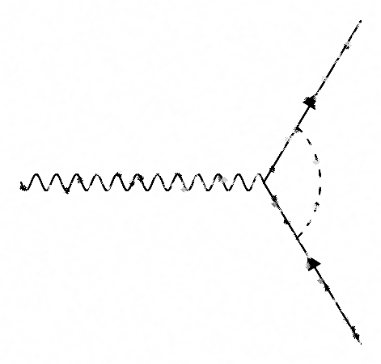
Electron EDM is measured
10⁵ more precisely than
Electron g-factor
Xing Fan
Research Assistant Professor
Northwestern University

Slide 2

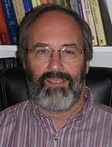
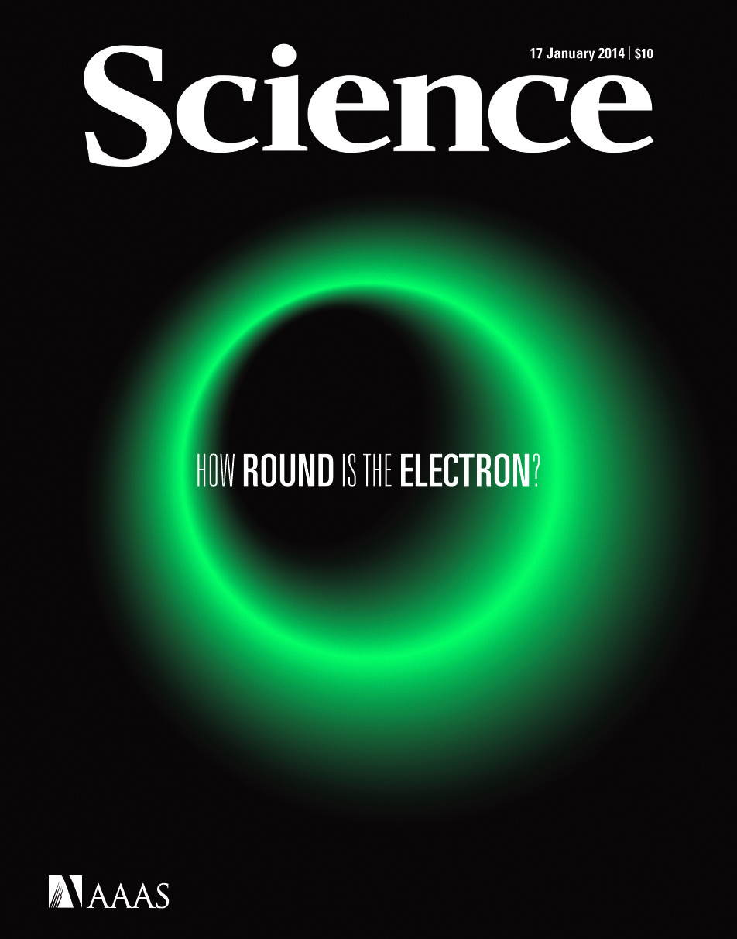
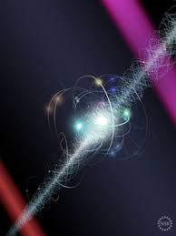
Who am I?
Undergrad and Master
PhD
Postdoc
M. S. 2016
the University of Tokyo
particle physics group
PhD. 2017-2022
Jerry Gabrielse
electron g-factor
the ACME
electron EDM collaboration
Nature
ACME II
2018
ACME I result
2014

Slide 3
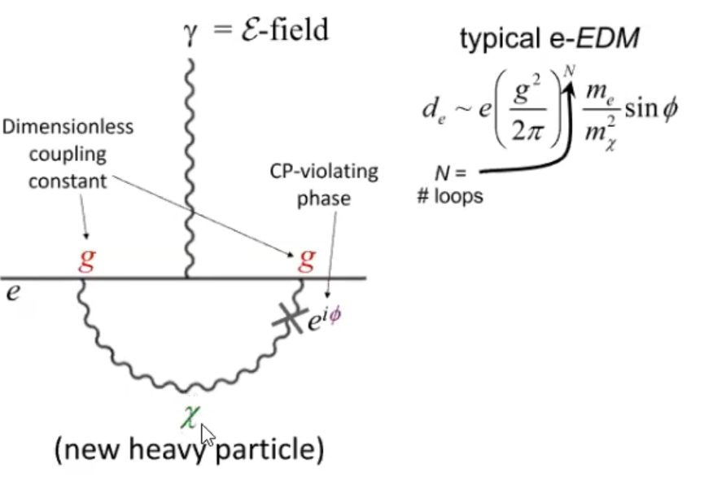
Dave’s slide: DAMOP 2023
isn’t this the same as the
g-factor diagram??

Slide 4


g-factor and electron EDM units
g = 2.002 319 304 361 18 (26) PRL 130, 071801 (2023)
ACME II |d_{e}|<1.1×10⁻²⁹ e•cm Nature 562, 355 (2018)
JILA II, |d_{e}|<4.1×10⁻³⁰ e•cm Science, 381,46 (2023)
How sensitively can you measure electron EDM?
yep! 10⁻³⁰ e•cm
I understand “e”, but what is “cm”?
it’s 1/10⁹ of the distance
from our planets’ North pole to equator.
10 is a good number because we have 10 fingers

Slide 5

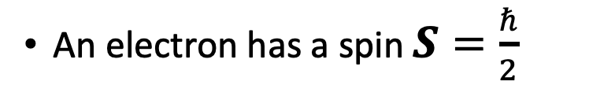
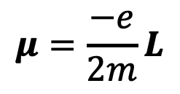
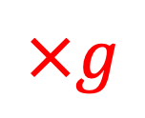
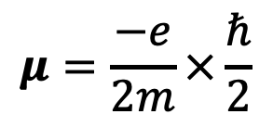
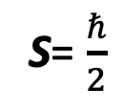
Magnetic Dipole Moment (g-factor)
N
Magnetic moment of an orbiting charge
angular
momentum L
e⁻
$$μ=\frac{−e}{2m}L$$
S
An electron has a spin $S=\frac{ℏ}{2}$
S= $\frac{ℏ}{2}$
e⁻
$$μ=\frac{−e}{2m}×\frac{ℏ}{2}$$
$$×g$$
?
g= 2.002 319 304 361 18 (26)
XF, et al, Phys. Rev. Lett. 130, 071801 (2023)

Slide 6
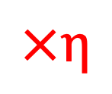
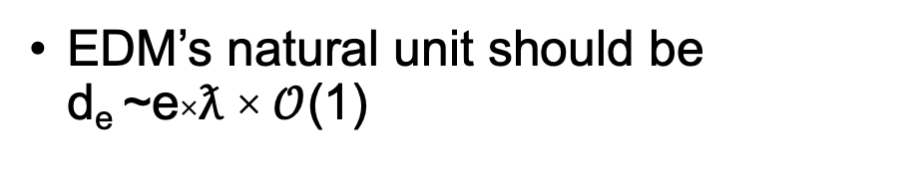
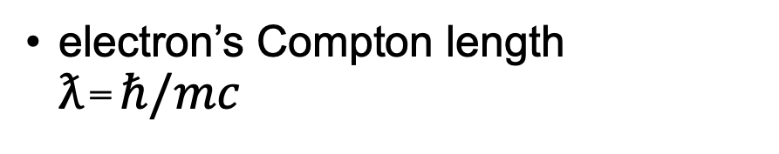
Electric Dipole Moment (EDM)
electron’s Compton length
ƛ=$ℏ/mc$
ƛ
EDM’s natural unit should be
d_{e} ~e×ƛ ×$𝒪$(1)
I take the last constant to be 1/4
(will explain the reason shortly)
unit: charge×length
$$×η$$
so, EDM should be expressed: d_{e}=eƛ/4=eℏ/4𝑚𝑐

Slide 7
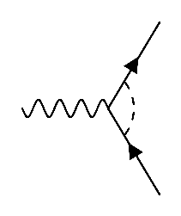
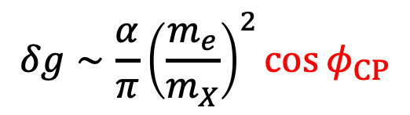
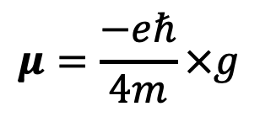
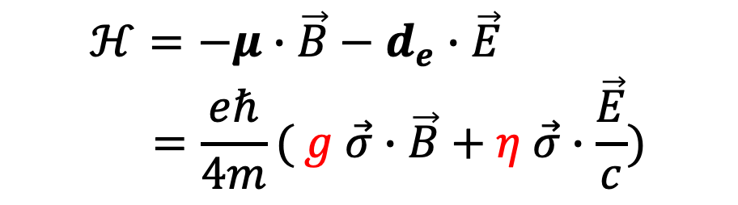
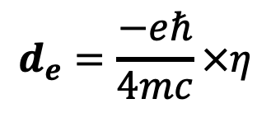
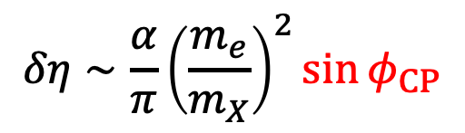
Why η?
$$μ=\frac{−eℏ}{4m}×g$$
$$d_{e}=\frac{−eℏ}{4mc}×η$$
spin
$$ℋ=−μ∙\vec{B}−d_{e}∙\vec{E} \\ =\frac{eℏ}{4m}( g \vec{σ}∙\vec{B}+η \vec{σ}∙\frac{\vec{E}}{c})$$
e⁻
naïve SUSY diagram
$$δg∼\frac{α}{π}{\left(\frac{m_{e}}{m_{X}}\right)}^{2}\cos{φ_{CP}}$$
Φ_{CP}
X
$$δη∼\frac{α}{π}{\left(\frac{m_{e}}{m_{X}}\right)}^{2}\sin{φ_{CP}}$$
e⁻

Slide 8
electron EDM History
atoms
molecules
electron g-2
equivalent
JILA
ACME
e⁻
Φ_{CP}
X
Science 343, 269 (2014) Phys. Rev. Lett. 119 153001
Nature 562, 355 (2018) Science, 381,46 (2023)
e⁻

Slide 9
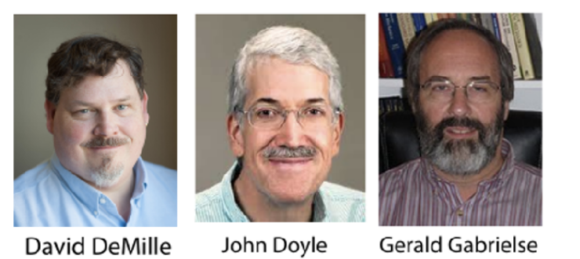




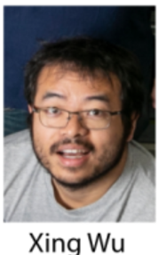
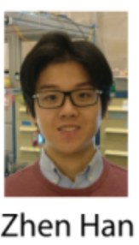
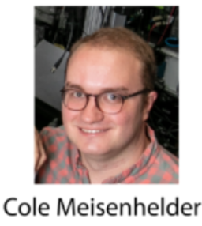


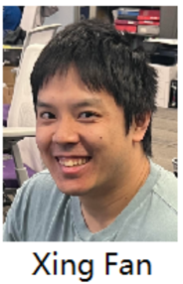




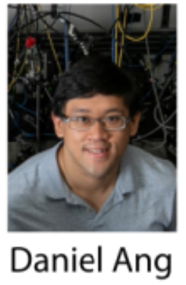



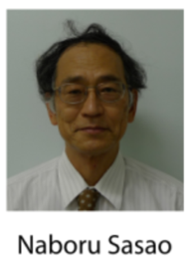

The ACME Collaboration

Slide 10

JILA’s View
ACME
JILA

Slide 11

ACME’s View
JILA
ACME

Slide 12
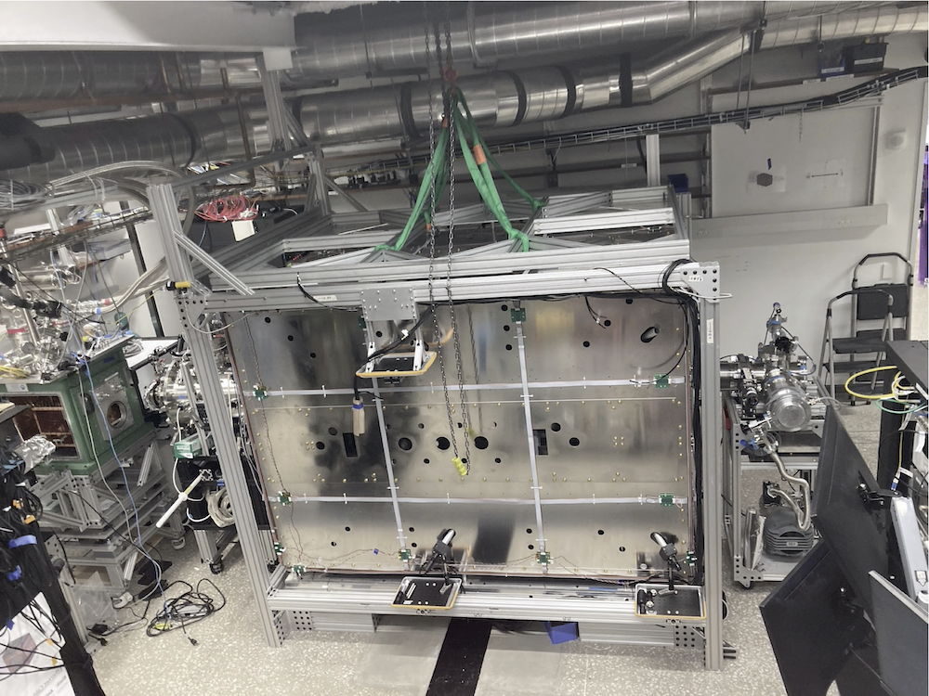
ACME III beamline at Northwestern Univ.
ThO
source
molecular
lens
magnetic shield
ThO
laser access
holes
2023 Jan
Already much more complicated

Slide 13
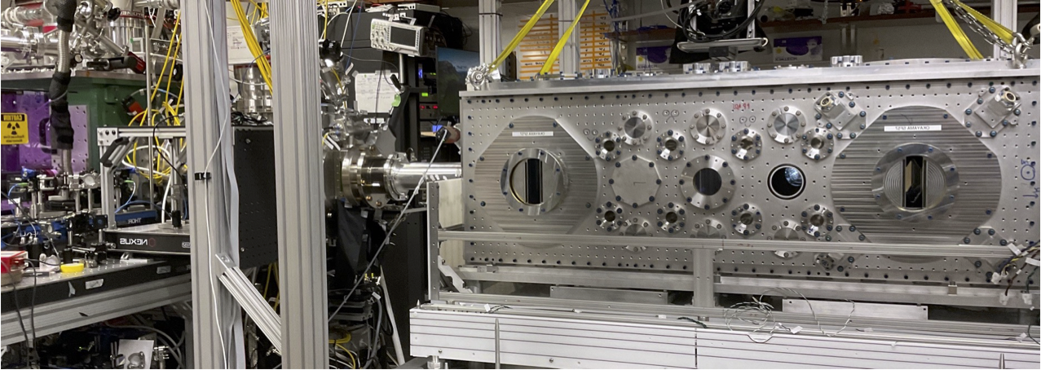
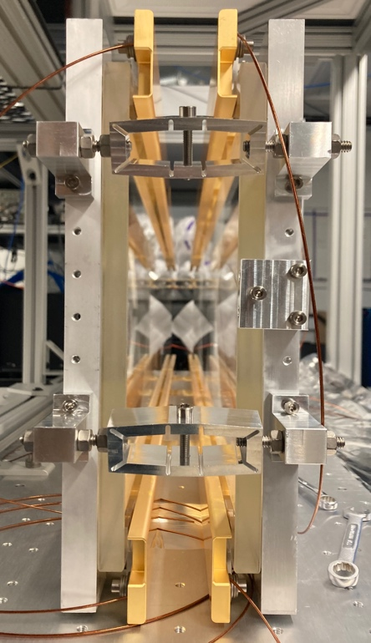
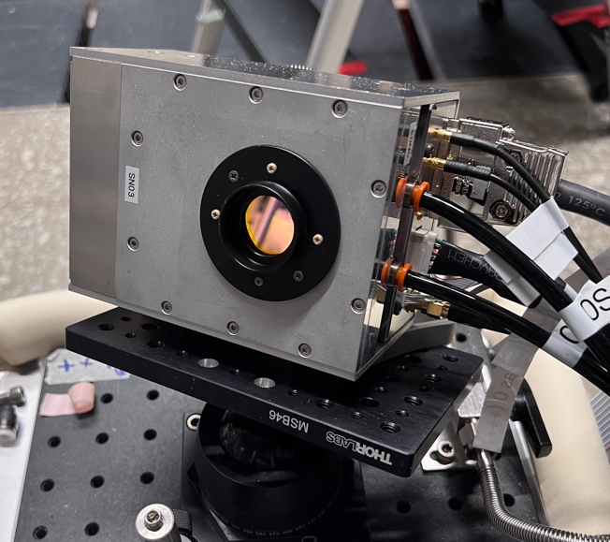
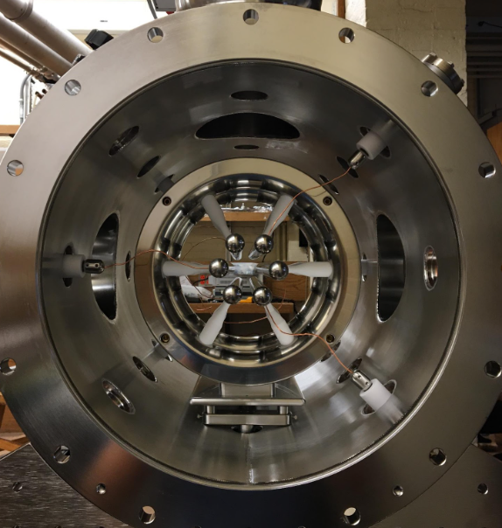
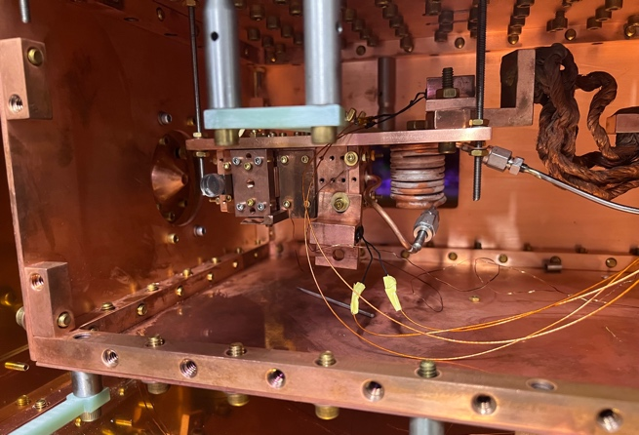
All Upgrades are ASSEMBLED
electric field plates
ThO
vacuum chamber
5 times longer than ACME 2
molecular lens
Silicon PhotoMultiplier
ThO source

Slide 14
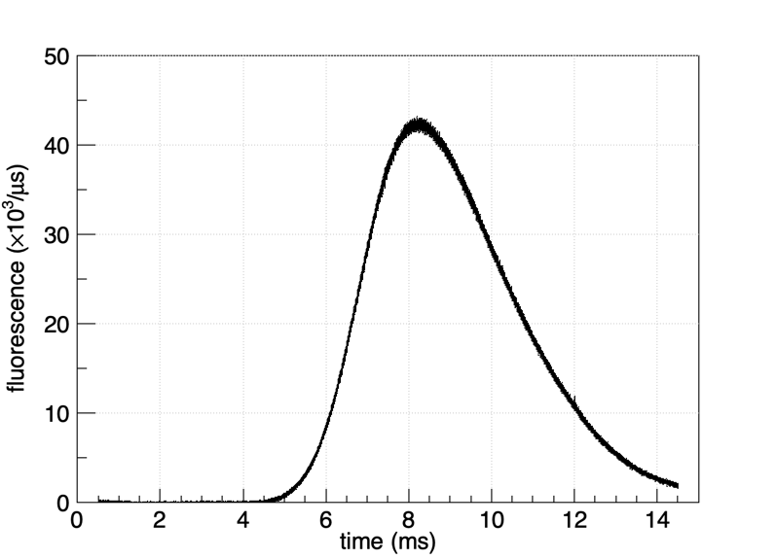
Birthday Gift from ACME team
x4 more than two weeks ago
x10 more than ACME 2
with 5 times longer τ
mainly from the lens
X Wu et al 2022
New J. Phys. 24 073043

Slide 15

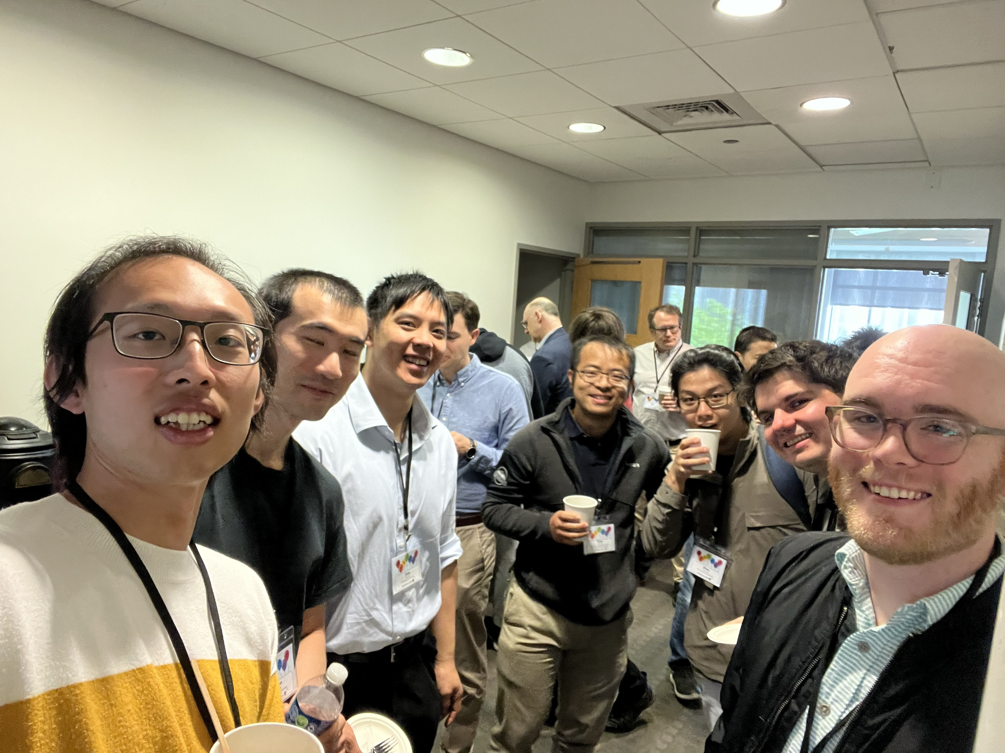
Happy Birthday
pictures for the next DeMilleFest

