Slide 1
Comb Spectra by HMP
CAUTION: Not every scan has the same resolution, vertical scale, etc!

Slide 2
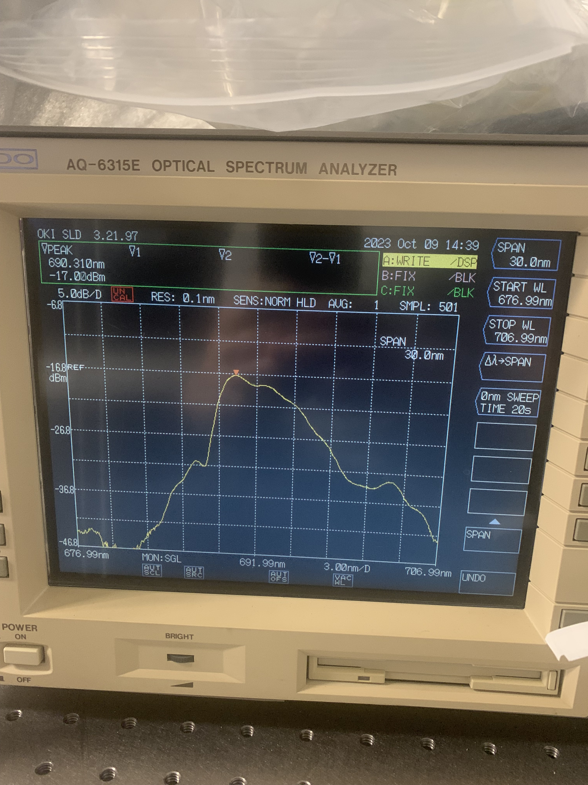
690 HMP

Slide 3
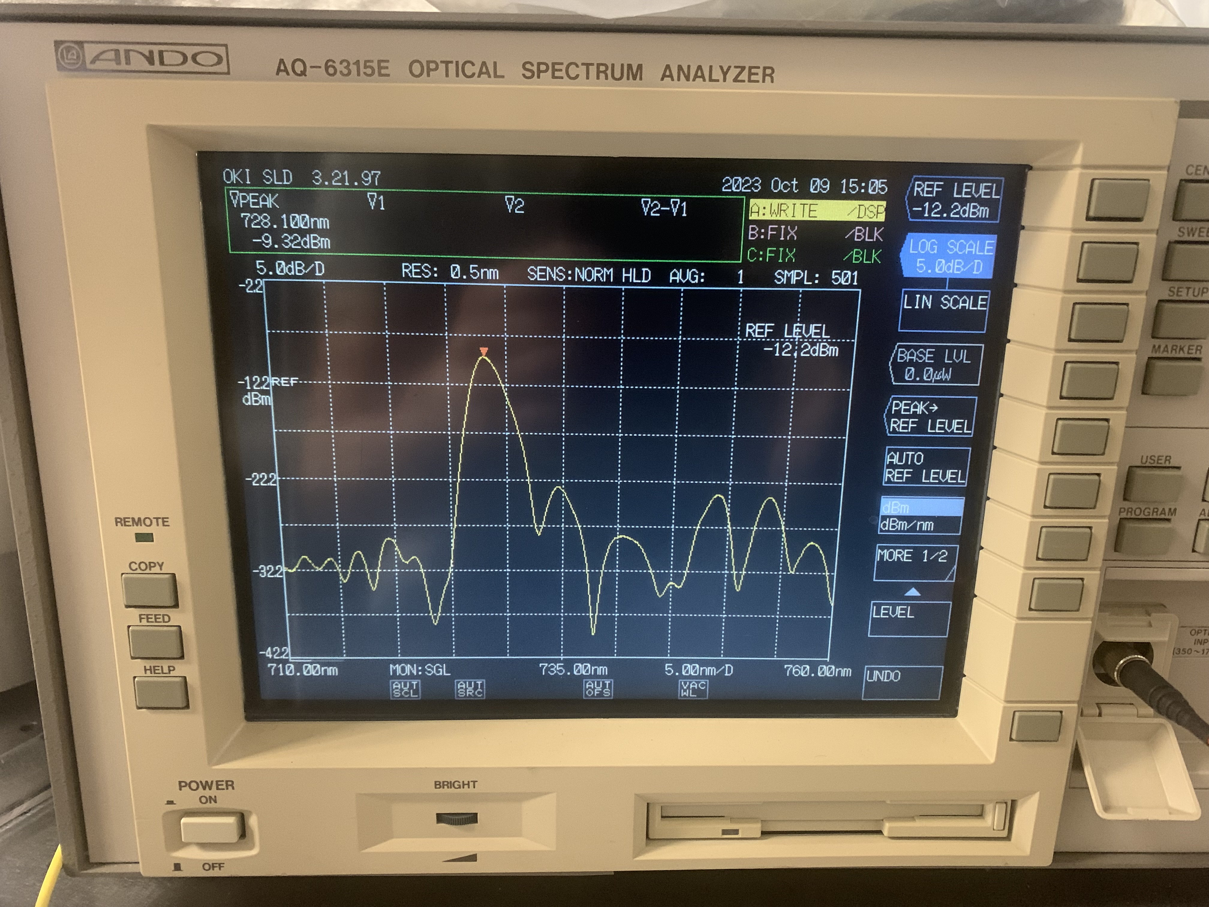
729 HMP

Slide 4
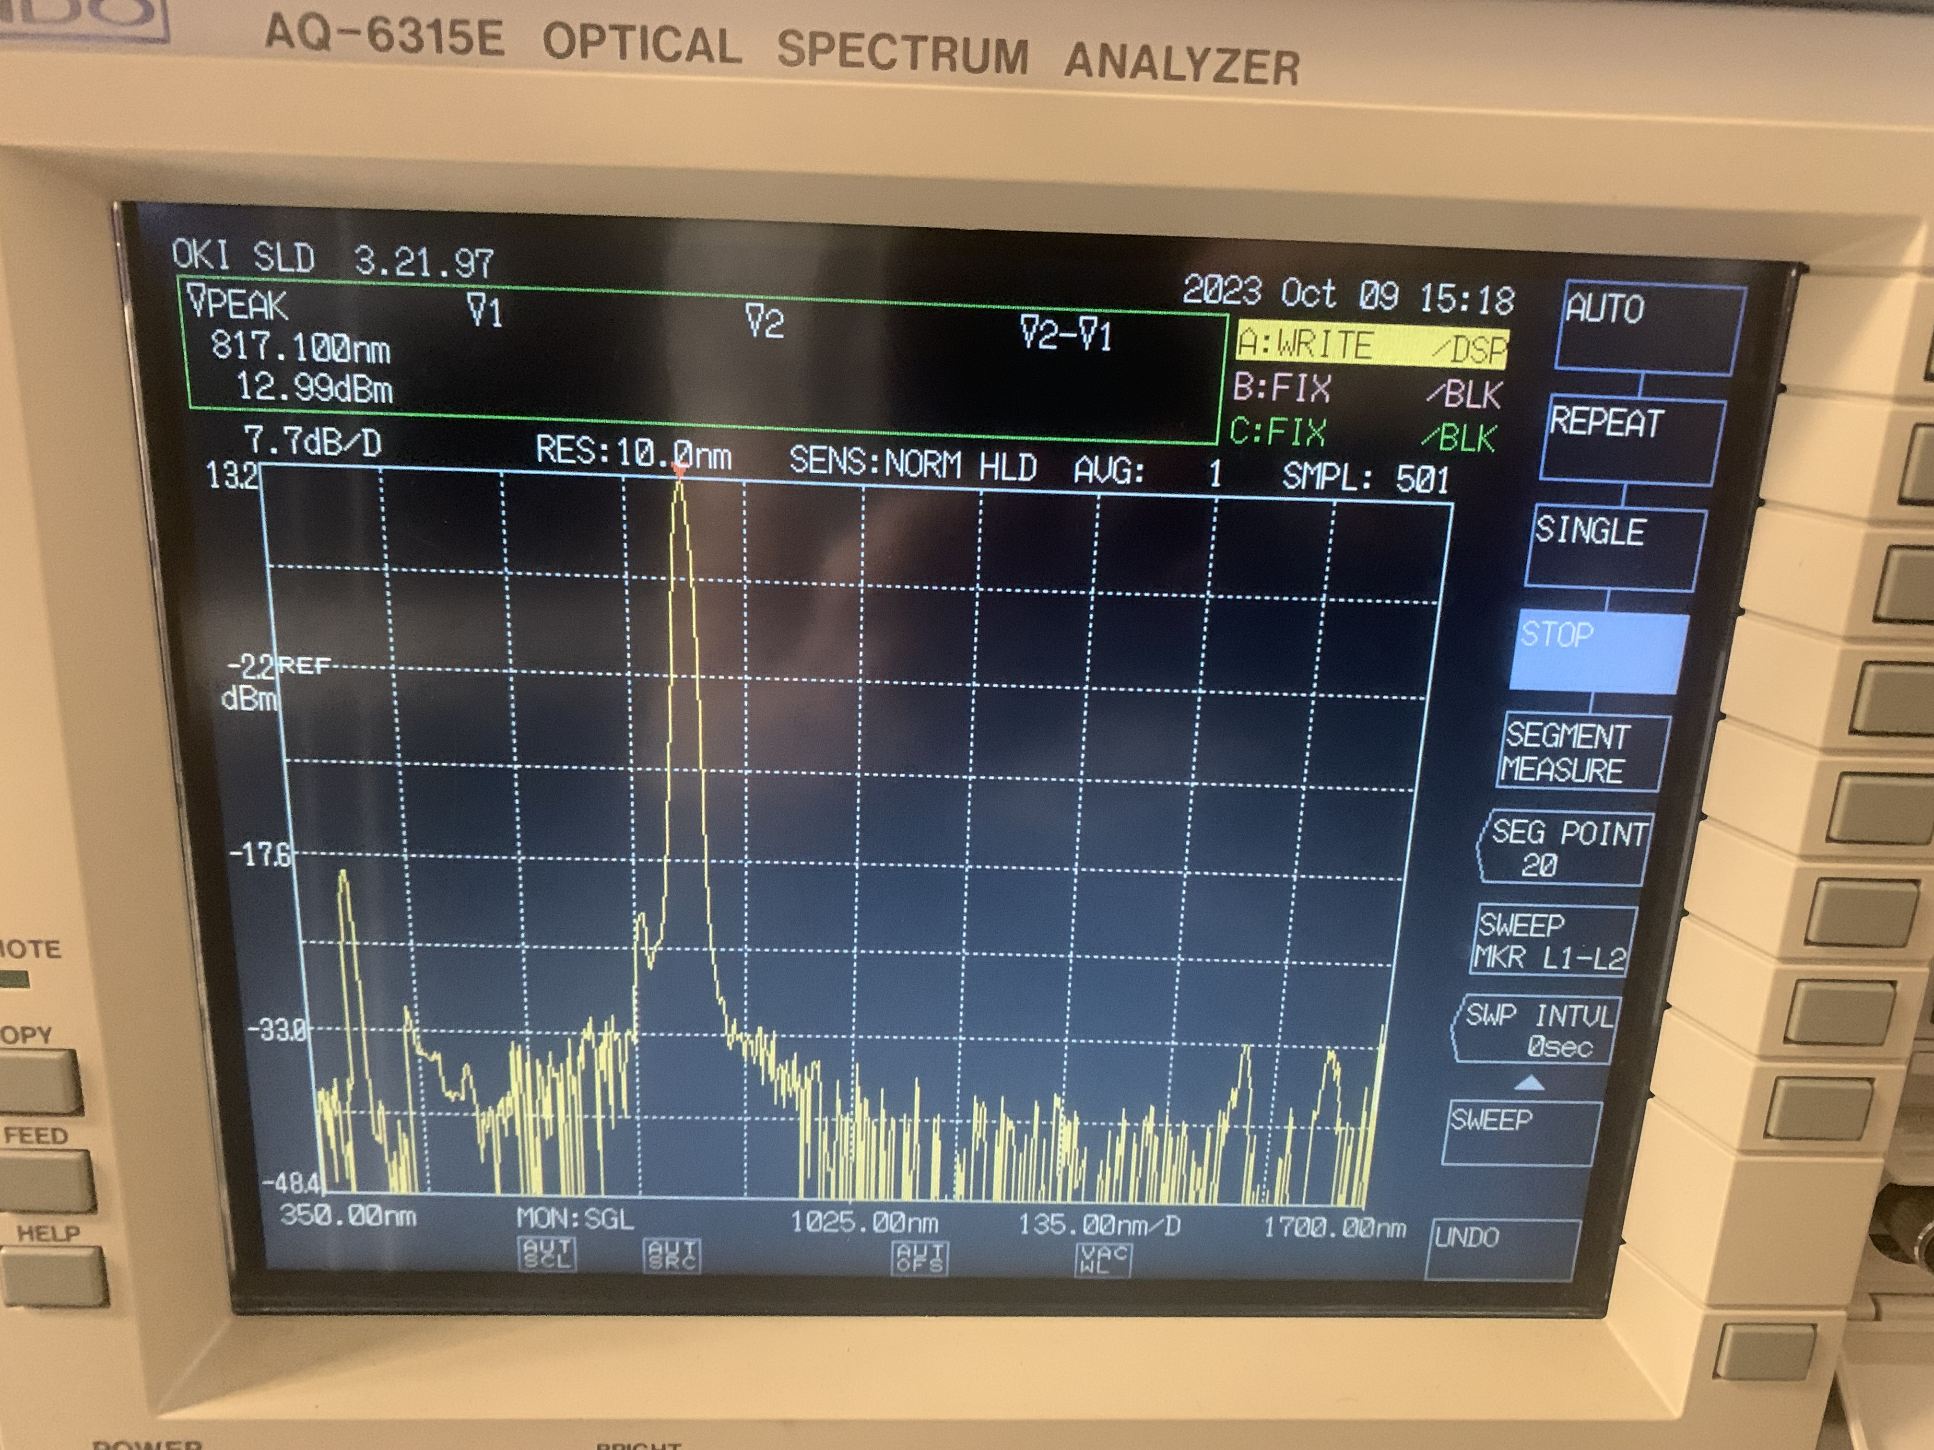
816 HMP

Slide 5
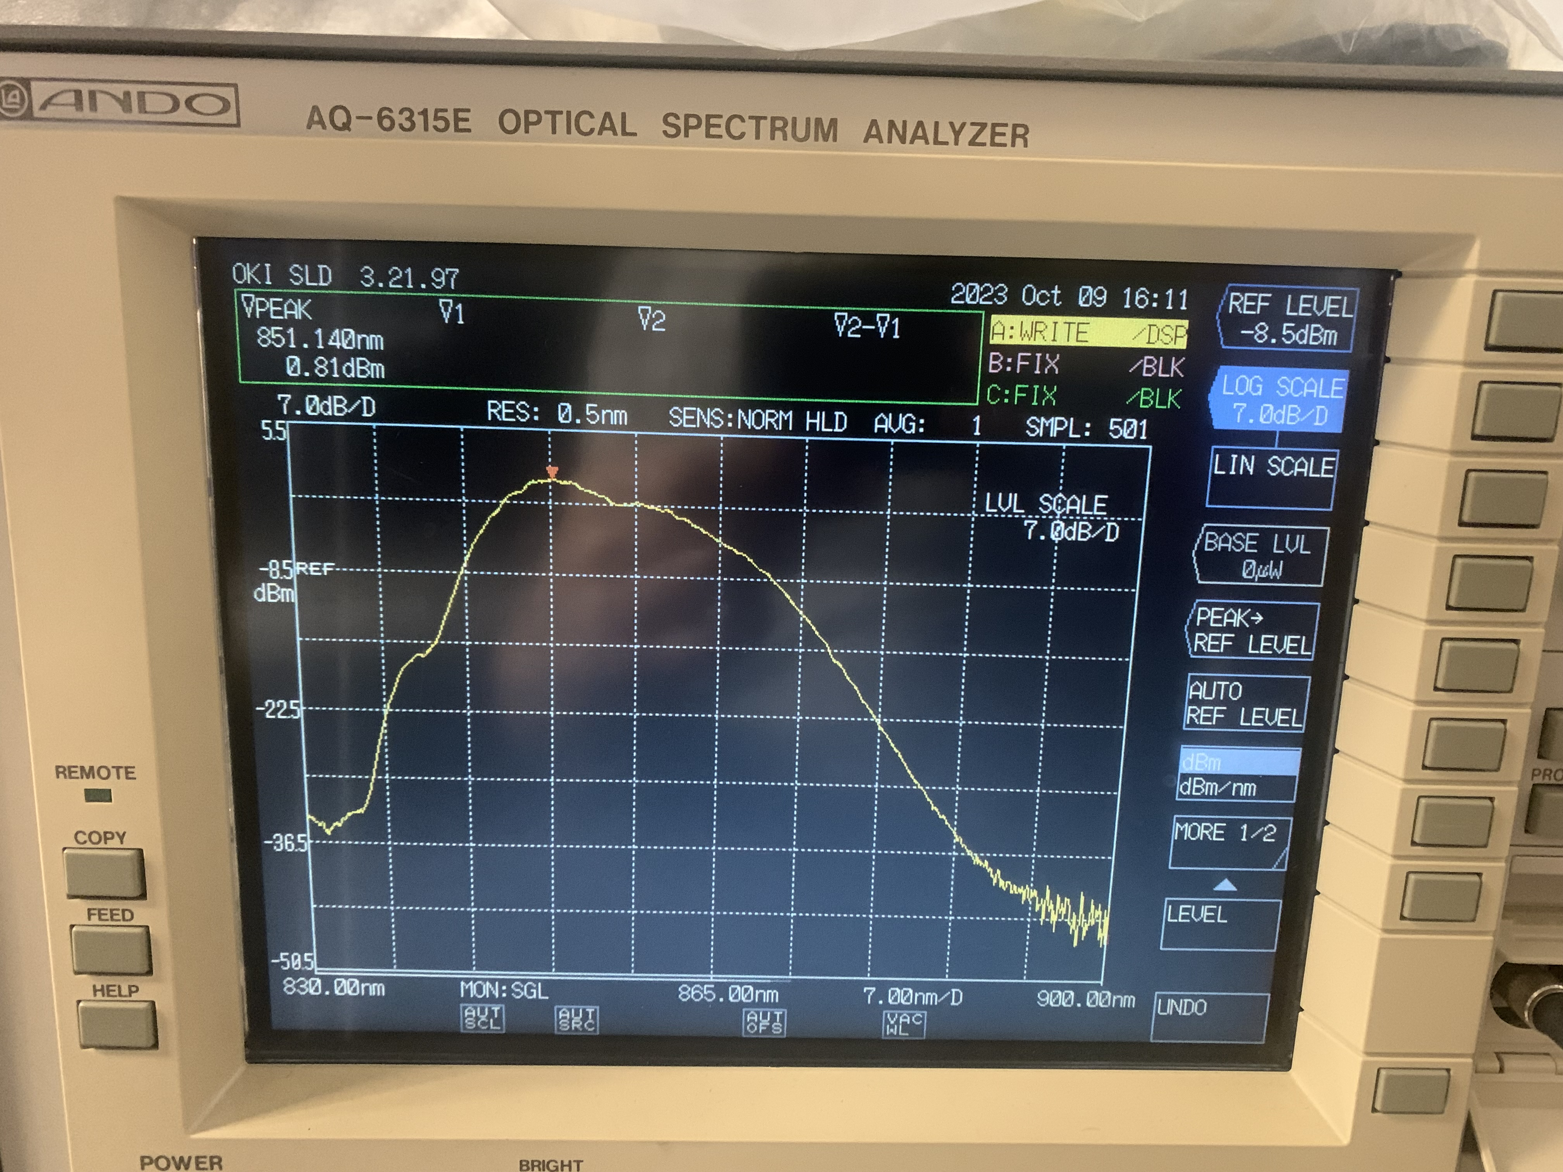
850 HMP

Slide 6
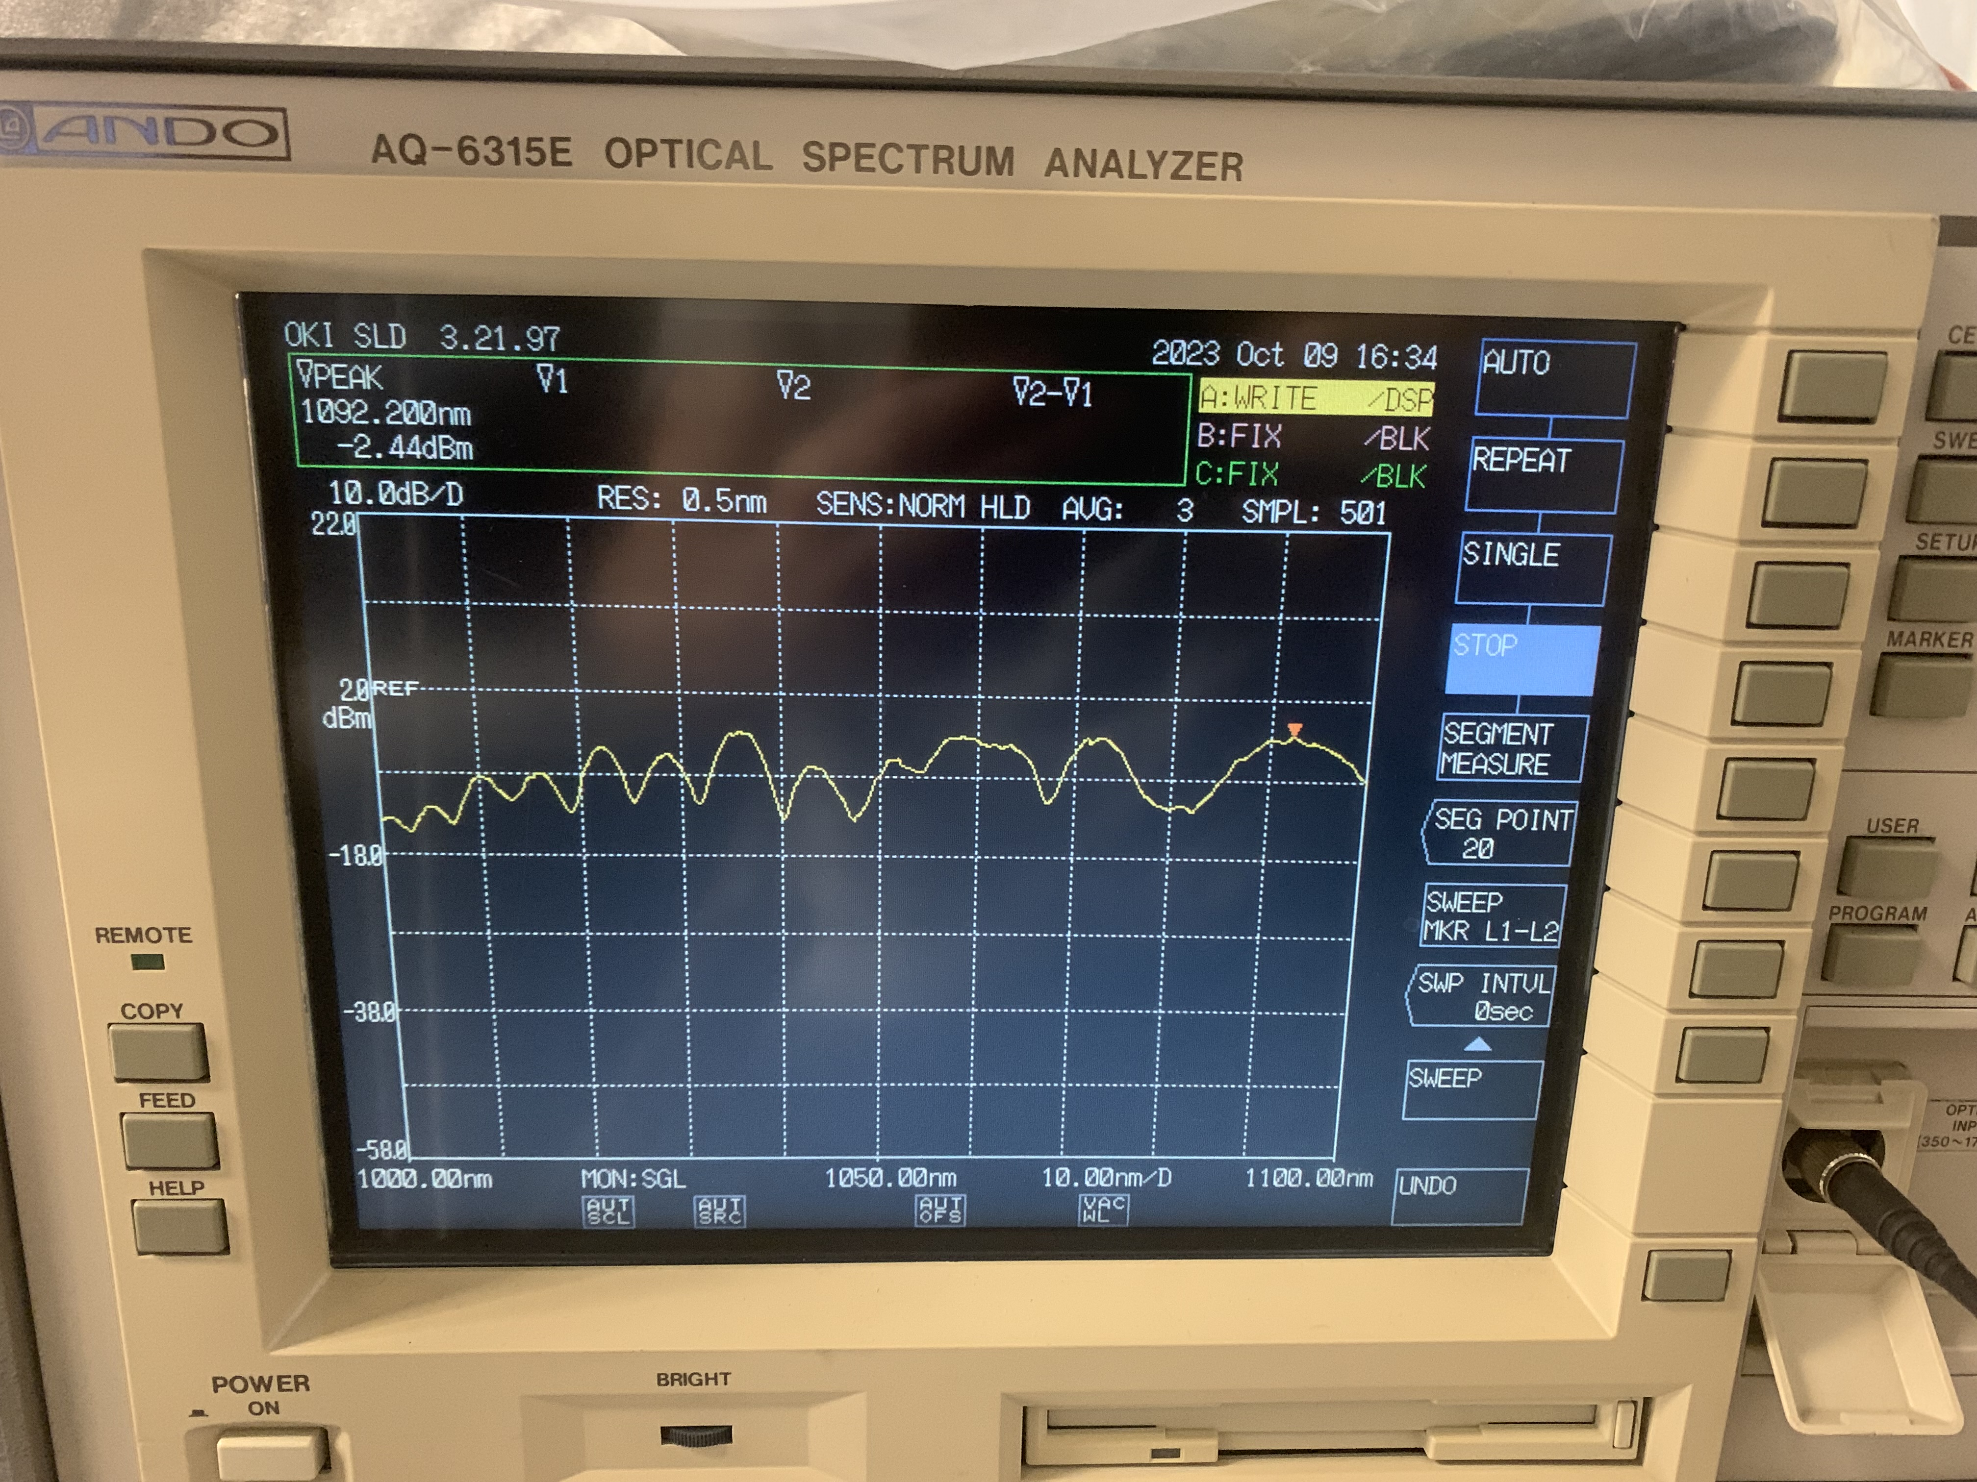
1022 HMP

Slide 7
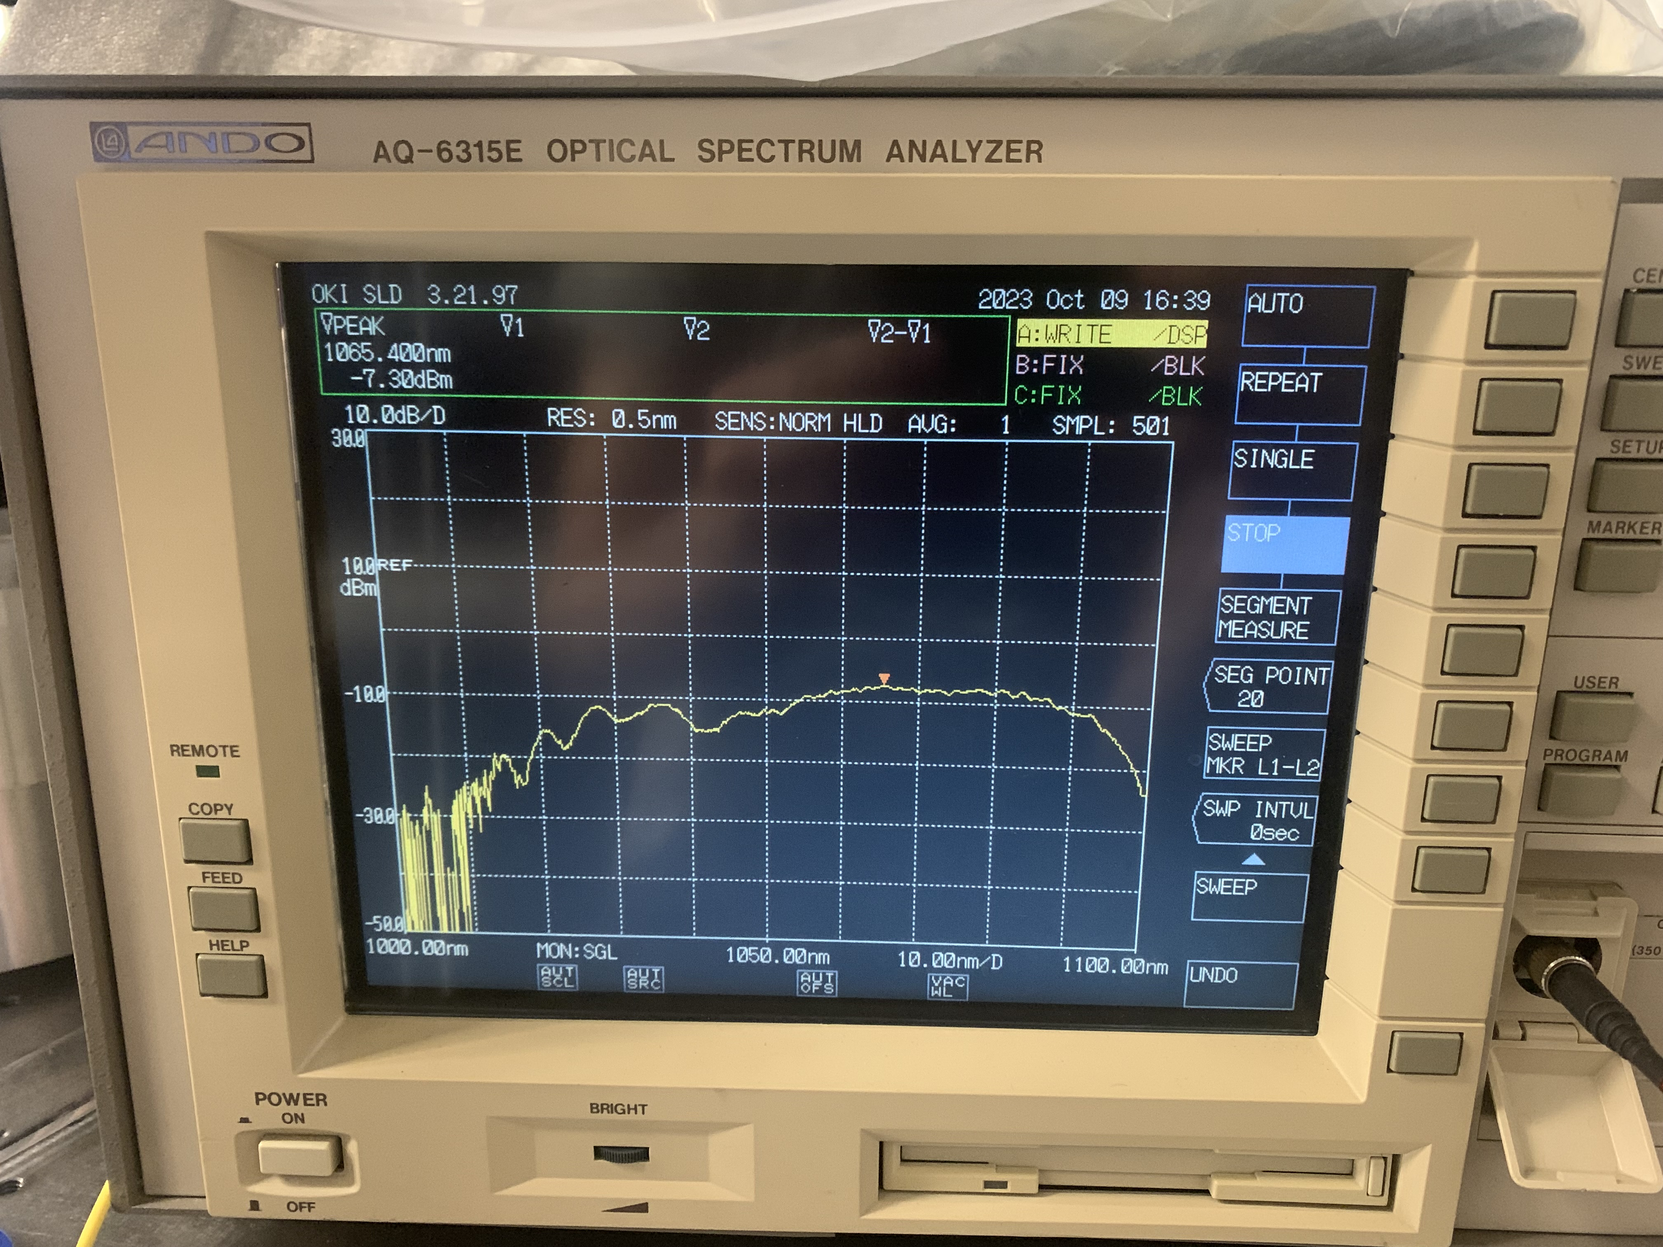
1014 HMP

Slide 8
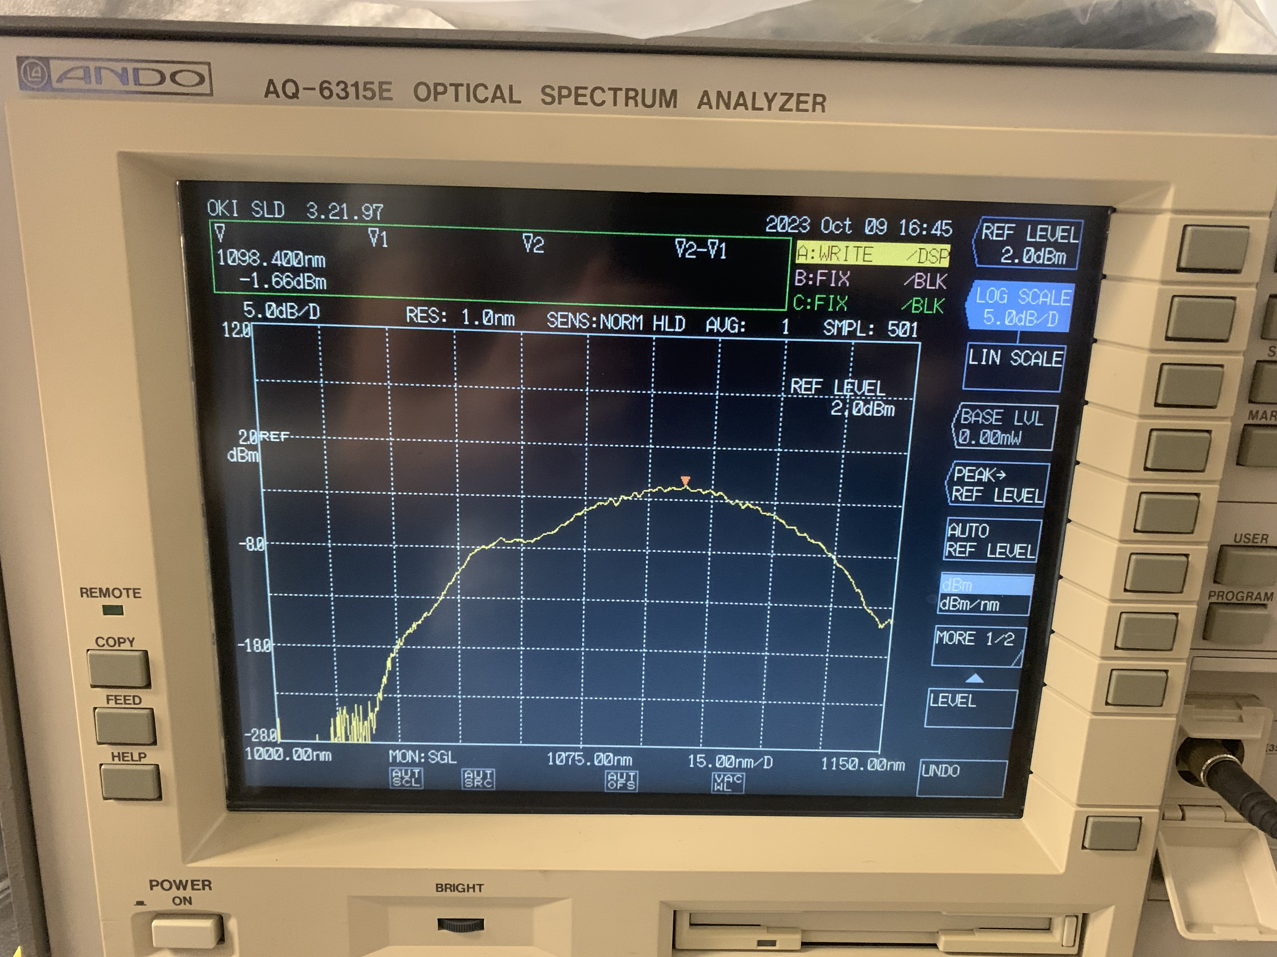
1091 HMP

