Slide 1
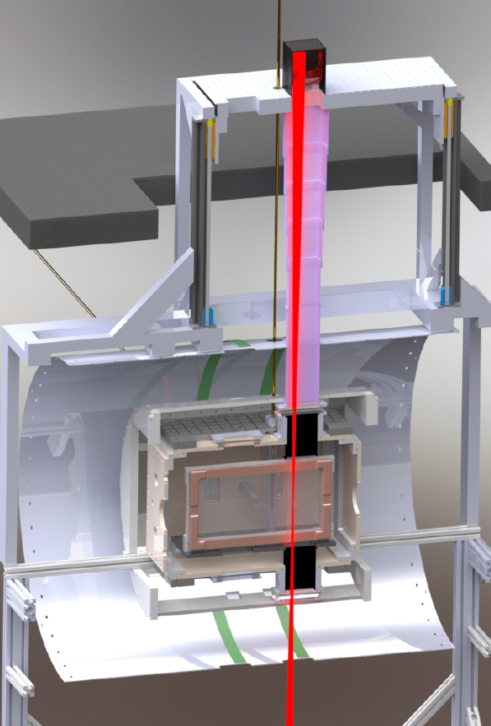
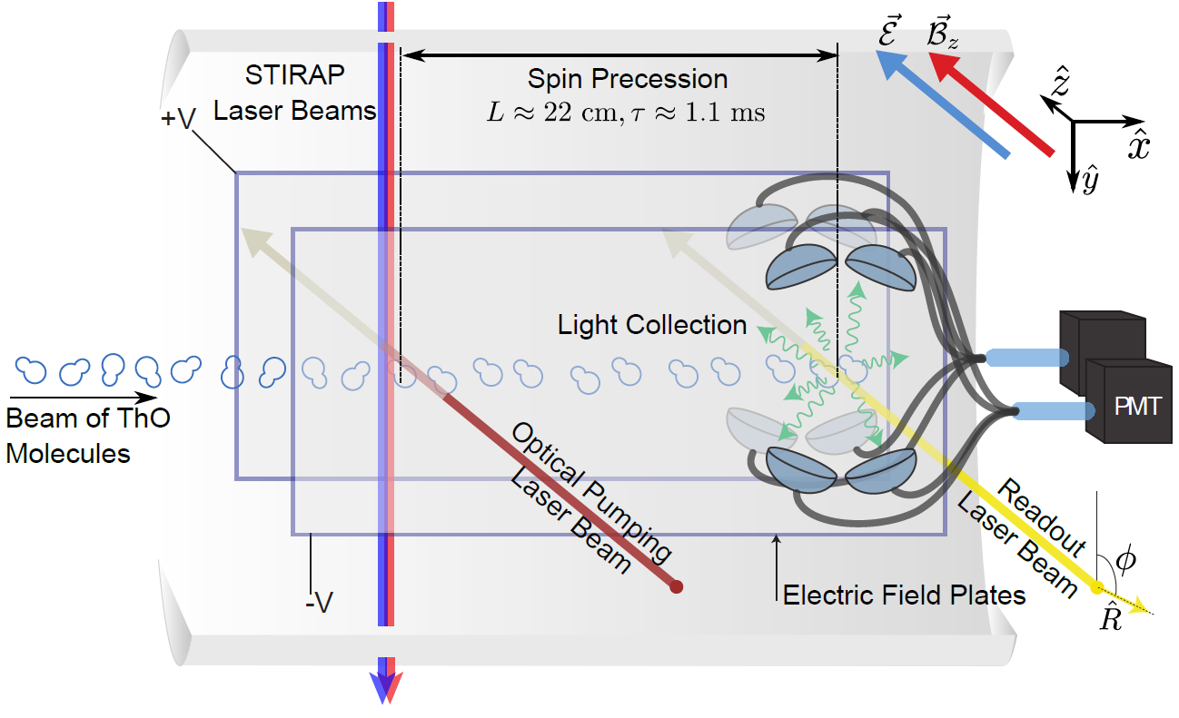
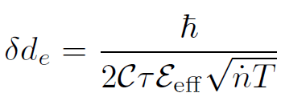
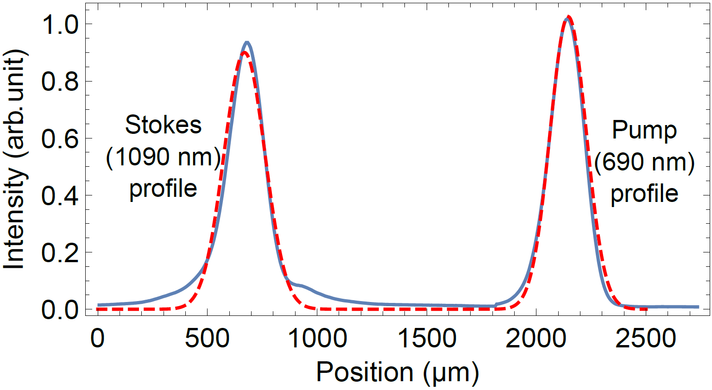
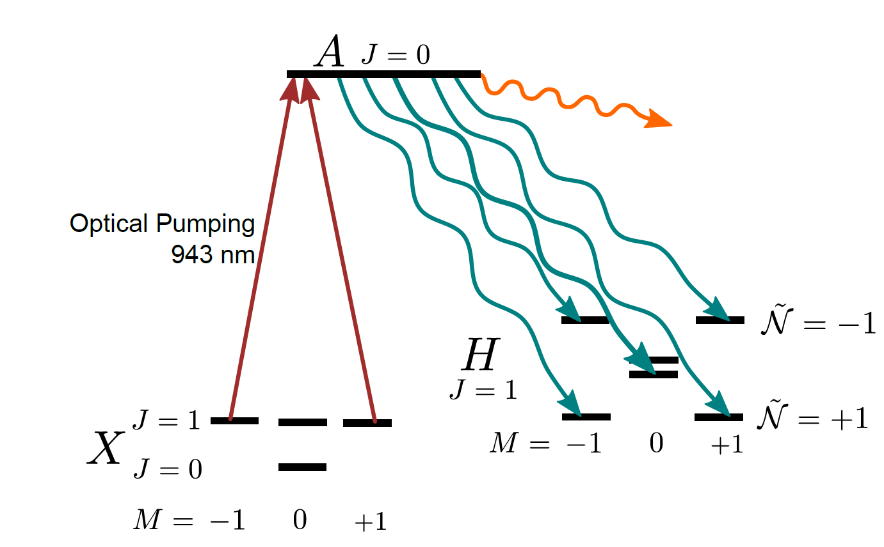
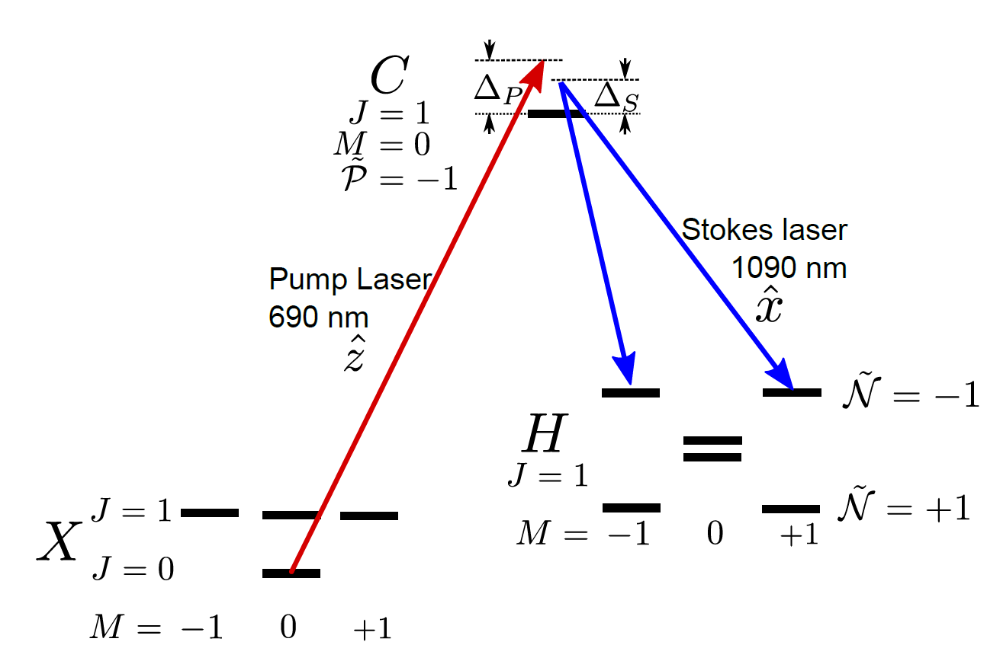
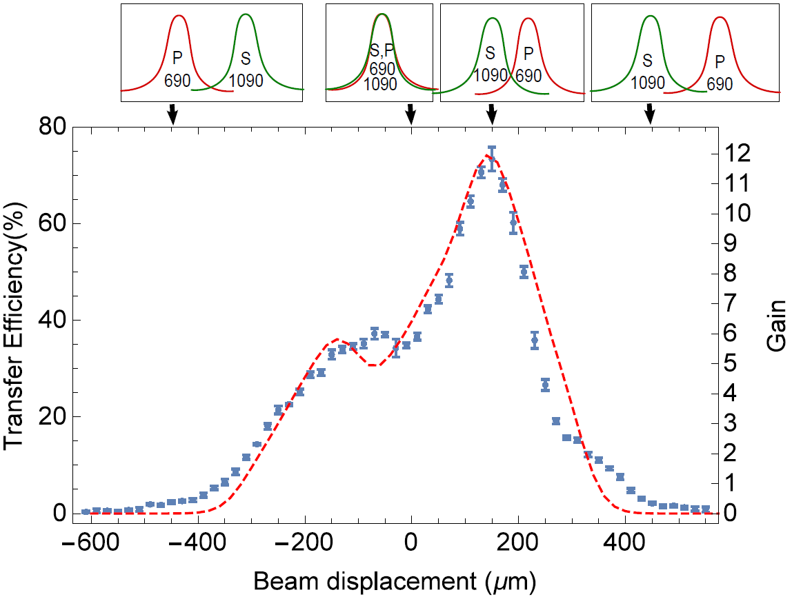
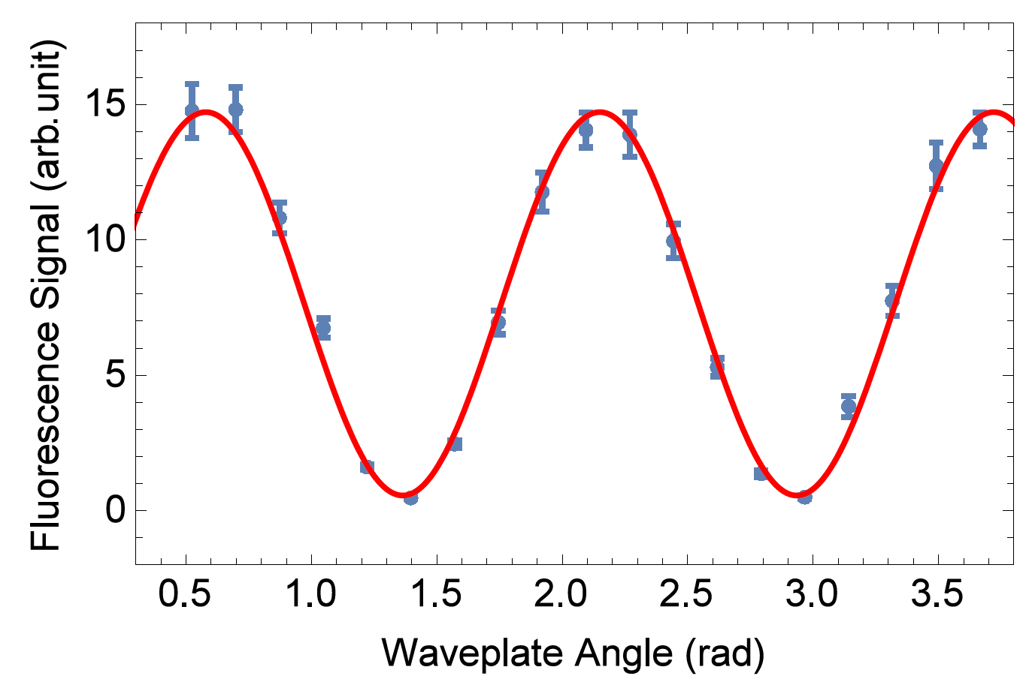
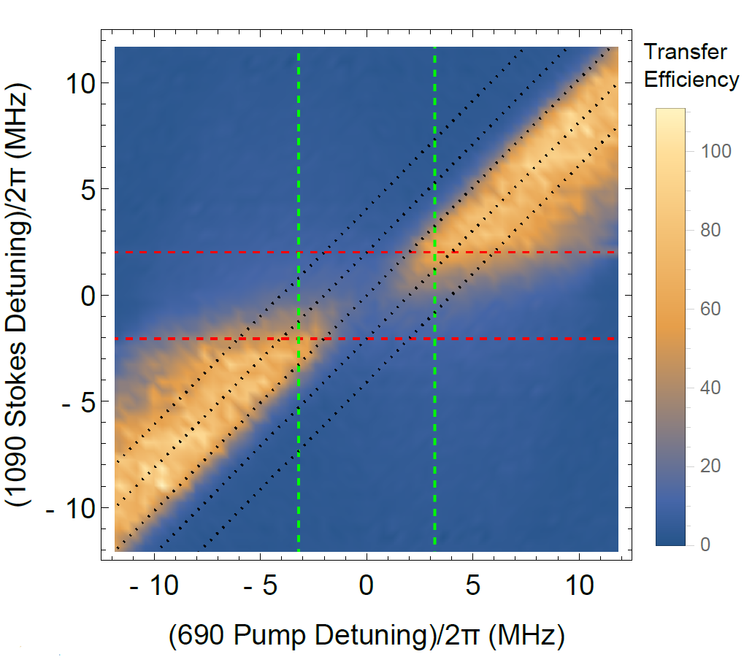
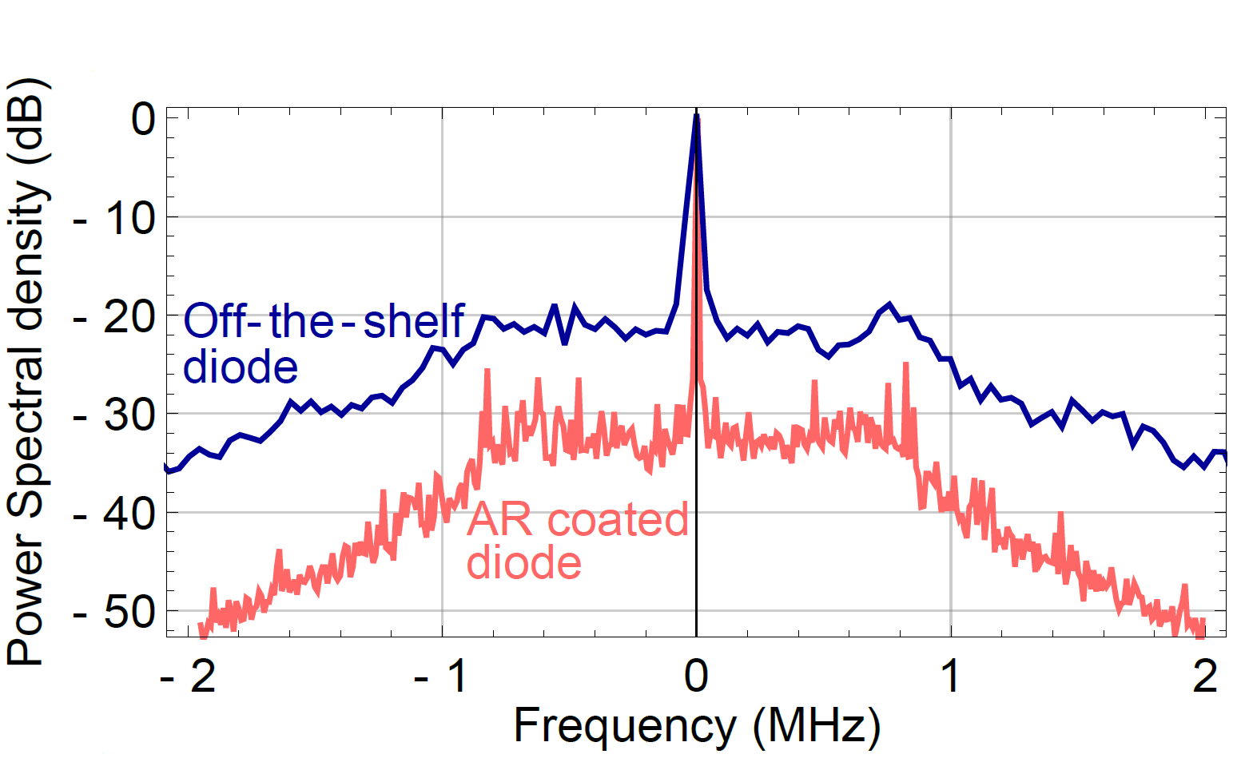
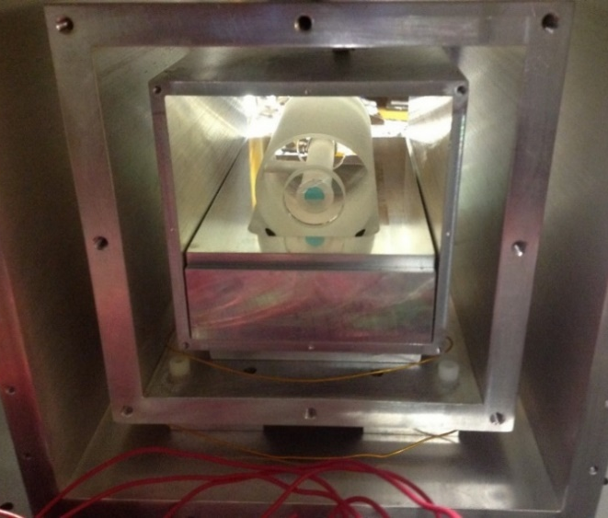
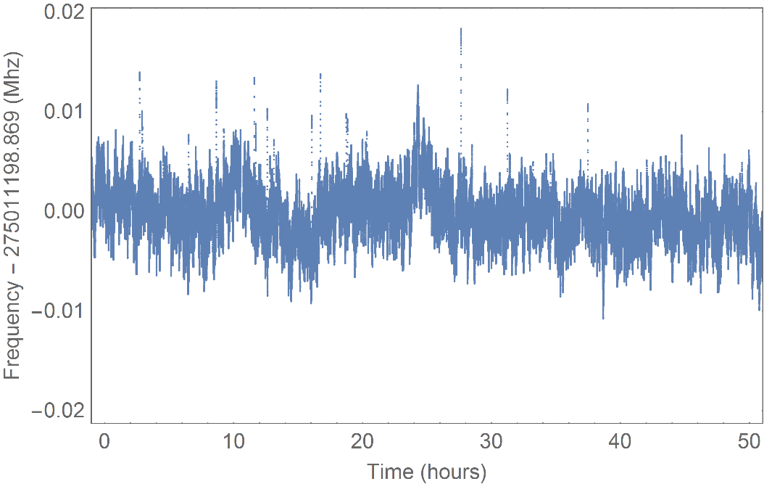
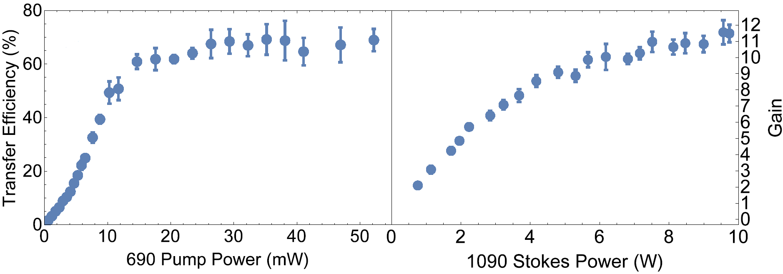
STIRAP Preparation of a Coherent Superposition of ThO ${H^{3}Δ}_{1}$ States
ACME Collaboration:
C. D. Panda,¹ B. R. O’Leary,² A. D. West,² J. Baron,¹ P. W. Hess,¹ C. Hoffman,¹
E. Kirilov,² C. B. Overstreet,¹ E. P. West,¹ D. DeMille², J. M. Doyle¹ and G. Gabrielse¹
Affiliation: ¹Harvard University, ²Yale University
Abstract: The ACME Collaboration recently reported an order of magnitude improved limit on the electric dipole moment of the electron (eEDM) (ACME collaboration, Science 343 (2014), 269-272), setting more stringent constraints on many time reversal (T) violating extensions to the Standard Model. The experiment was performed using spin precession measurements in a molecular beam of thorium oxide. We report here on a new method of preparing the coherent spin superposition state that represents the initial state of the spin precession measurement using STImulated Raman Adiabatic Passage (STIRAP). We demonstrate a transfer efficiency of 75% giving a twelve-fold increase in signal. We discuss the particularities and challenges of implementing STIRAP in the ACME measurement and the methods we have used to overcome them.
For more information,
electronedm.info
Measurement Scheme
STIRAP Implementation
Laser Beamshaping
The electron electric dipole moment (eEDM) is aligned with the spin and interacts with the giant (~84 GV/cm) effective internal electric field of the ThO molecule.
The statistical sensitivity of the measurement is given by
STIRAP increases the usable molecule flux by improving the EDM state preparation efficiency.
Small H-C transition dipole moment (0.01 ea₀) and limited power (10 W at 1090 nm) constrain the Stokes intensity.
Beamshaping difficult with limited optical access due to multiple experimental systems (field plates, vacuum chamber, magnetic shields, coils etc.)
We measure the energy splitting between two electrons oriented oppositely with respect to the molecular electric field by performing a Ramsey-type phase measurement to observe molecule precession.
= coherence time
= number of molecules
= effective electric field
GEN I – Optical Pumping
Efficient State Preparation
In Gen I, state preparation using incoherent optical pumping was ~6% efficient.
STIRAP transfers population into the desired superposition of state ~75% efficiency.
GEN II-STIRAP
STIRAP Signature and Saturation Behavior
Coherent State Preparation
We find it advantageous to run with a significant one-photon detuning.
Narrow, Stable Lasers
Spin coherence fringes show coherent state preparation.
Contrast ~93%, comparable to GEN I levels.
Lasers locked to ULE cavities for linewidth reduction and frequency comb used for absolute frequency reference.
Linewidths of ~100 Hz with noise pedestals suppressed by 30 dB.
Long term stability better than ~10 kHz for days.
Conclusion
We have demonstrated a factor of twelve increase in signal through STIRAP coherent state preparation. Out STIRAP implementation has been demonstrated to be robust and is already fully implemented in the main apparatus. We are confident that STIRAP and the other improvements will allow us to reduce the upper limit on the electron’s electric dipole moment, or detect a non-zero value within the next order of magnitude.
Pump power is sufficient, while Stokes laser power limits achieved efficiency.
Frequency-275011198.87 (MHz)
References
ACME Papers:
STIRAP and Other Results: “Stimulated Raman adiabatic passage preparation of a coherent superposition of ThO H states for an improved electron electric-dipole-moment measurement.” C. D. Panda et al. Phys. Rev. A 93, 052110 (2016)
GEN I Experimental Result: “Order of Magnitude Smaller Limit on the Electric Dipole Moment of the Electron.” ACME Collaboration. Science 343, p. 269-272 (2014)
Effective E-field Calculations:
Skripnikov et al. J. Chem. Phys. 142 024301 (2015)
T. Fleig et al. J. Mol. Spectrosc. 300 16 (2014)
Time (hours)

