Slide 1
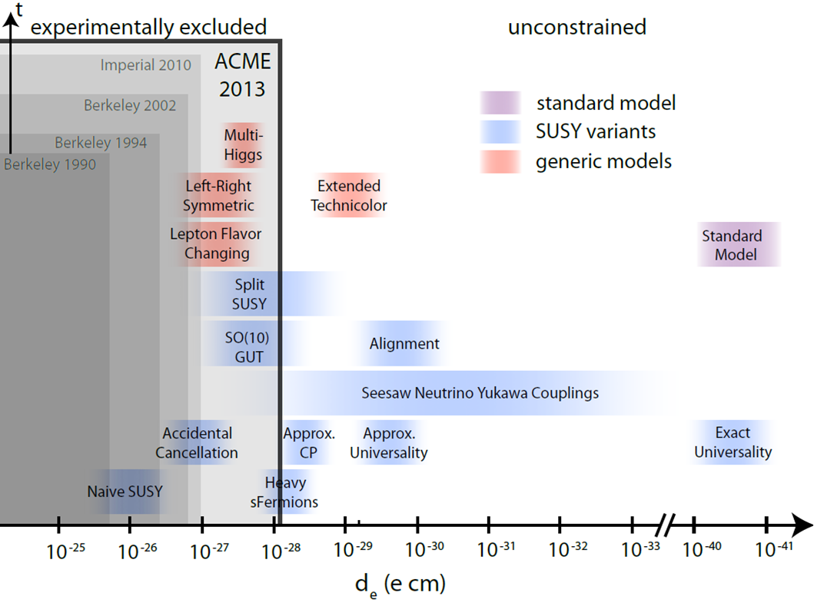
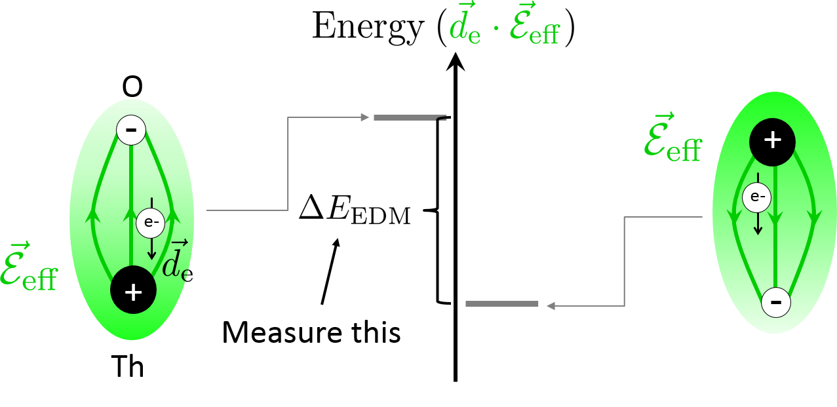
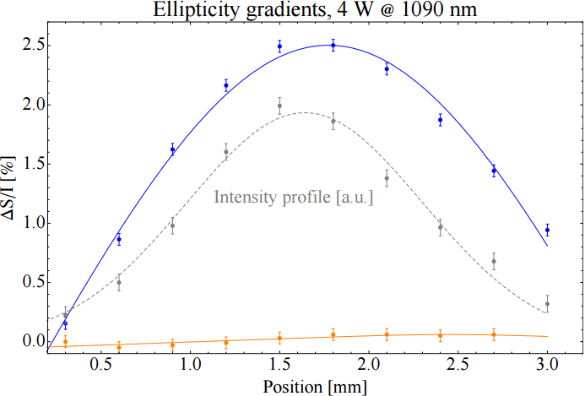
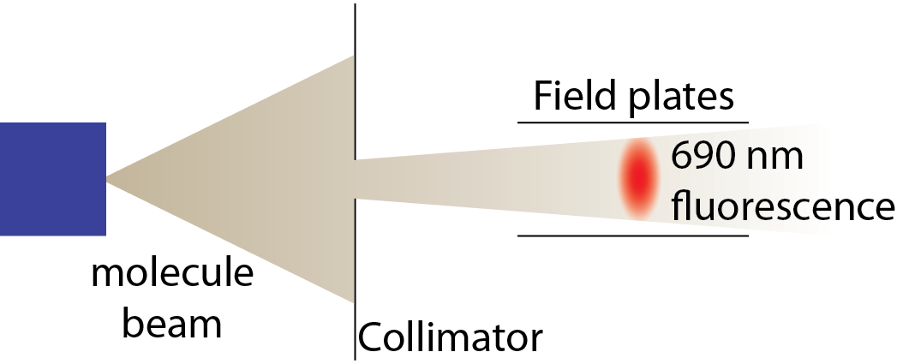
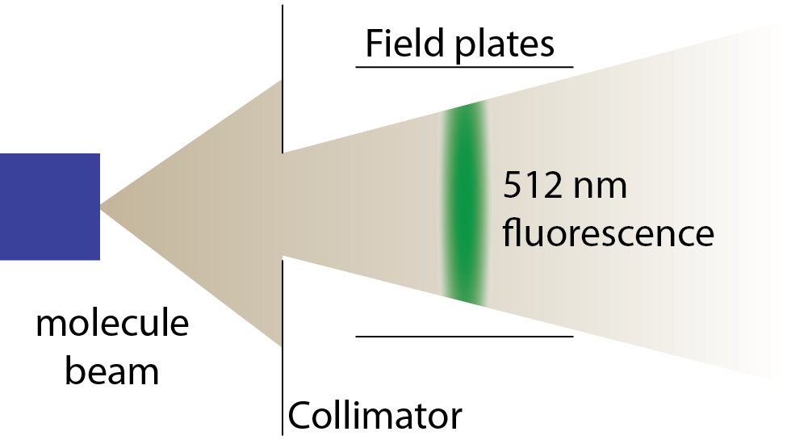
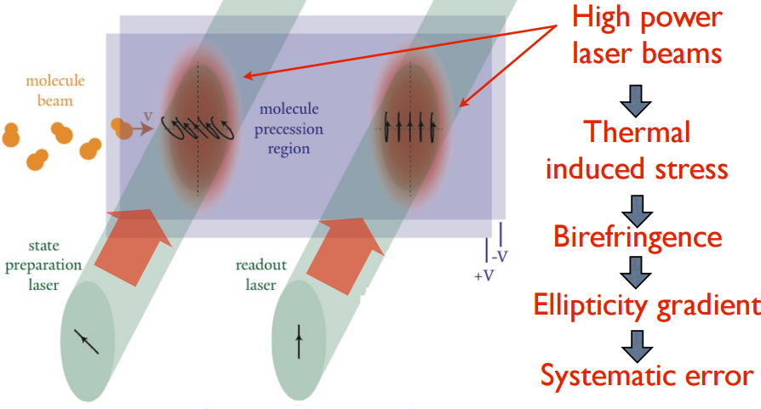
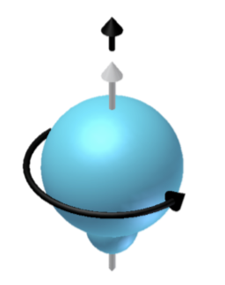
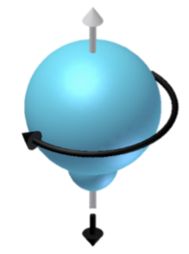
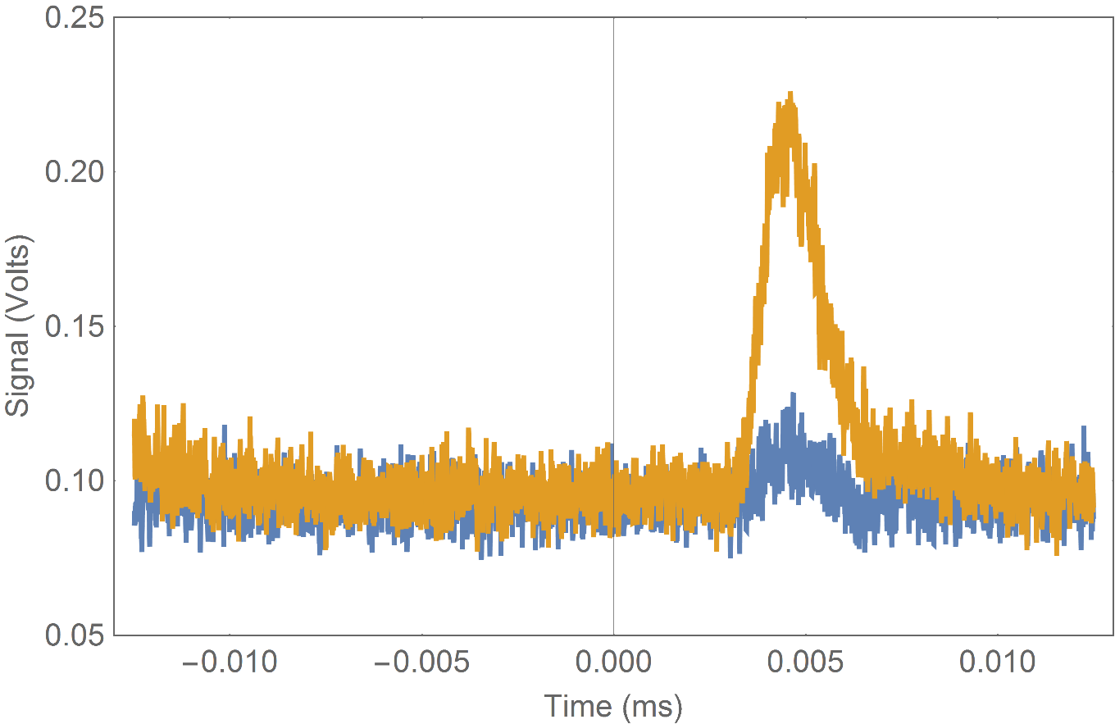
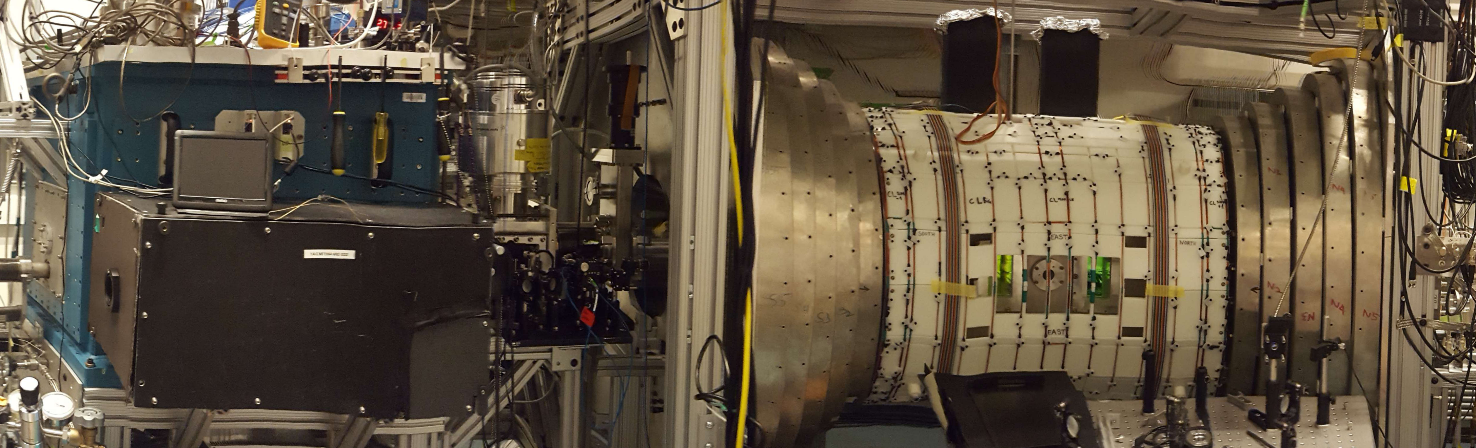
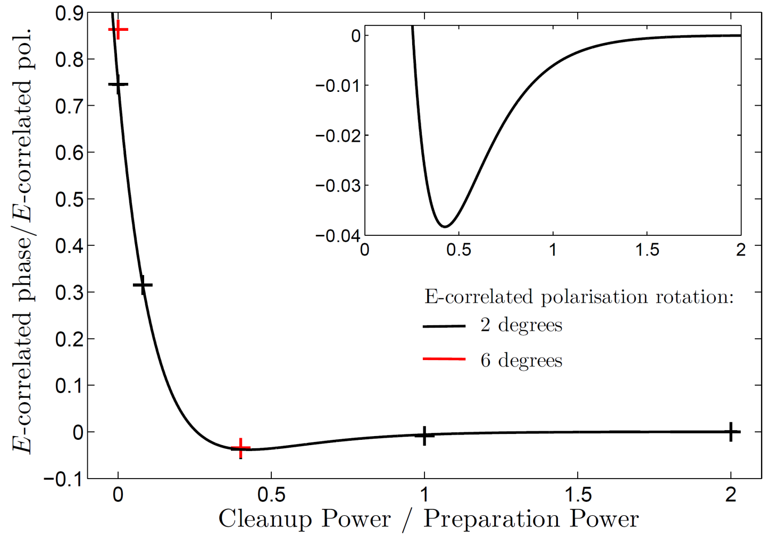
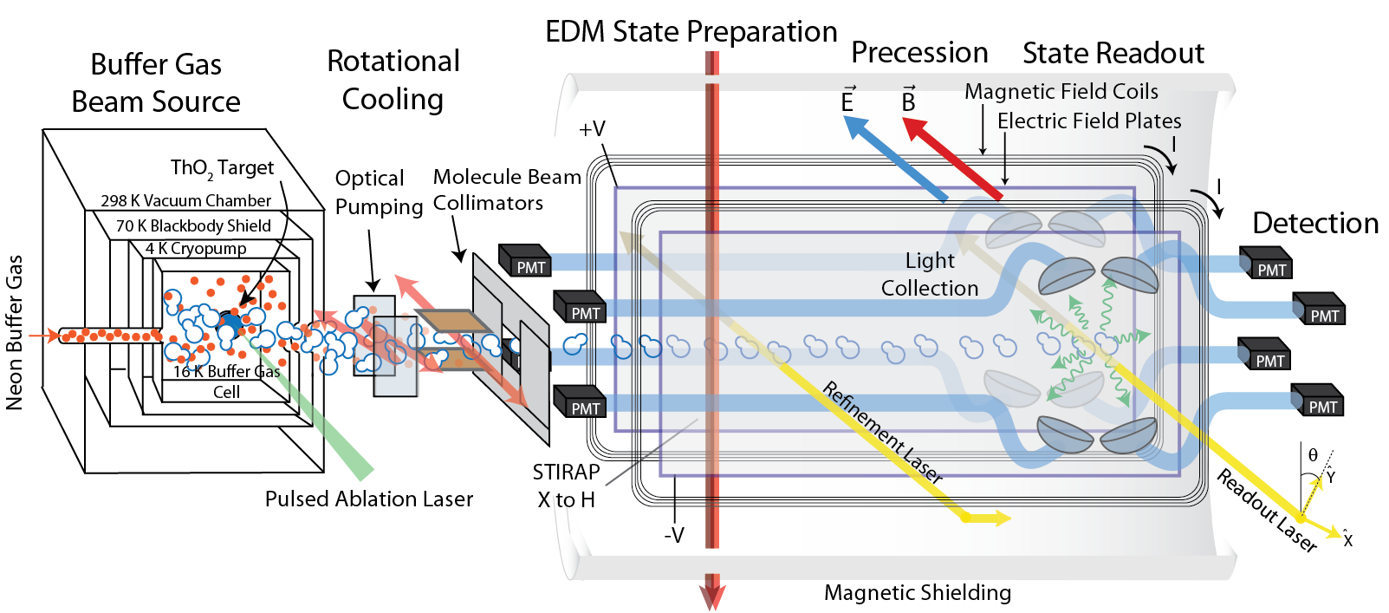
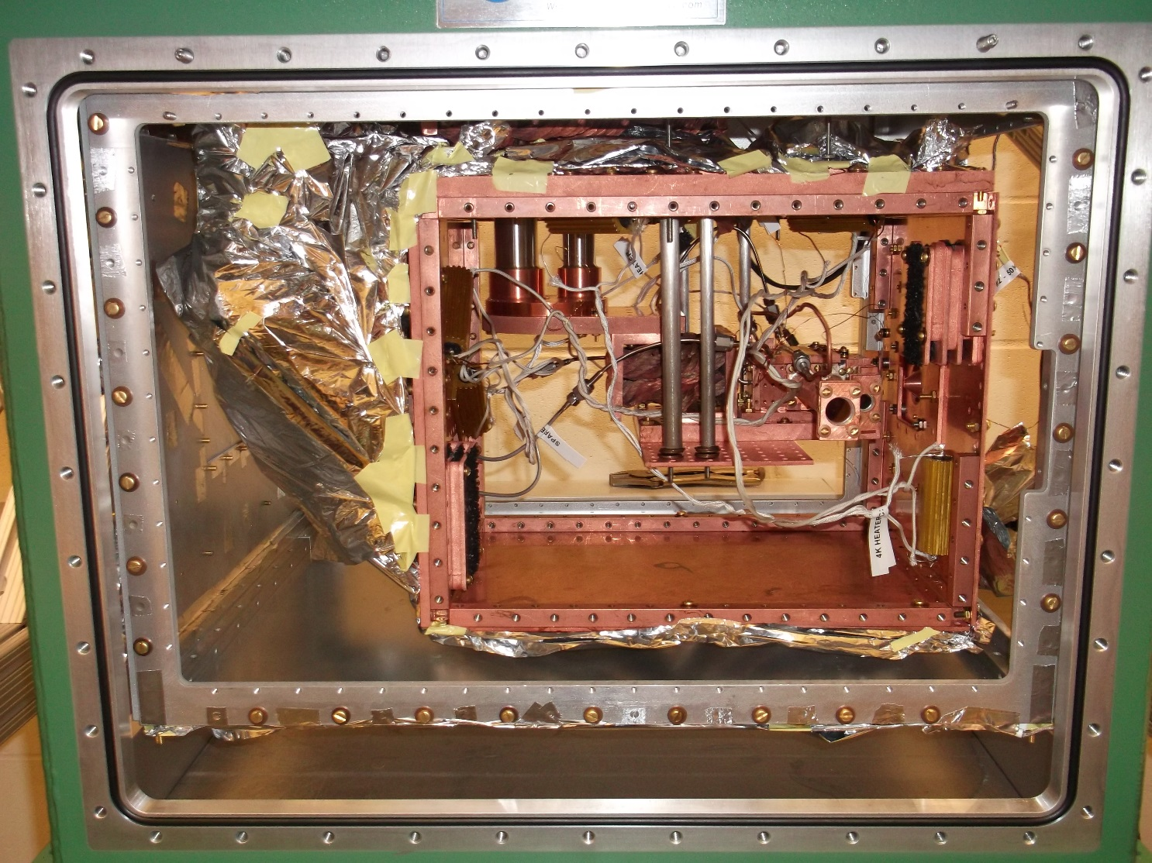
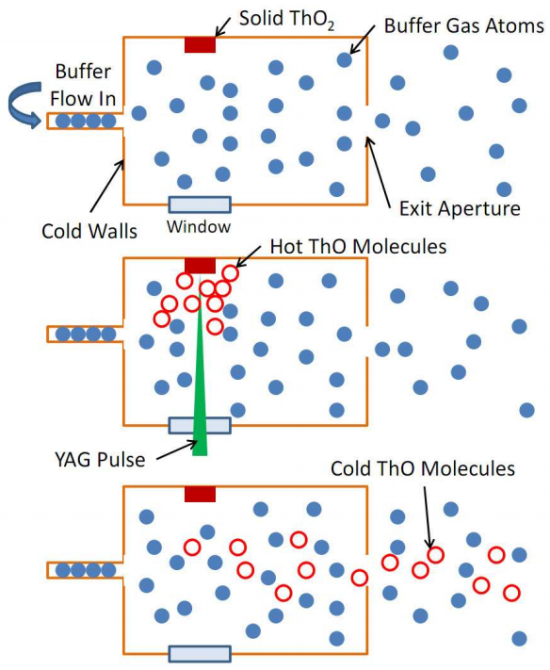
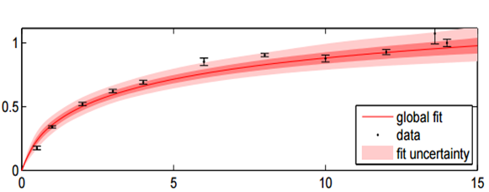
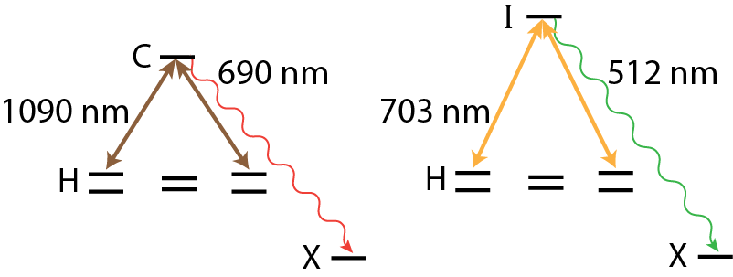
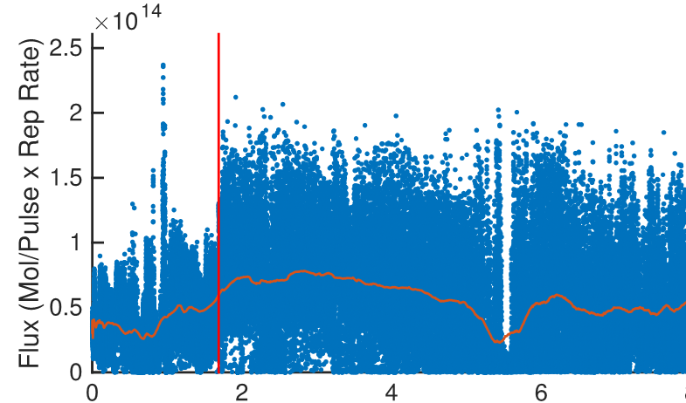
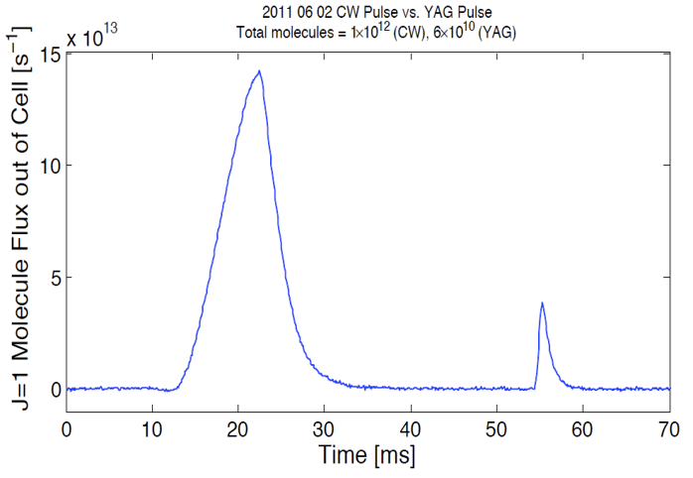
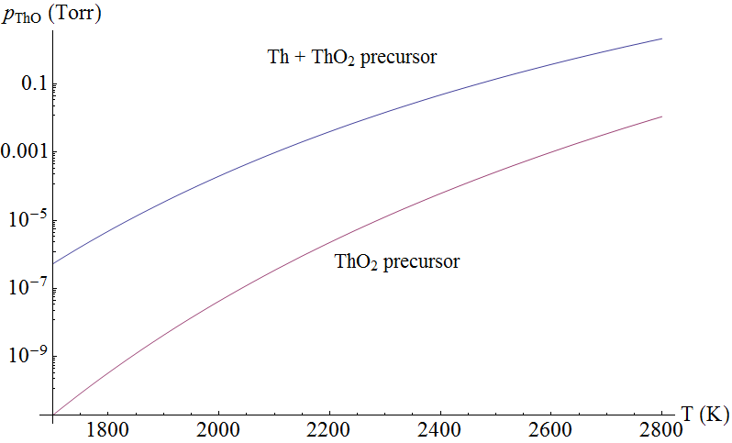
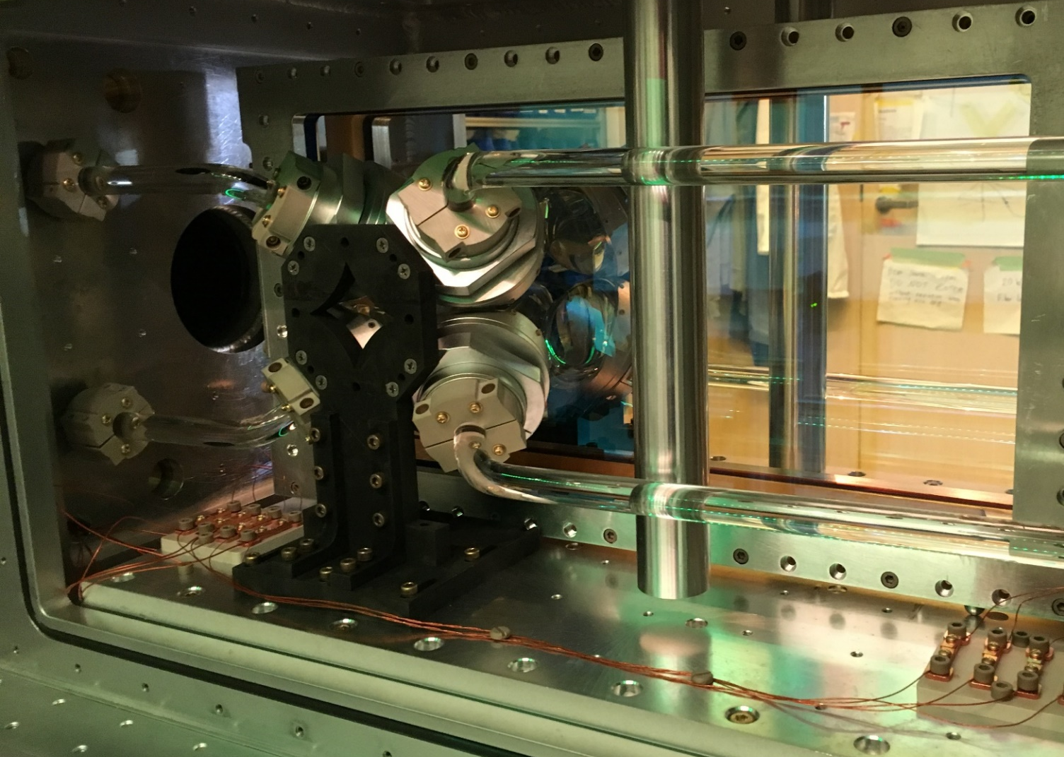
Electron EDM measurements in a beam of ThO:
Demonstrated and planned upgrades
ACME Collaboration: Zack Lasner,² Vitaly Andreev,¹ Daniel Ang,¹ Jacob Baron,¹ David DeMille² (PI), John M. Doyle¹ (PI), Gerald Gabrielse¹ (PI), Nicholas R. Hutzler,¹ Brendon R. O’Leary,² Cristian D. Panda,¹ Christian Weber,² Adam D. West,² Elizabeth P. West,¹ Grey Wilburn¹
Affiliation: ¹Harvard University, ²Yale University
Motivation
Solid angle enhancement
Improved electric field plates
$$H_{d}=−{\vec{d}}_{e}⋅\vec{ℇ}$$
ACME I
$$S$$
$$d_{e}$$
$$d_{e}$$
$$T$$
$C=$ measurement contrast
$τ=$ coherence time
$ℇ_{\text{eff}}=$ effective electric field
$\dot{n}=$ molecule flux
$T=$ integration time
$$S$$
$$δd_{e}=\frac{ℏ}{2Cτℇ_{\text{eff}}\sqrt{\dot{n}T}}$$
ACME I
ACME II
ACME II
Permanent EDMs violate T-symmetry
Many theories beyond the Standard Model predict T violation and EDMs at current experimental precision
Shorter beamline and wider collimator spacing give higher acceptance by $\sim 8×$
Large $ℇ_{eff}$ inside ThO molecule
ACME II: Increase usable molecule flux $\sim 100×$Reduces $δd_{e}$ by $\sim 10×$
State Preparation
Refinement and readout beam control
ACME II Apparatus
Preparation of spin precession state previously performed via optical pumping with $\sim 6\%$ efficiency
Coherent state preparation via STIRAP has $\sim 75\%$ demonstrated efficiency
STIRAP gives $\sim 12×$ gain in state preparation
ACME II
Monitor and feed back on preparation and readout beam pointing to suppress anticipated Stark interference phase offset and relative Doppler shift between two readout beams
Beam pointing ($μ$rad)
Time
3.
Signal (arb.)
Also monitor and correct ellipticity in preparation and readout beams to suppress anticipated phase offset:
$$Φ=φ+λ\left(dθ_{prep}−\frac{dθ_{X}+dθ_{Y}}{2}\right)−λ^{2}{\tilde{P}}_{prep}{\tilde{P}}_{read}dΘ_{prep}\left(dΘ_{X}−dΘ_{Y}\right)+O(λ^{3})$$
Measured
phase
ACME I
Desired
phase
Linear polarization
offsets
Prep/Read coupling via ellipticity
4.
5.
Time (ms)
Summary of upgrades
1.
2.
See poster “Twelve-fold increase in the number of usable ThO molecules for the ACME electron electric dipole measurement through STIRAP,” Panda et al.
Demonstrated upgrades | Gain
Beamline geometry | $$\sim 8×$$
Fluorescence collection | $$\sim 2.5×$$
STIRAP state preparation | $$\sim 12×$$
Detection wavelength | $$\sim 2.5×$$
Total projected statistical improvement | $300$ $$−600×$$
Feature | Anticipated systematic error improvement
Refinement beam | Suppress STIRAP polarization fluctuations, AC Stark shifts, AC Stark interference
Reduced field plates birefringence | Suppress ellipticity gradients
Beam pointing | Monitor and feed back to reduce Stark interference
Ellipticity control | Monitor and feed back to reduce phase offsets
Modified apparatus for magnetometry | Measure non-reversing magnetic field near spin precession region to suppress AC Stark shift phases
Refinement beam
3.
4.
5.
STIRAP beam polarization fluctuations may lead to spurious EDM-like phase. Suppressed by “refinement” beam to re-project desired superposition state.
Refinement also suppresses anticipated AC Stark shift and Stark interference phases from high-intensity STIRAP lasers
1.
2.
Not yet demonstrated with spin precession measurement
Thermochemical Beam Source
Detection wavelength
Thermochemical
target (Th $+$ ThO₂)
PMTs detect 512 nm with $\sim 2.5×$ efficiency of 690 nm detection used in ACME I
Detecting 512 nm fluorescence suppresses effect of scattered light from 690 nm STIRAP laser
ACME I
ACME II
Fluorescence (arb.)
50 W “long pulse” fiber laser
Ablation target
(ThO₂ )
$\sim$15 W time-averaged power
703 nm laser power (mW)
Saturation of $H→I$ detection transition
$\sim 10×$ ablation yield
Pulse shapes
Equilibrium partial pressure of ThO^{[1]}
Light collection
Change conditions
Thermochemical
source
Ablation
source
Flux level competitive with ablation
Time (arb.)
Still under development; anticipate $\sim 10×$ flux beyond ACME II
References
More information: www.electronedm.info
1.“A thermodynamic study of the thorium-oxygen system at high temperatures.” R.J. Ackermann et al. J. Phys. Chem. 67(4), p. 762-769 (1963)
ACME I Result: “Order of magnitude smaller limit on the electric dipole moment of the electron.” ACME Collaboration. Science 343, p. 269-272 (2014)
State preparation: “Stimulated Raman adiabatic passage preparation of a coherent superposition of ThO $H^{3}Δ_{1}$ states for an improved electron electric-dipole moment measurement.” C.D. Panda et al. Phys. Rev. A 93, 052110 (2016)
Previous eEDM Limit: “Improved measurement of the shape of the electron.”J. J. Hudson et al. Nature 473, 7348 (2011)
E_{eff} Calculations: “Theoretical study of ThO for the electron electric dipole moment search.” L. V. Skripnikov et al. J. Chem. Phys. 142 024301 (2015)
“Electron electric dipole moment and hyperfine interaction constants for ThO”T. Fleig et al. J. Mol. Spec. 300 p. 16-21 (2014)
Optimized collection optics using light pipes instead of fiber bundles with $\sim 50\%$ packing fraction increases detection by $\sim 2.5×$

